Slide 1

Notes:
Abstract: Google has recently open-sourced its framework for machine learning and neural networks called Tensorflow. With this new tool, deep machine learning transitions from an area of research into mainstream software engineering. In this session, we will teach you how to choose the right neural network for your problem and how to make it behave. Familiarity with differential equations is no longer required. Instead, a couple of lines of Tensorflow Python, and a bag of "tricks of the trade" will do the job.
No previous Python knowledge required.

Slide 2

Notes:
Batch normalisation is a promising new regularisation technique.
What problem does it solve ? Let us have a look at typical problems that a dataset can have.

Slide 3
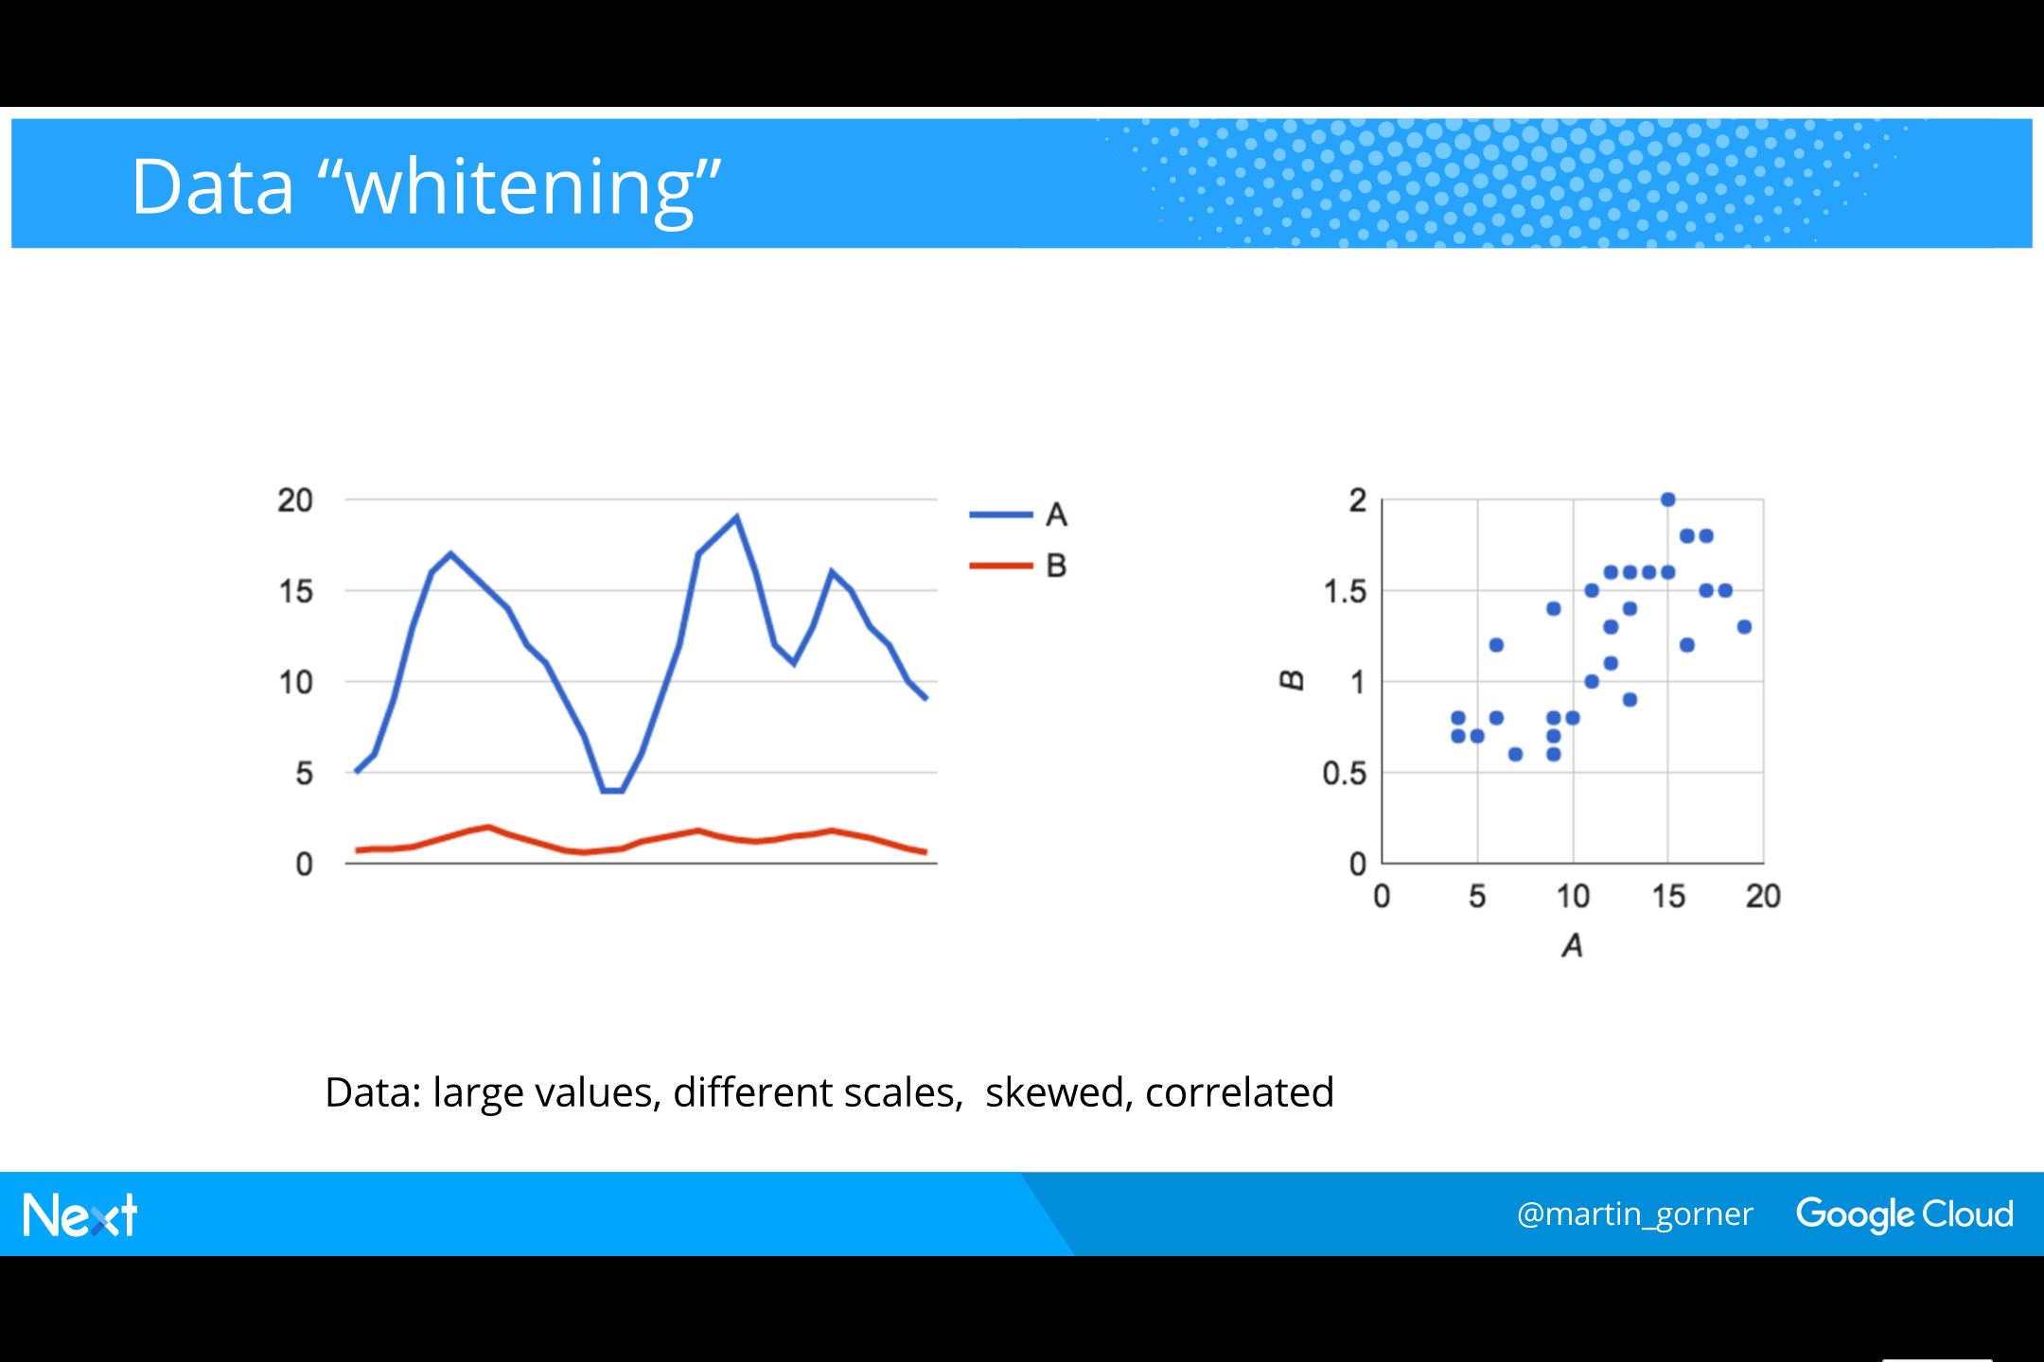
Notes:
Here are two data series.
Problem #1: they are on different scales.
A is in [0, 20]
B is in [0, 2]
Problem #2: they have non-zero and very different average values
A is oscillating around 12
B is oscillating around .2
Both are problems for neural networks. Neurons work with an activation function that has a sweet spot in the [-5, 5] range

Slide 4
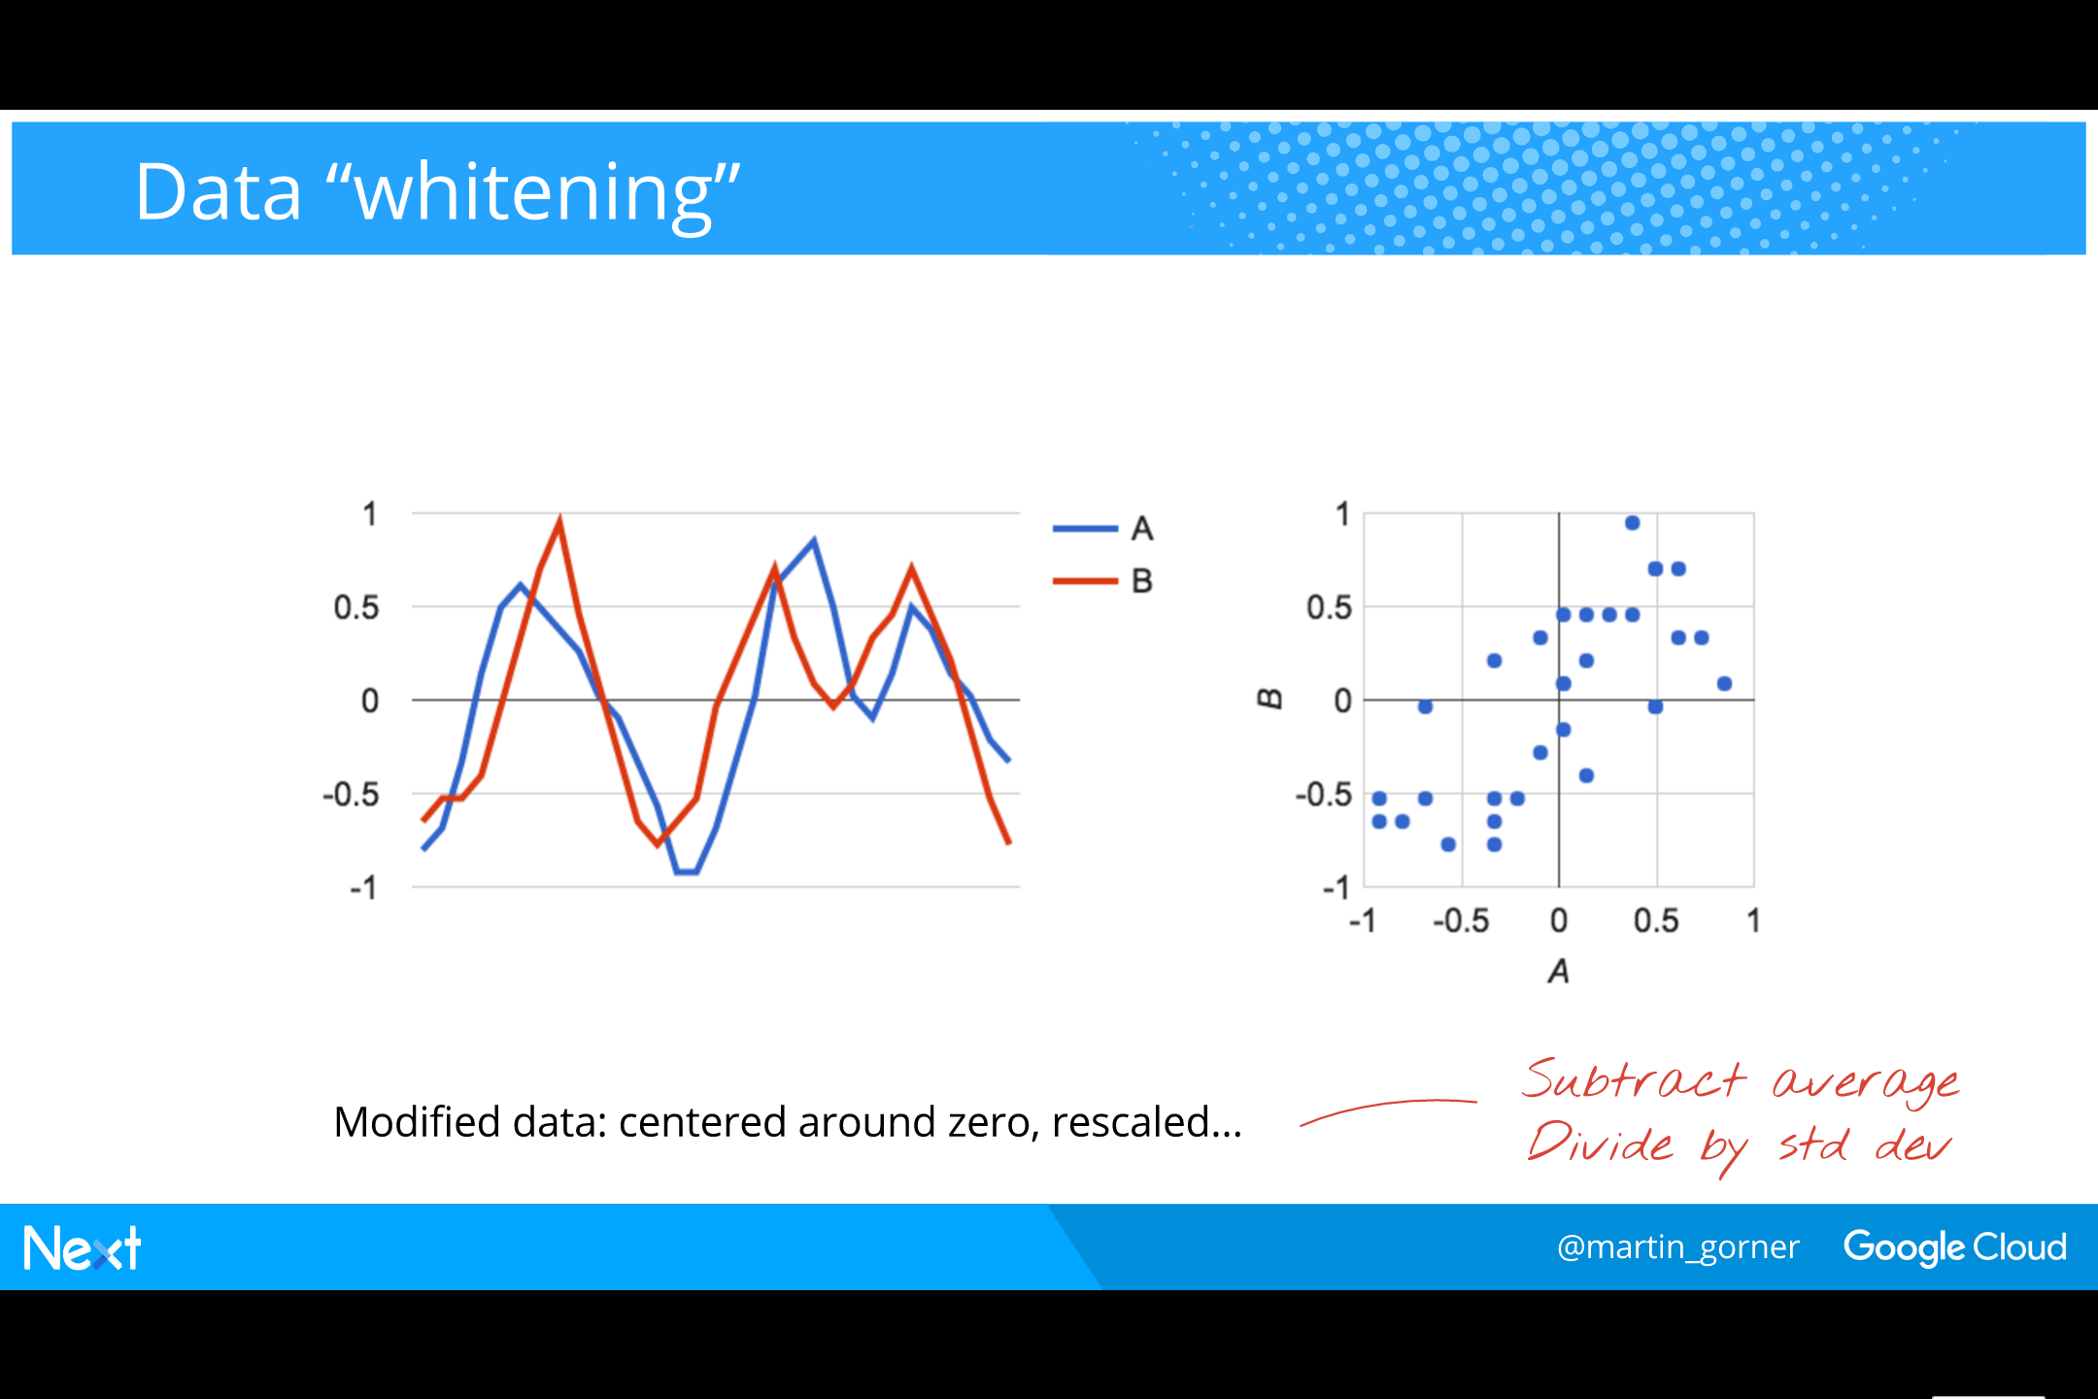
Notes:
(It is good practice in training neural networks to center and scale data before sending it to the neurons. It is being done less often today with deep networks because weights and biases can be arranged to have the same effect. The network will need extra weights and biases for the extra work though.)
Now that we have centered and scaled the data, we see that the two datasets are also strongly correlated. B does not bring much information on top of A. However, there might be valuable information hidden in the differences between them. That is the basic idea behind decorrelation.
On the right-side graph, the correlation can be seen because the points roughly align on an y=x line. A non-correlated series forms a rounh halo around (0, 0) without an obvious direction of alignment.

Slide 5
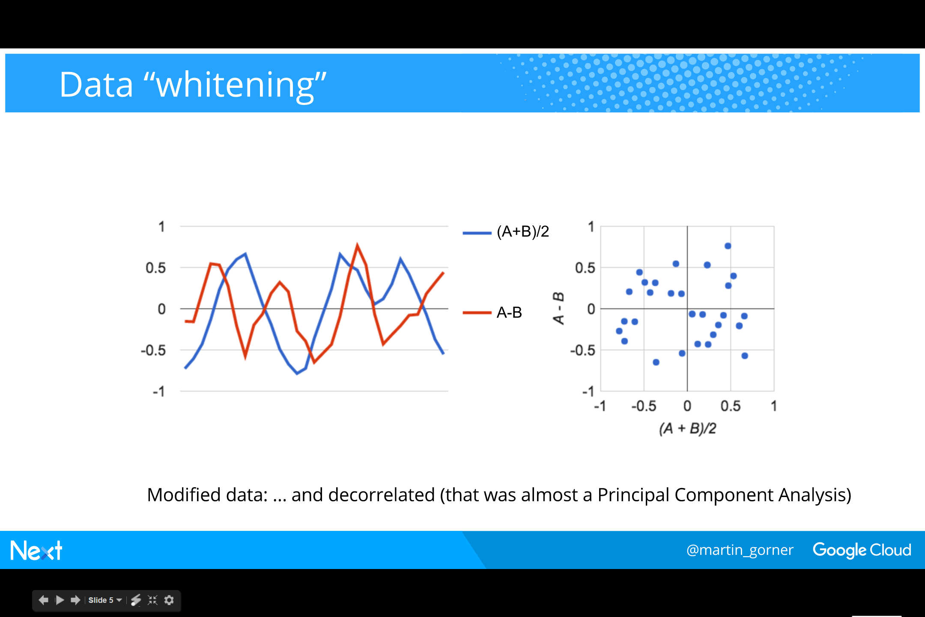
Notes:
We decorrelate the data, here by considering the average and the difference of A and B.
(Principal component analysis is a general technique for doing this, which works in more than 2 directions and for any correlation.)

Slide 6
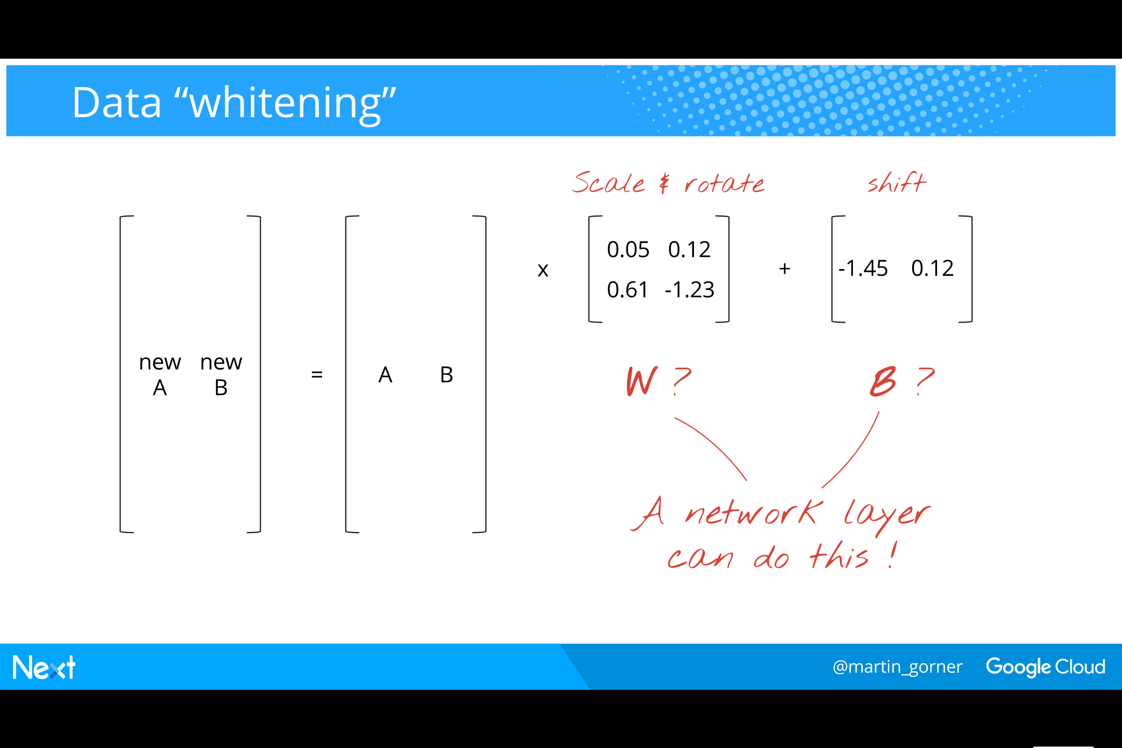
Notes:
If we combine the scale, shift and decorrelation operations we just did, we obtain a scale and rotation matrix and a translation vector.
This looks a lot like a neural network layer with the same number of inputs and outputs. The scaling and rotation coefficients can be programmed in the weights and the translation coefficients in the biases.
Conclusion: a neural network layer can center, scale, and decorrelate your data.

Slide 7
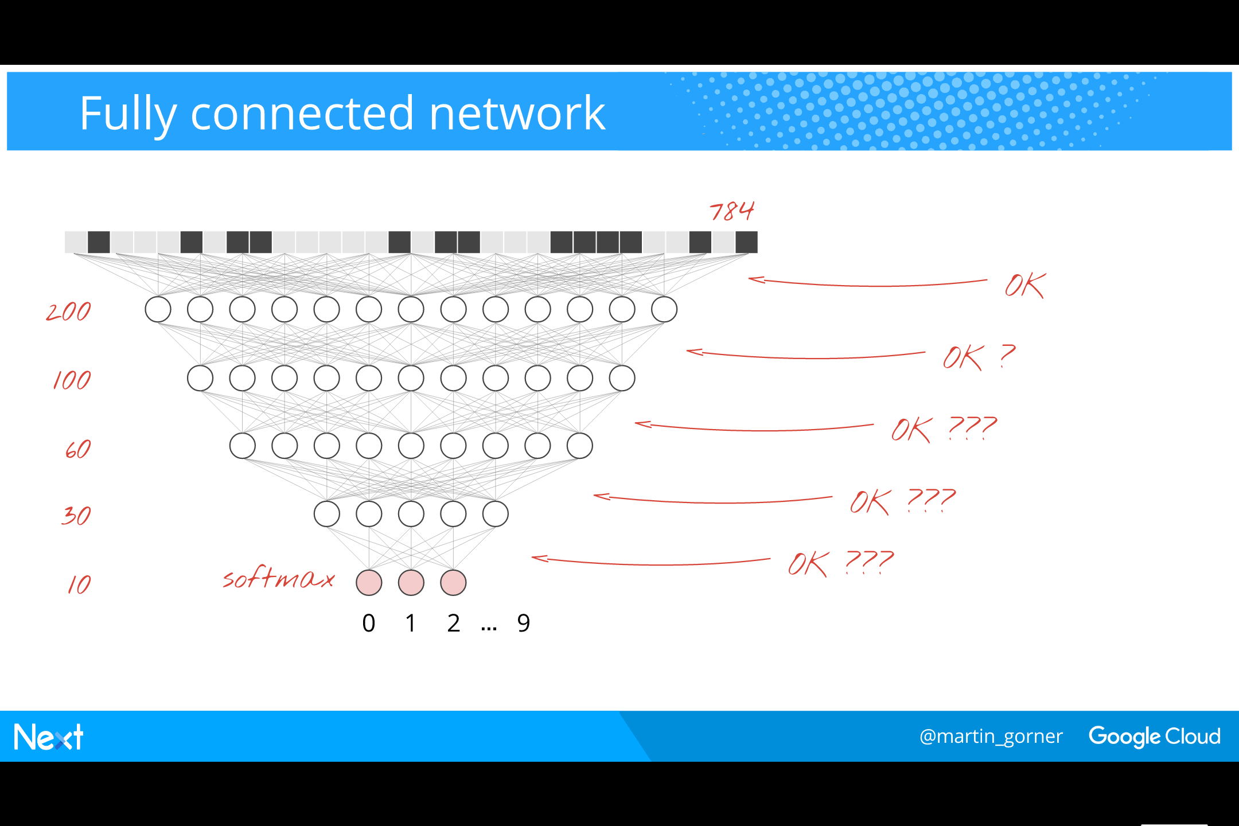
Notes:
But in deep networks,
Is it OK to “waste” one layer to handle badly conditioned data ? Probably yes.
How about the hidden layers though ? What guarantees are there that their inputs will be well conditioned?
None at all. And although an additional layer before each existing layer could solve this, it looks like a very expensive approach.
There must be a better way.

Slide 8
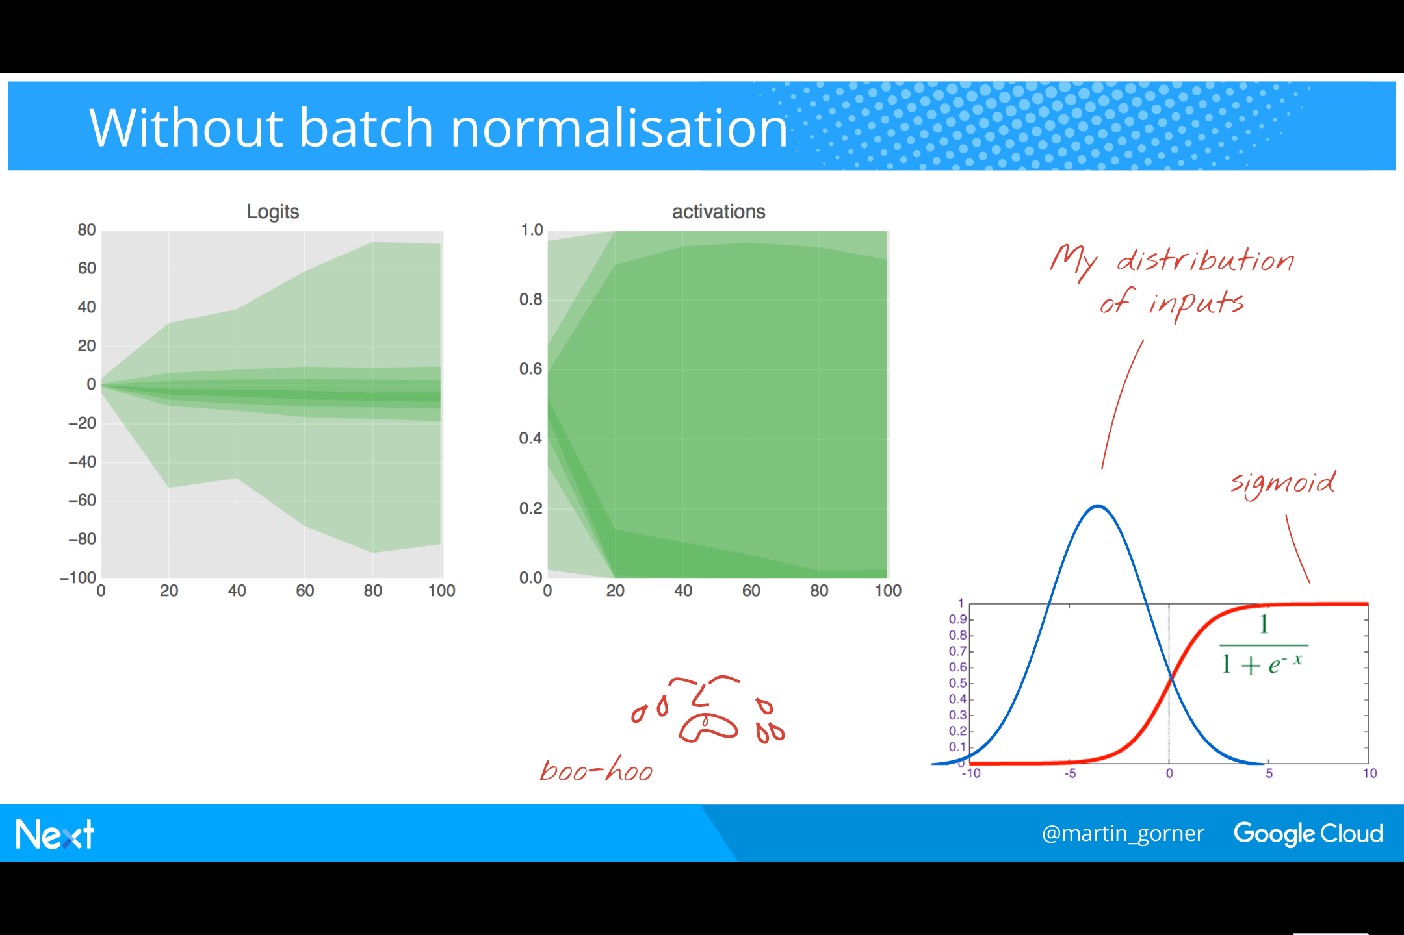
Notes:
Let’s look at the typical output of a dense neural network layer without batch normalisation. This layer uses the sigmoid activation function.
The graphs represent percentiles of all neuron activations over time, before the sigmoid (“logits”) and after (“activations”).
On the “logits” graph you see that by training iteration 100, the distribution of values is a roughly normal distribution centered around -4.
Look at the plot of the sigmoid on the right with a bell-curve centered on -4 printed on top: with input values following this bell curve, we will not be operating in the “sweet spot” of the sigmoid at all and almost half of the neurons will be completely saturated.
Indeed, you see on the “activations” graph that the output of the sigmoid is very skewed, with the 4 bottom color bands (almost 50% of all activations) are squashed against 0.

Slide 9
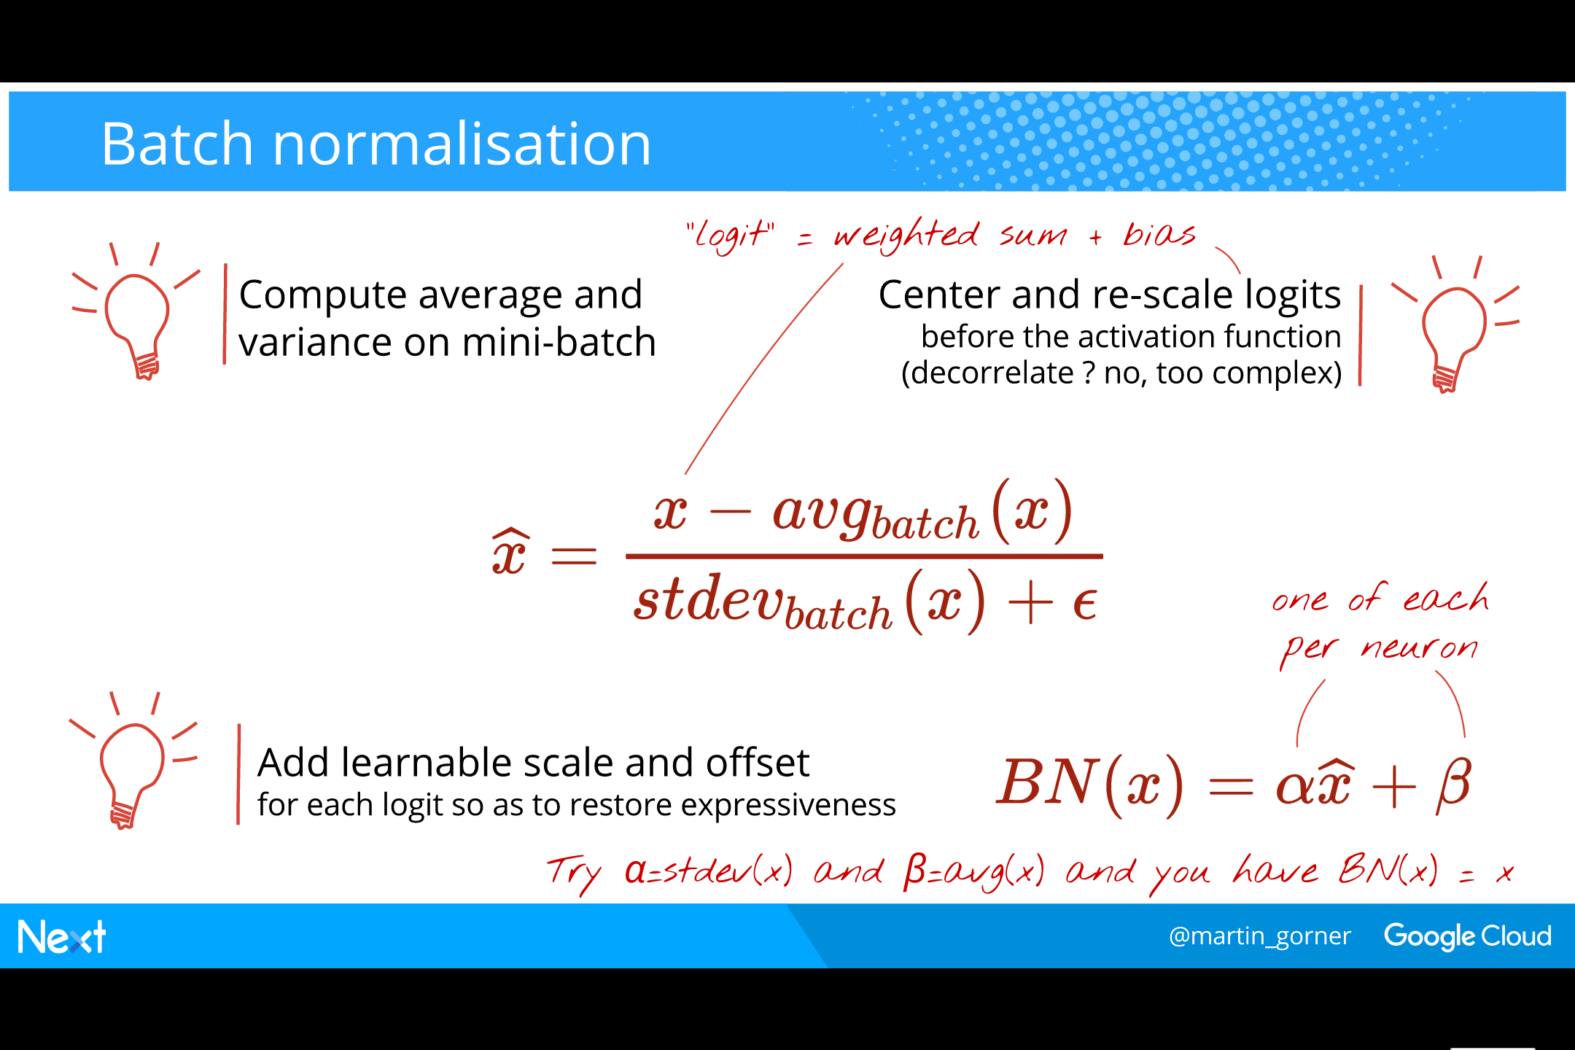
Notes:
Batch normalisation:
Before feeding the outputs of one layer into the inputs of the next, we center and rescale them. When working with mini-batched, we have 100 different instances of each value, computed on the 100 training images in the mini-bath. We can compute statistics ! By subtracting the average and dividing by the standard deviation, we have centered and re-scaled our values.
x_hat is perfectly centered and scaled across the linear portion of the sigmoid which mean that the sigmoid will work in its linear portion: that’s what we wanted but it is also not good. Neural networks only work with non-linear activation functions. We add two learnable parameters to change that. They can have values that restore the “no BN” behaviour, if that is the right thing to do, so the neural network with BN is at least as expressive as without.
​
Latex formulas:
\widehat{x} = \frac{x-avg_{batch} (x)}{stdev_{batch}(x)+\epsilon }
BN(x) = \alpha \widehat{x}+\beta

Slide 10
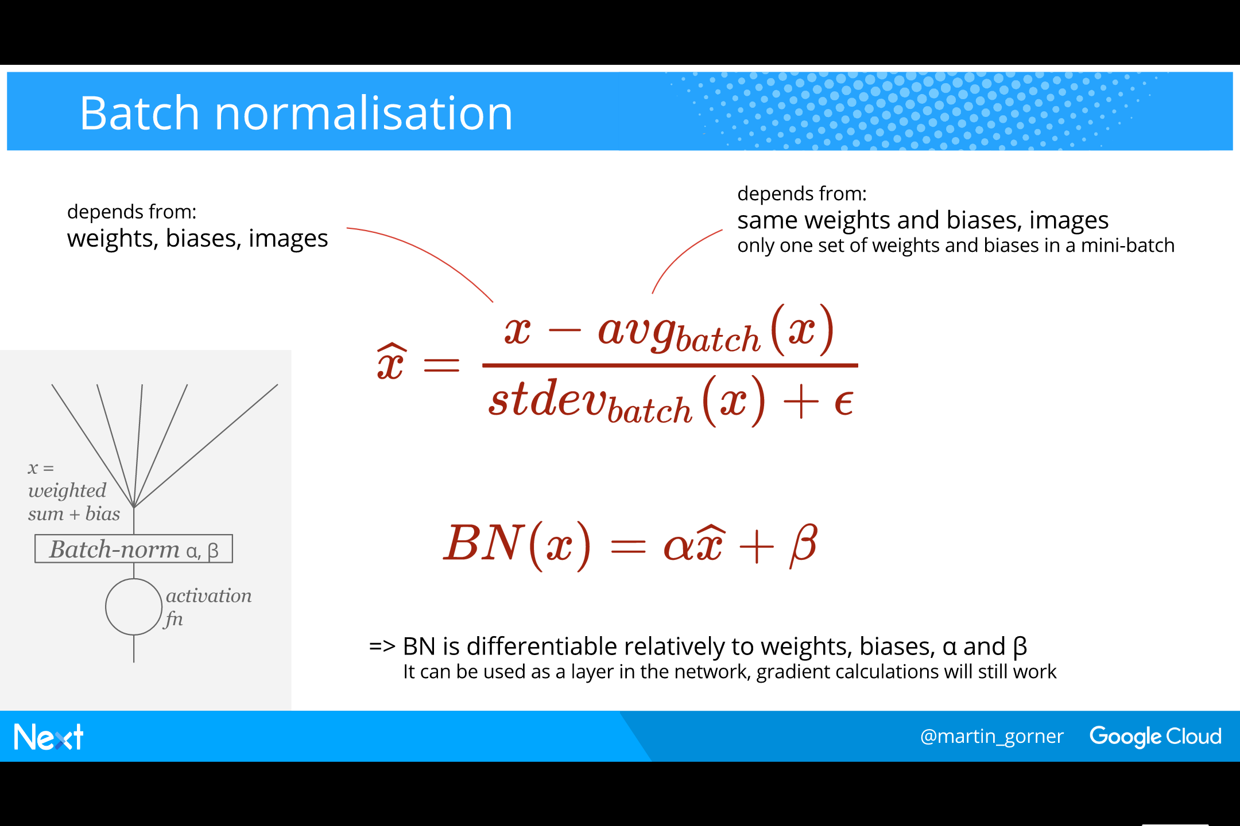
Notes:
Let us check that the batch-norm version of an activation is still a differentiable function of weights and biases: yes it is. So Batch norm can be added before the activation function of each neuron and Tensorflow will still be able to compute a gradient and make backpropagation work.
​
Finally, why batch norm when we have seen that a neural network layer can do the same kind of data conditioning ?
BN: 2 additional parameters per neuron (alpha and beta)
Layer: N additional weights per neuron (N being the size of the previous layer)
=> BN is much, much, much cheaper !

Slide 11
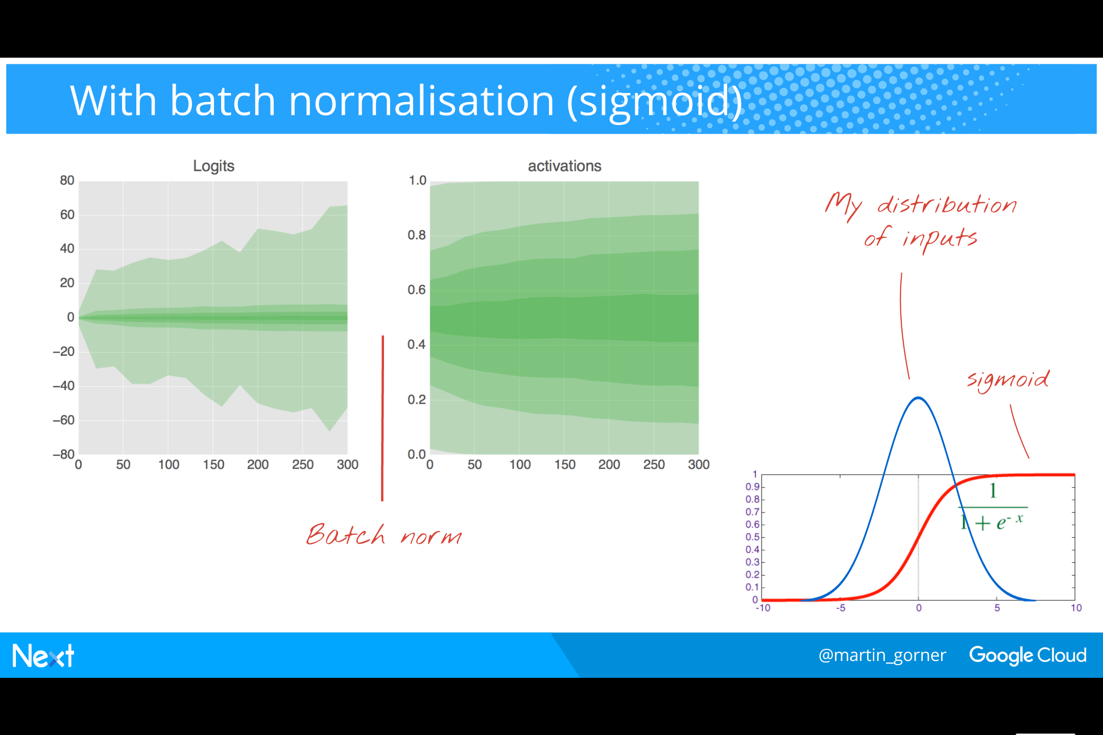
Notes:
Back to testing (using sigmoids):
With BN, activations are nicely distributed across the [-1, 1] spectrum of the sigmoid. Yay!
Compare this with the situation on slide 8: it is a great way of checking visually that BN has been applied correctly.
​

Slide 12
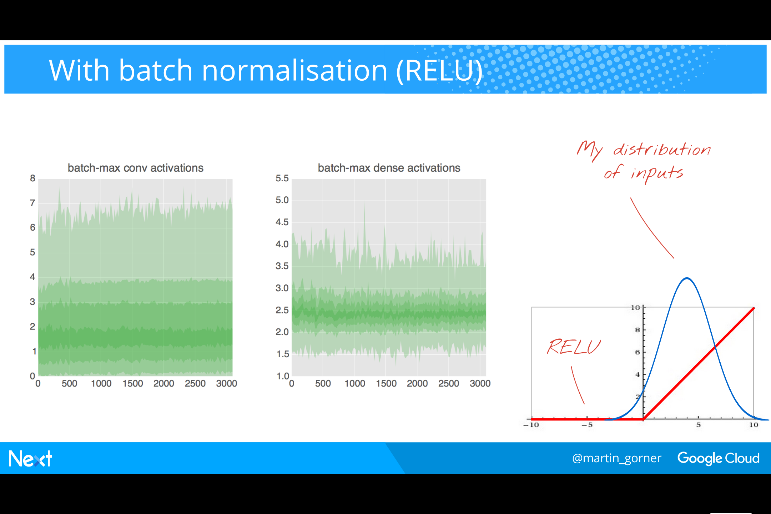
Notes:
Back to testing (using RELUs):
Batch norm is still useful with RELUs, even if they have a much bigger sweet spot interval.
​
To see something on the curves with RELUs, we cannot just count all the activation values across all the examples in the current mini-batch as we did for sigmoids. Indeed, RELU outputs are often 0. However a neuron outputting 0 on one images in a mini-batch, or even on the majority of images is not a dead neuron. It is dead only if it always outputs 0. So to get a percentile distribution where dead neurons can be spotted, I use the max value of each activation across a mini-batch.
​
These two graphs display the distribution of activations in a convolutional network being trained on the MNIST dataset. One graph shows the activations in the convolutional layers, the second one in the single dense layer. You can see that in both cases the activations (neuron outputs after the RELU) are nicely distributed across a useful portion of the RELU. There are some dead neurons in the convolutional layers (the bottom band), none at all in the dense layer.

Slide 13
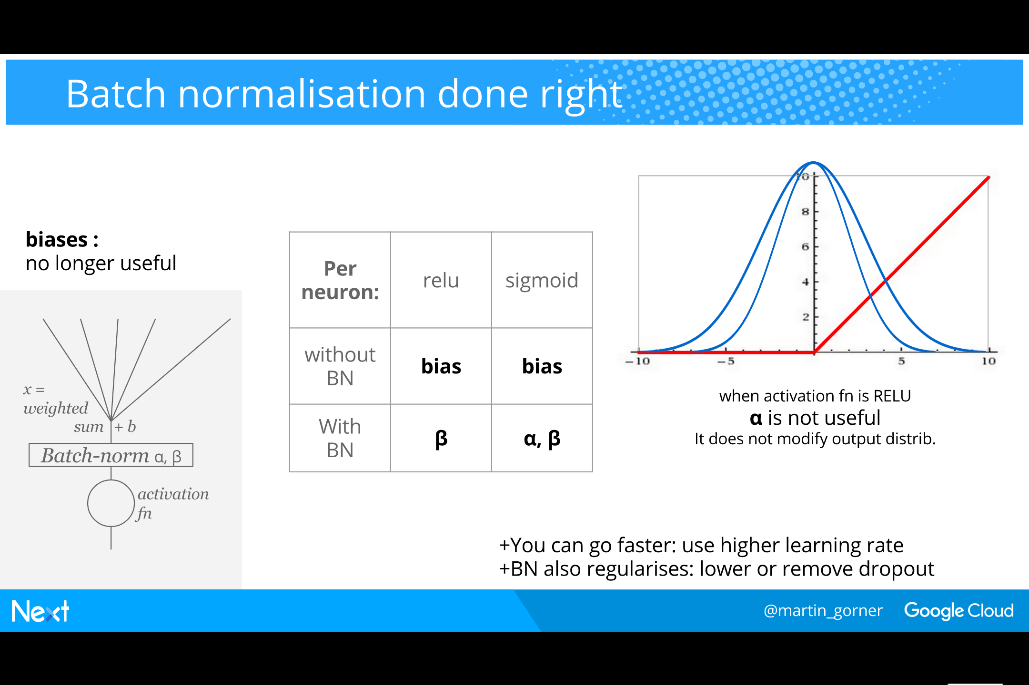
Notes:
Finally some practicalities:
​
Biases are actually not useful when using BN. BN computes its stats across all the values of an activation in a mini-batch. If a bias is added, it is the same for all values in the mini-batch (since a bias is per neuron) so as soon as we subtract the mean, the bias will be gone. The beta factor (also called “offset”) plays the role of biases in BN.
​
The alpha factor (also called “scale”) is useful only if the the activation function produces a different distribution of outputs when the scale of its inputs changes. That is the case for the sigmoid. With RELUs however, any input scaling is passed as is to the output. The output distribution is just scaled but unchanged in shape. Weights further down in the layers will be able to cope with this scale easily. There is no need for a beta factor.
​
Summarised in this table are all the cases and where biases, BN-alphas or BN-betas should be used.
​
Two practical benefits of BN:
You can use higher learning rates (actually, you have to use higher rates to see a benefit).
It is a regularisation technique so you can remove or lower your dropout
With well chosen parameter (learning rate and dropout) you can achieve higher accuracy with BN.

Slide 14
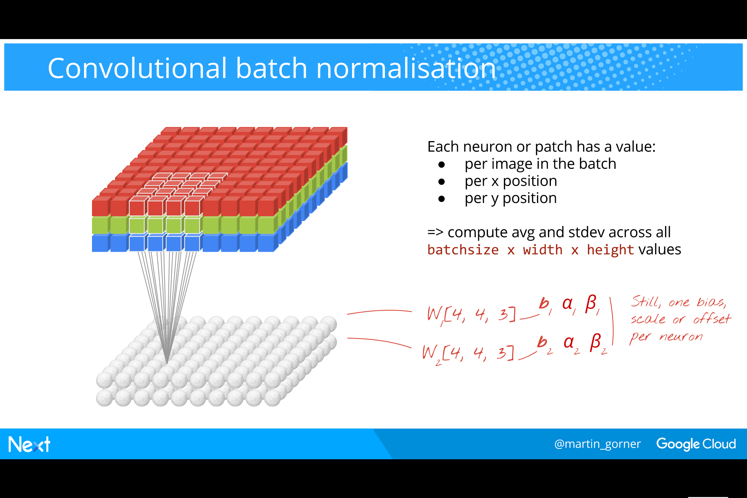
Notes:
Where to apply the alphas and betas in convolutional networks ?
Answer: one alpha and beta per neuron (the same as biases previously)
But what is “one neuron” in a convolutional network ?
Answer: “one neuron” = one patch of weights that gets passed on the input image.
​
How to compute the BN statistics ?
“One neuron” or patch gives one output value per image in the mini-batch but also per x and y positions as it is being passed across the image
So we have to compute the statistics for “one neuron” across all those values.

Slide 15
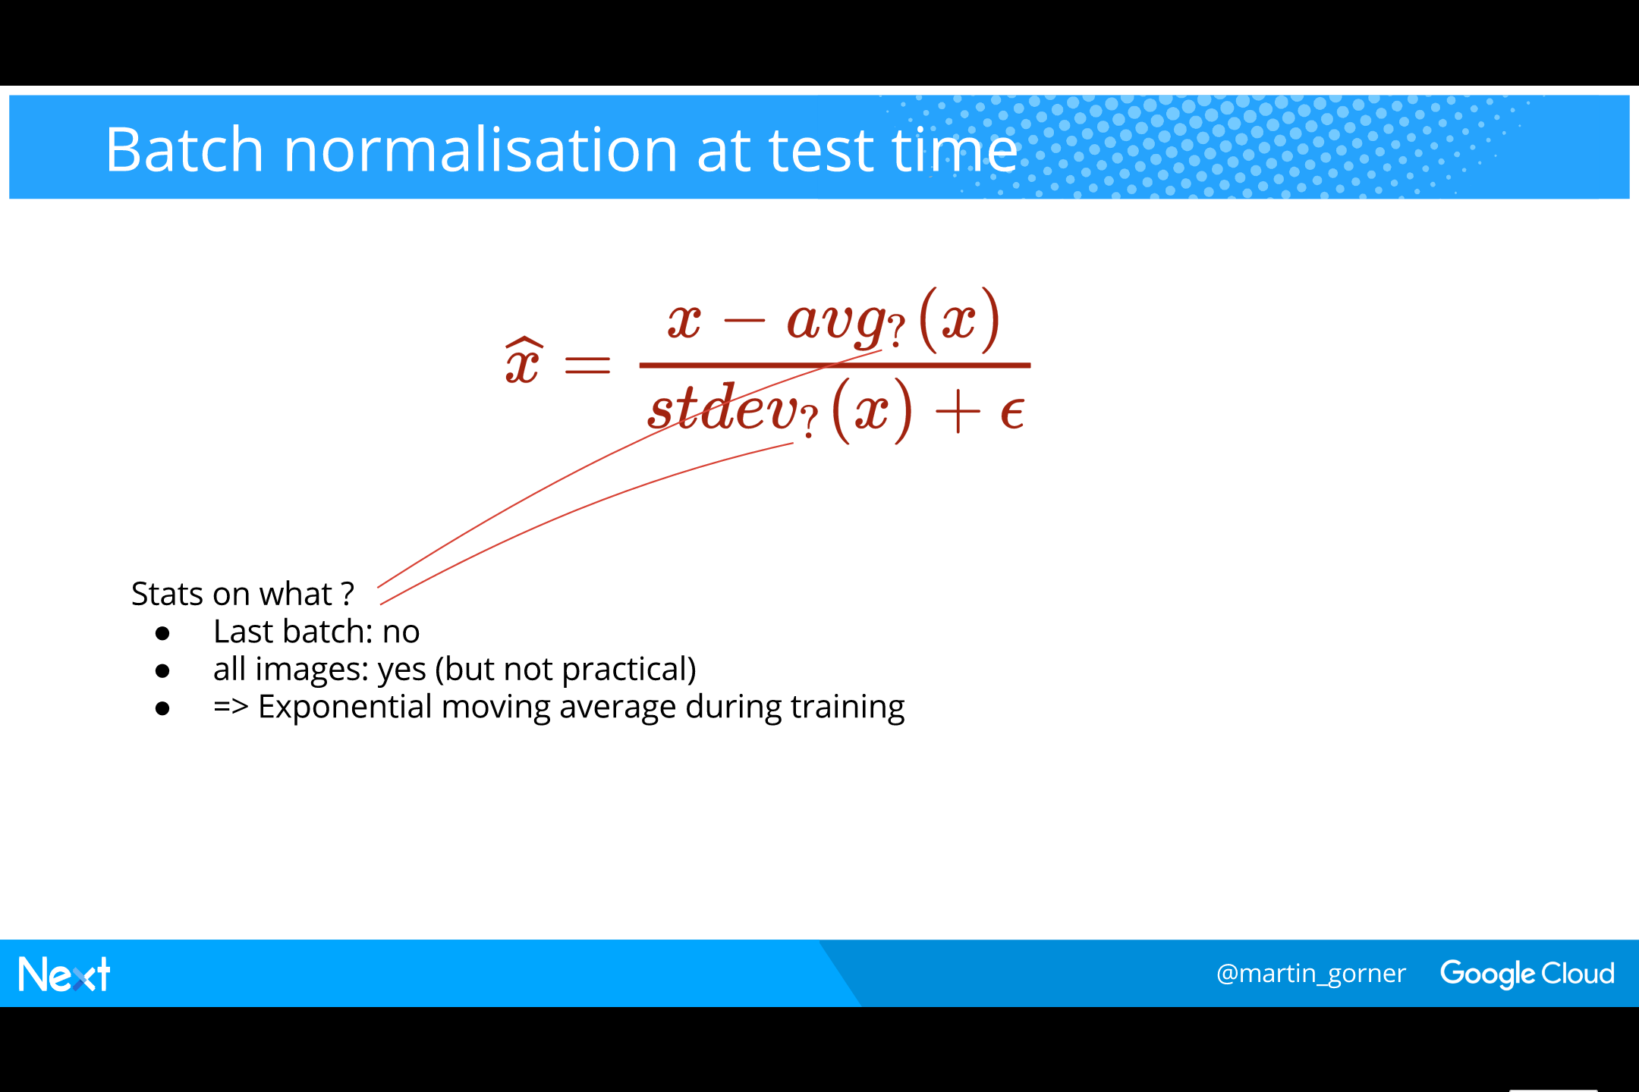
Notes:
At test time, what is the correct “batch” across which to compute BN statistics ?
It is not the last training batch which is irrelevant for testing
All test images: that would be nice but not very practical. There are many of them (10,000 in the MNIST example)
Pragmatic solution: some average of some number of the last training images seen. In practice, we use an exponential moving average.

Slide 16
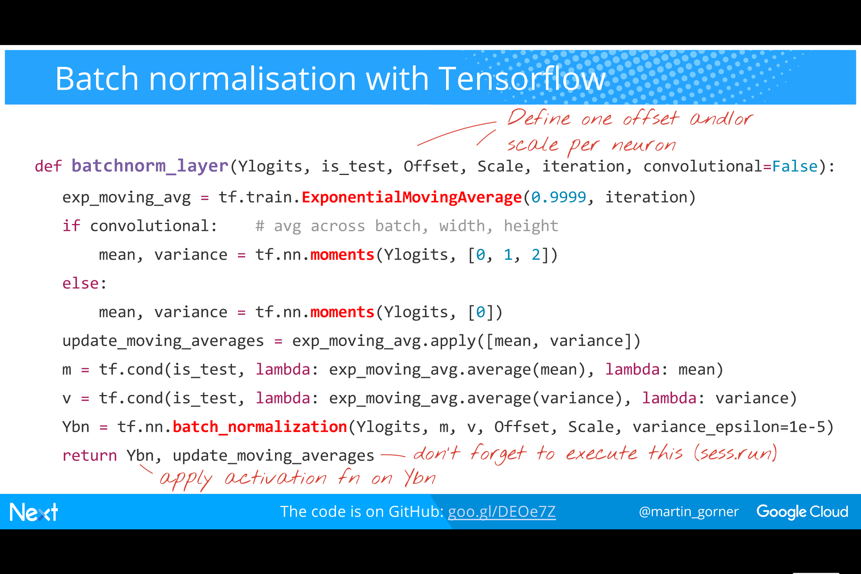
Notes:
The code for BN in Tensorflow (low-level, at the matrix multiply level).
Tensorflow has a batch_normalisation function but that just subtracts the means ad divides activations by their standard deviations.
Fortunately, Tensorflow also has a “moments” function that computes the means and variances. So we can simply pass the output of one function to the other.
​
We have to handle the convolution case where the stats are computed not just across the minibatch but also across all the x,y positions a patch can take. That is what tf.nn.moments(Ylogits, [0, 1, 2]) does. It computes the stats across tensor directions 0 (image instances in mini-batch), 1 (x positions) and 2 (y positions).
​
We also compute a exponential moving average of means and variances during training. When testing, we use these stats instead.
​
Written like this, the batchnorm_layer function can now be inserted between the logits and that activation function in each neural network layer.

Slide 17
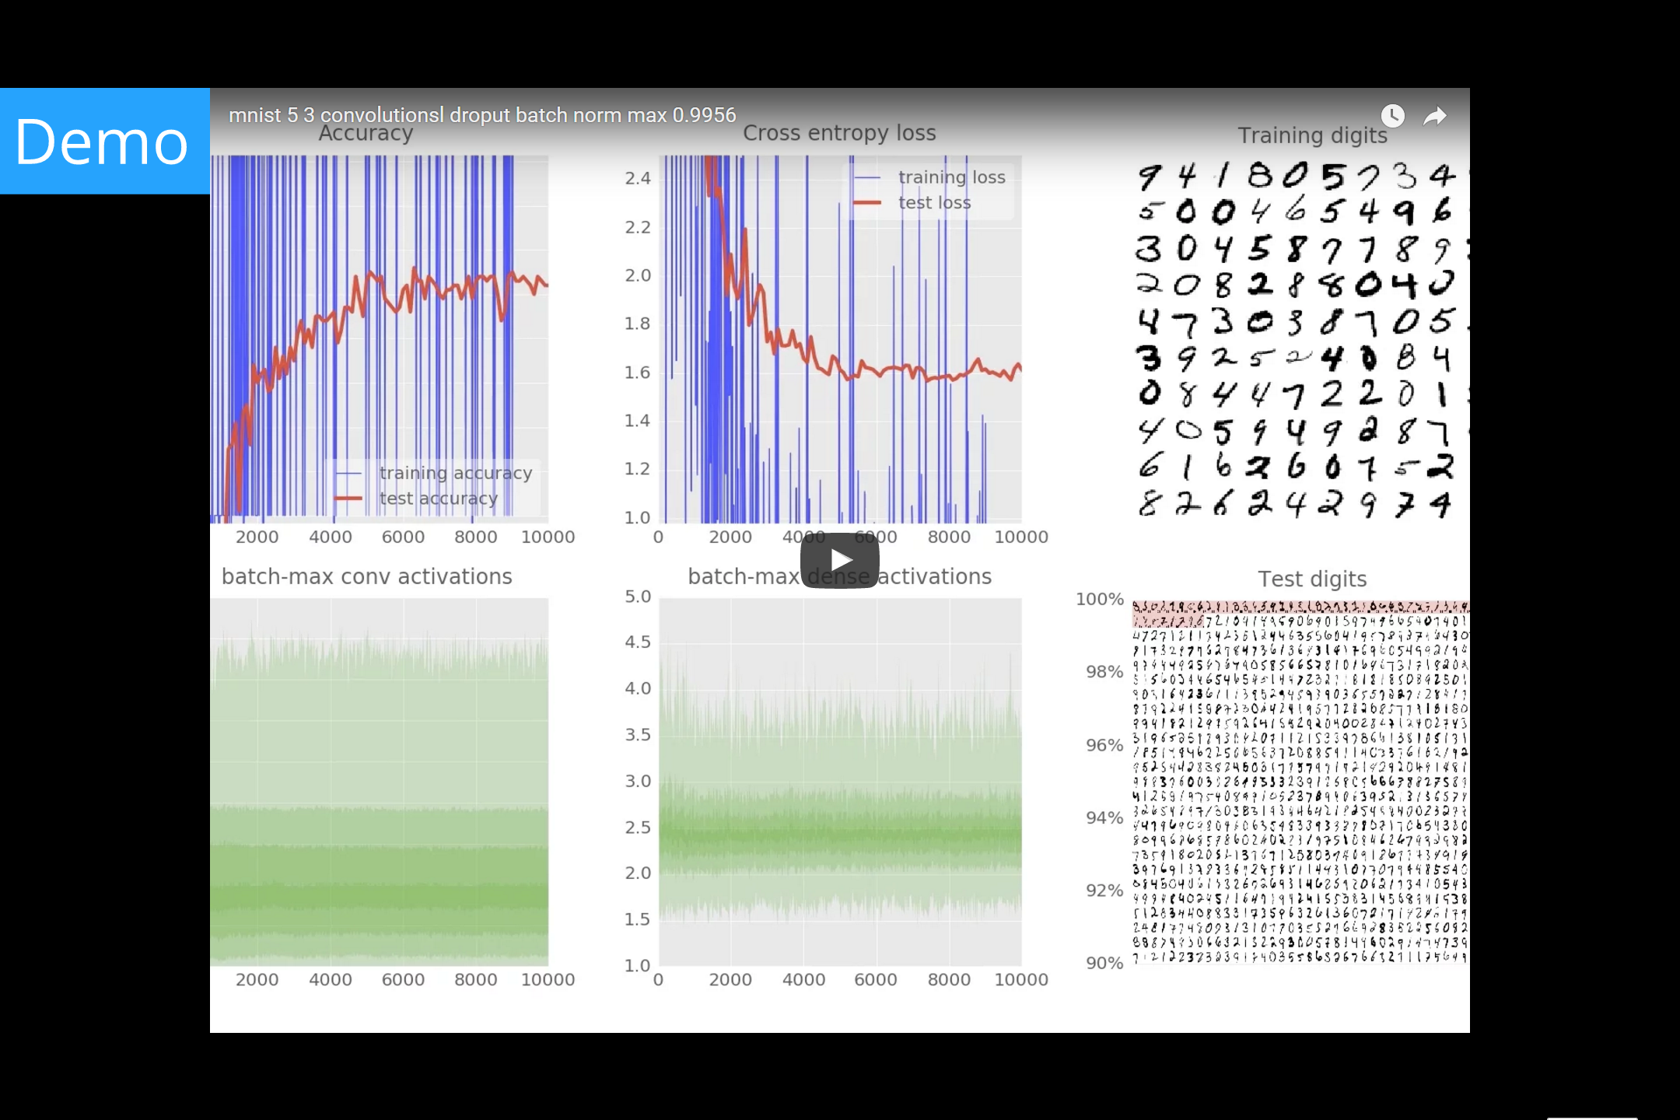
Notes:
Test accuracy now hovers confidently in the 99.3 % region and even peaks at 99.38% !
99% barrier shattered.
The test cross-entropy still goes up slightly after 4000 iterations but nowhere as badly as previously.

Slide 18
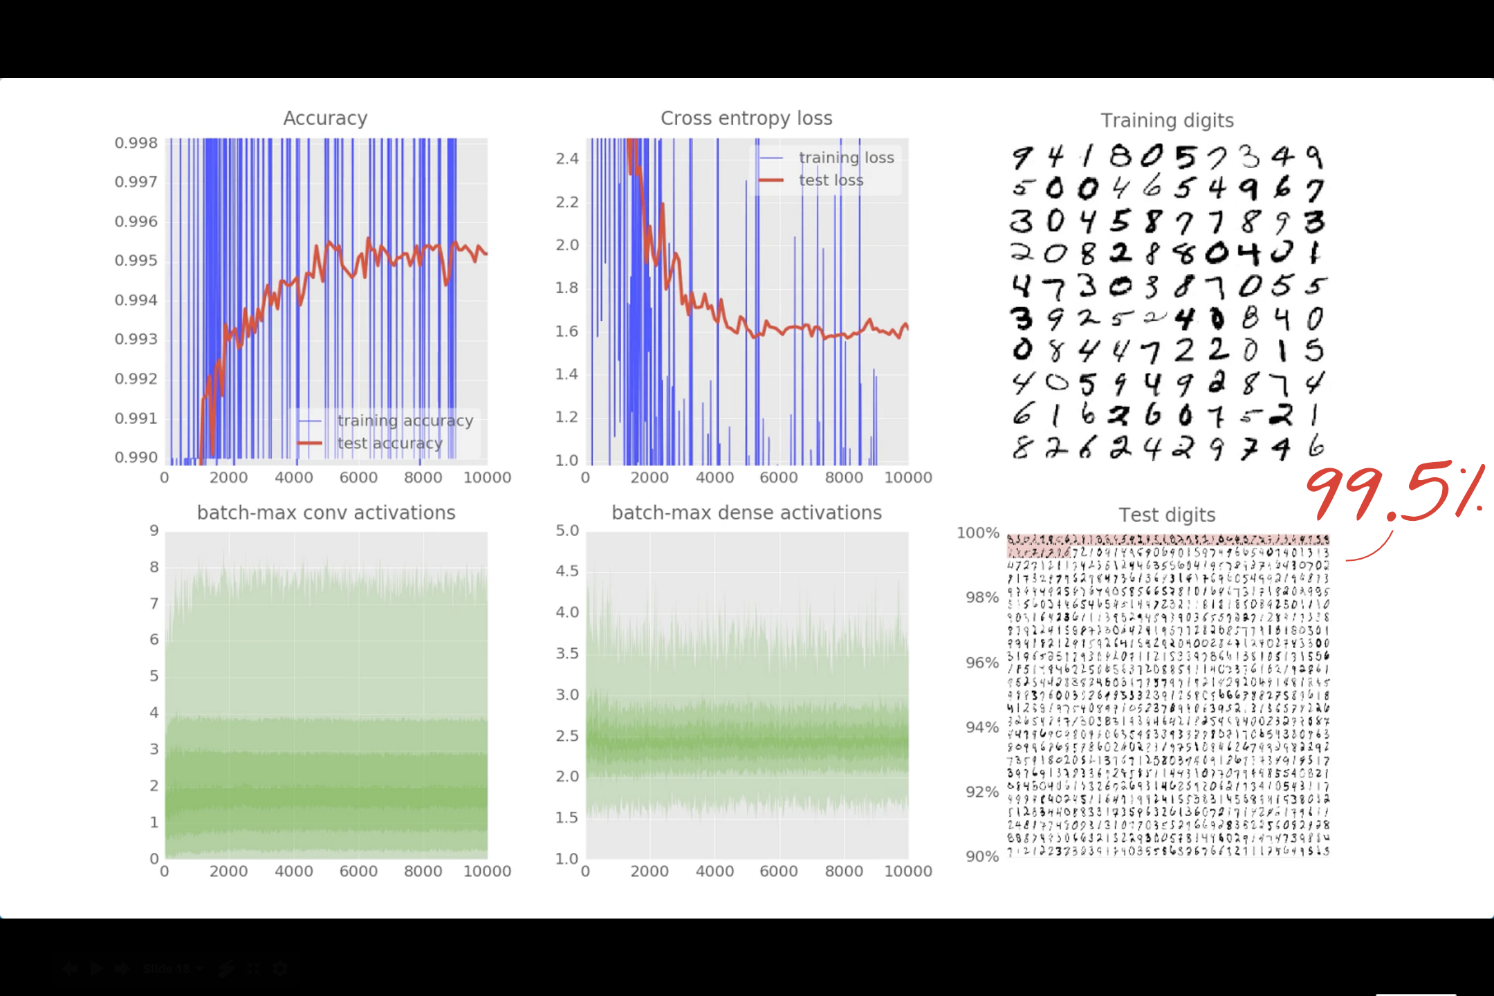
Notes:
With BN, we reach 99.5% test accuracy. The world record is 99.77%. Paper linked from the MNIST web site: http://yann.lecun.com/exdb/mnist/

Slide 19
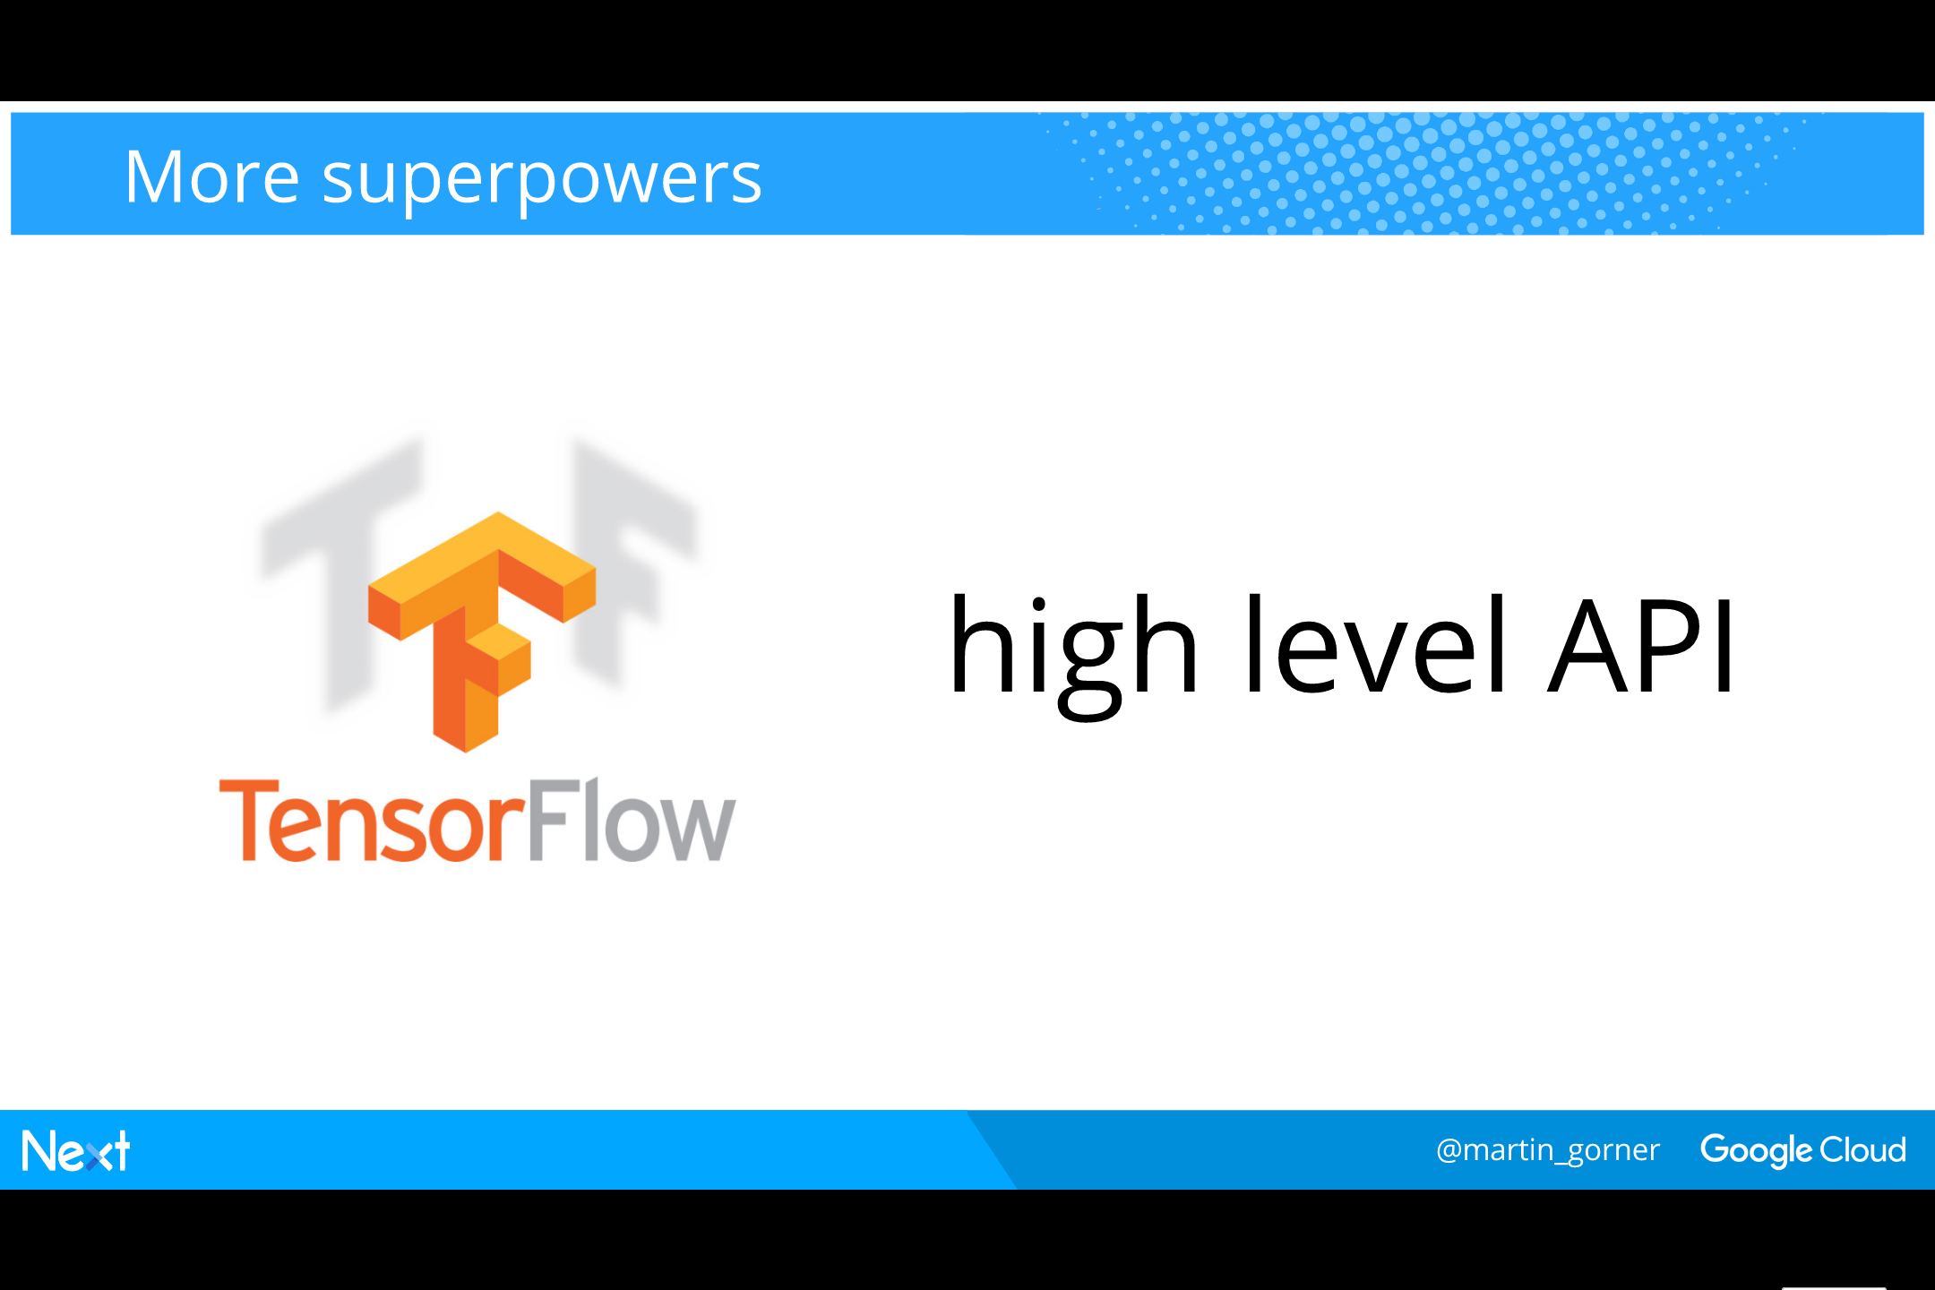
Notes:
We have worked at the matrix multiply level up to now but Tensorflow also has a higher-level API called tf.earn
You can use it build models in fewer lines of code.

Slide 20
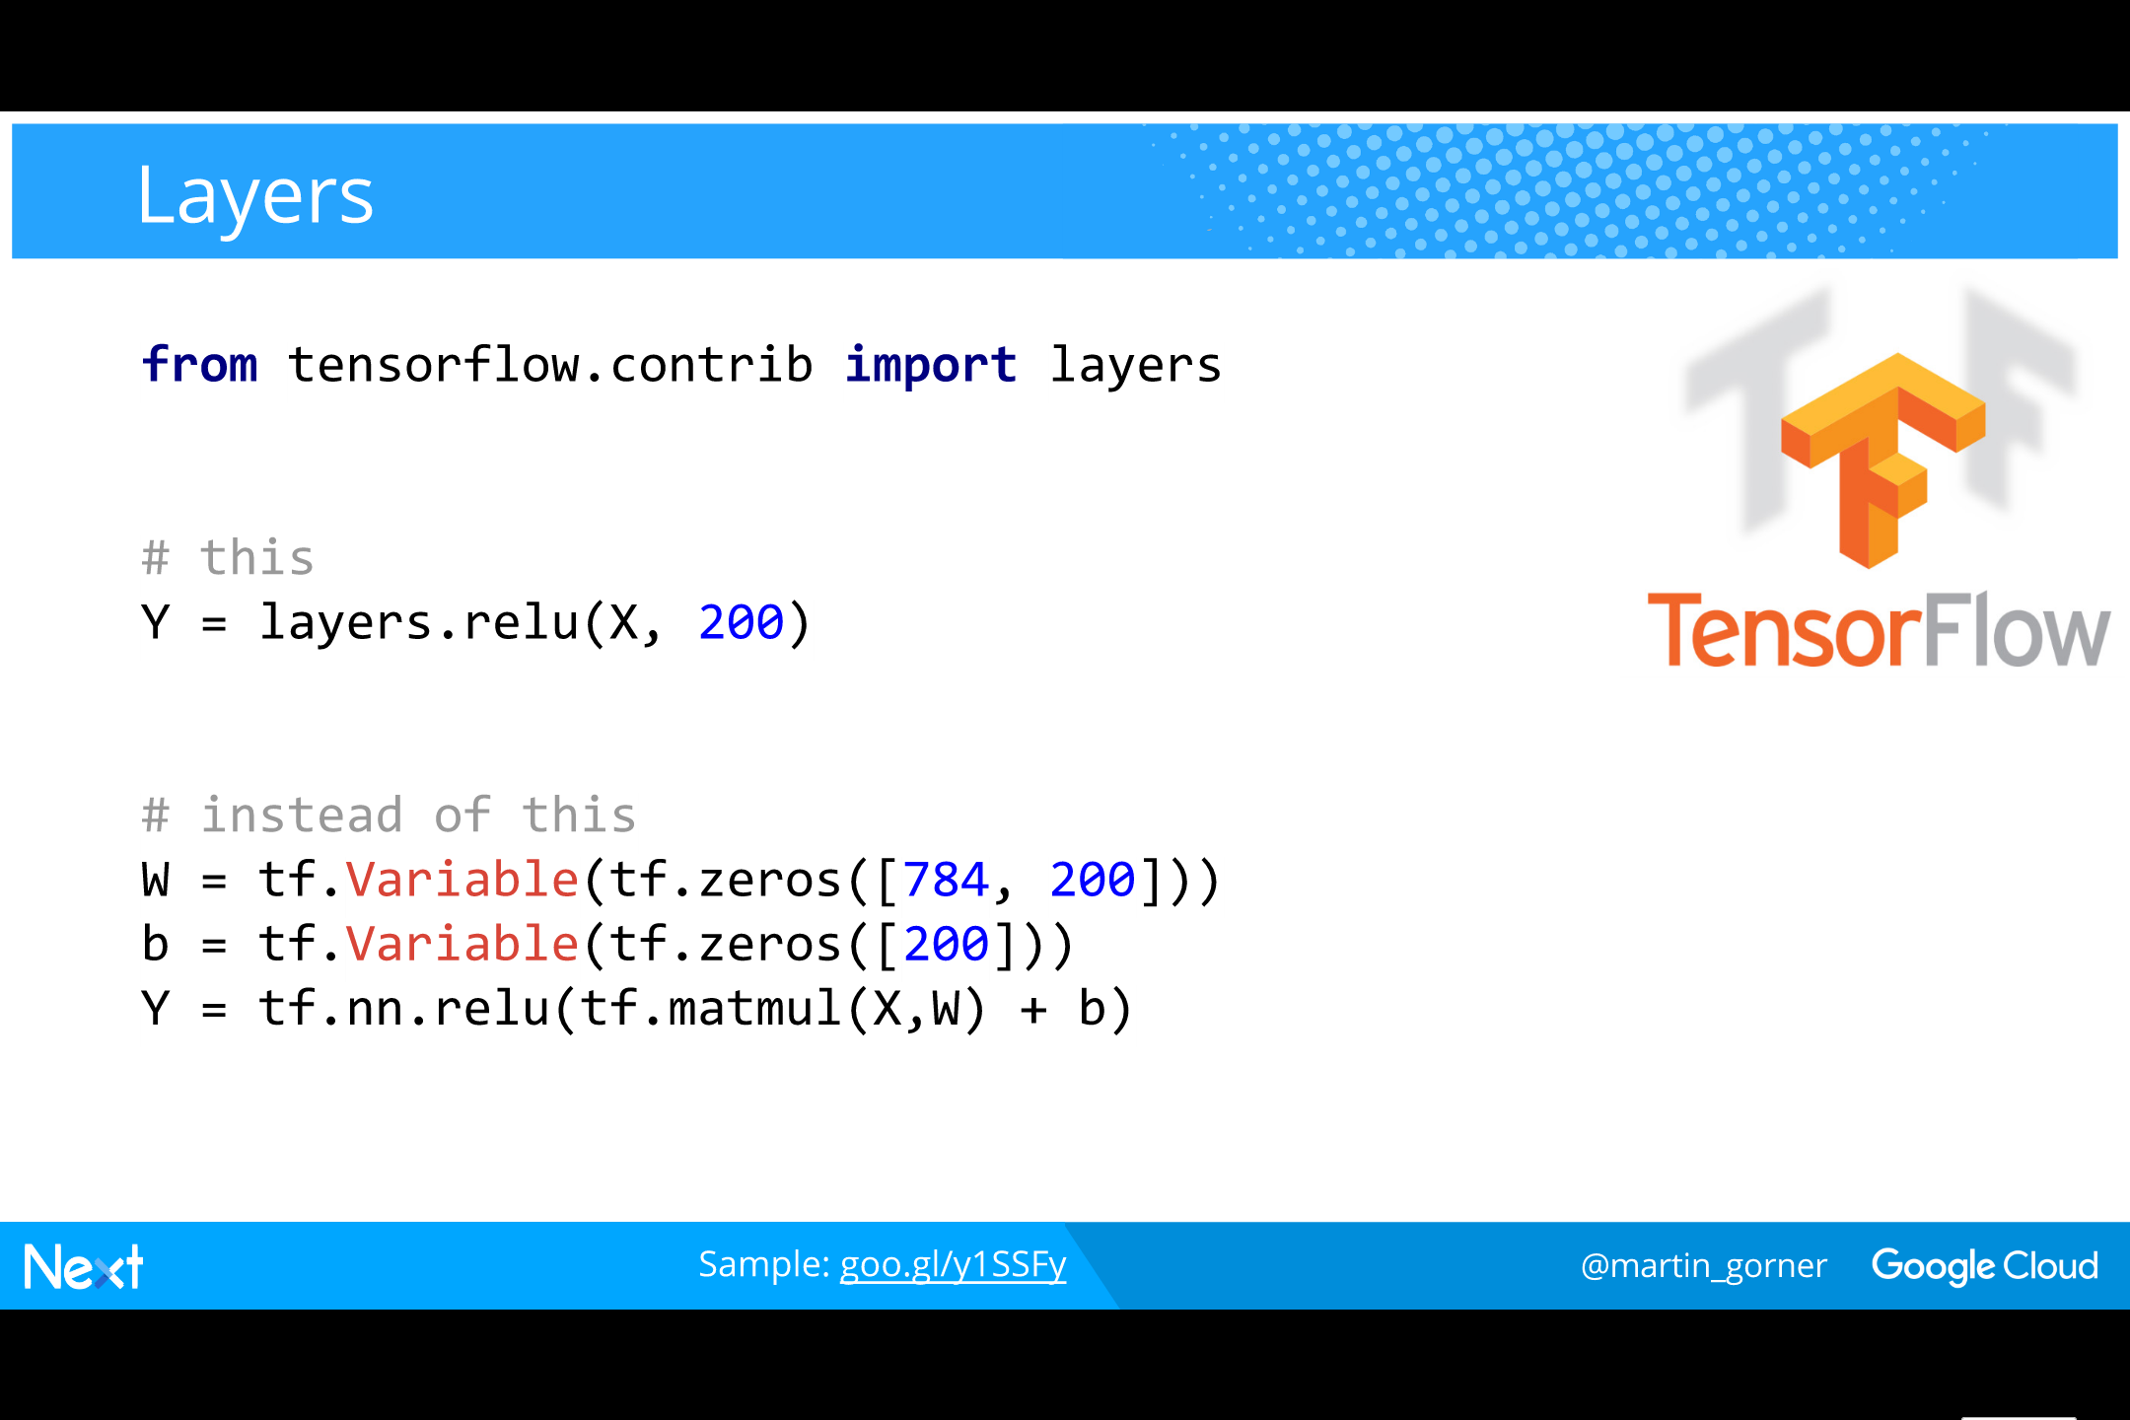
Notes:
The “layers” module has a one-line syntax for all common neural network layers.
Weights and biases are defined and initialised implicitly for you, using best practices.

Slide 21
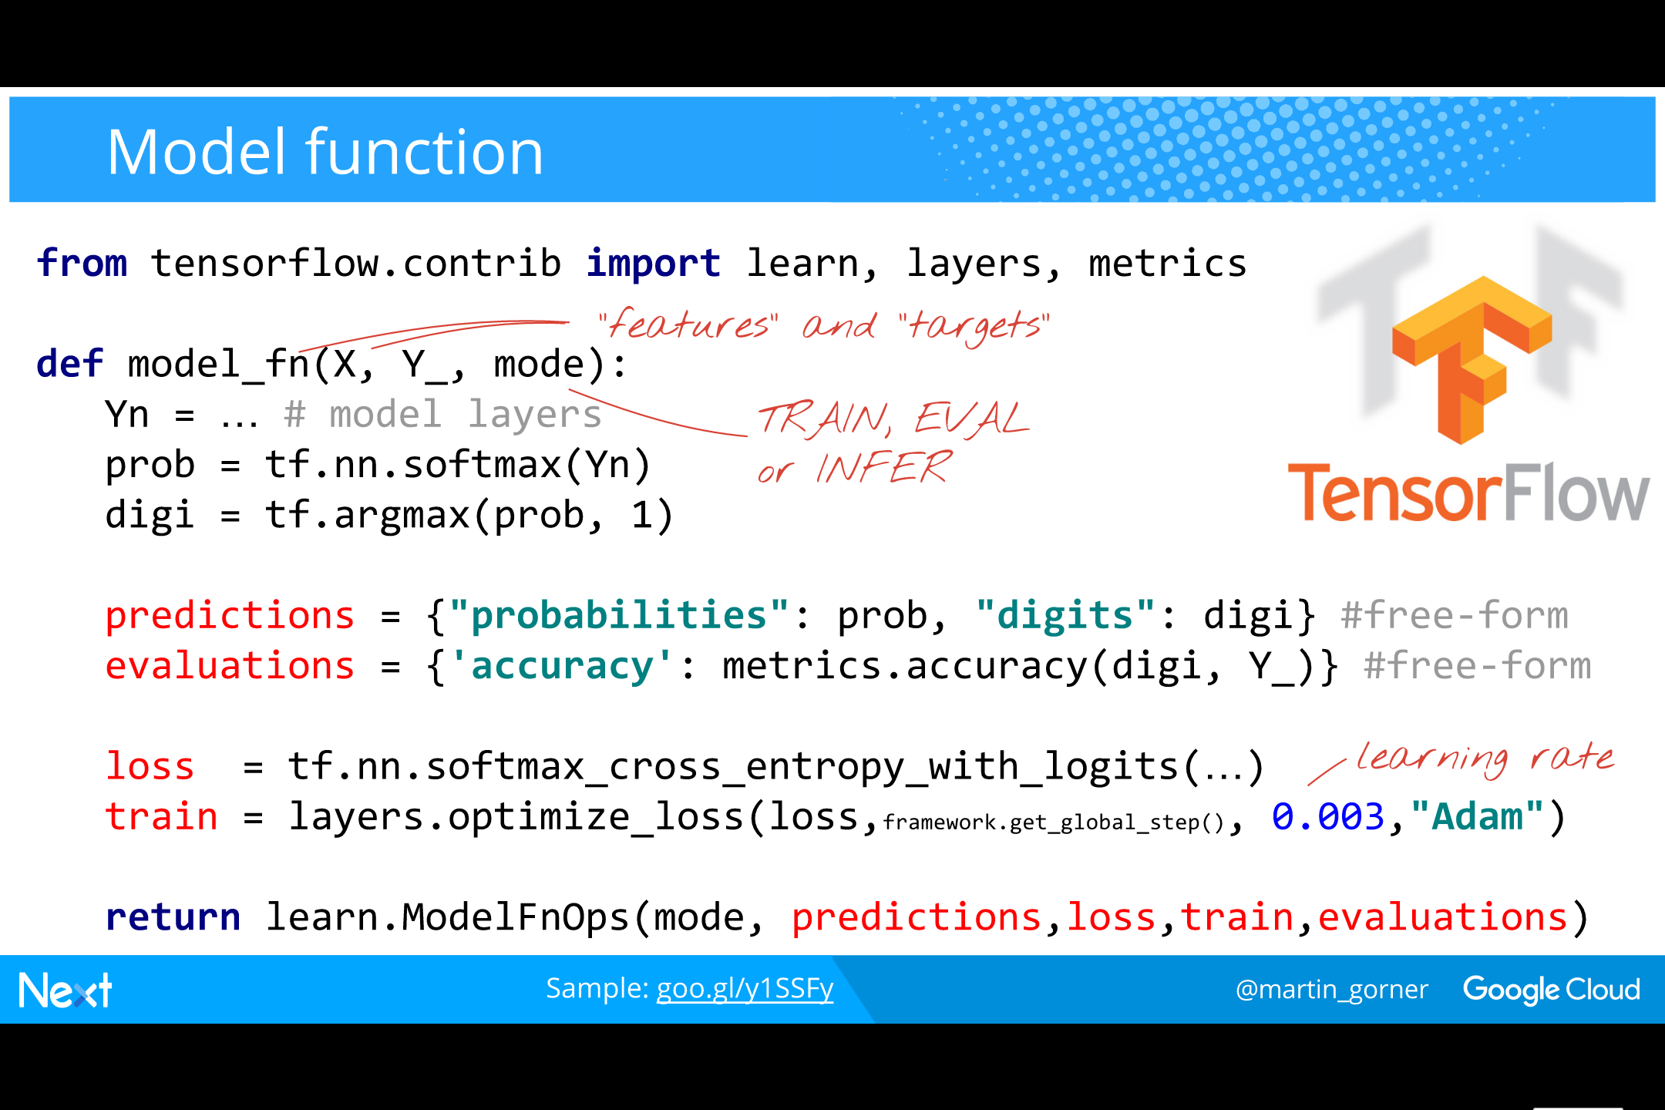
Notes:
To build a model, you write a model function that takes in your “features” (images in our example) and the desired predictions (digit classes in our example).
The output is a dictionary of whatever you want (usually predictions) as well as the loss and the train_step output by the Optimizer you used in your model.
​
Tf.learn also saves you the hassle of writing your training loop:
You define an Estimator by passing it your model function and call the Estimator.fit function to train.

Slide 22
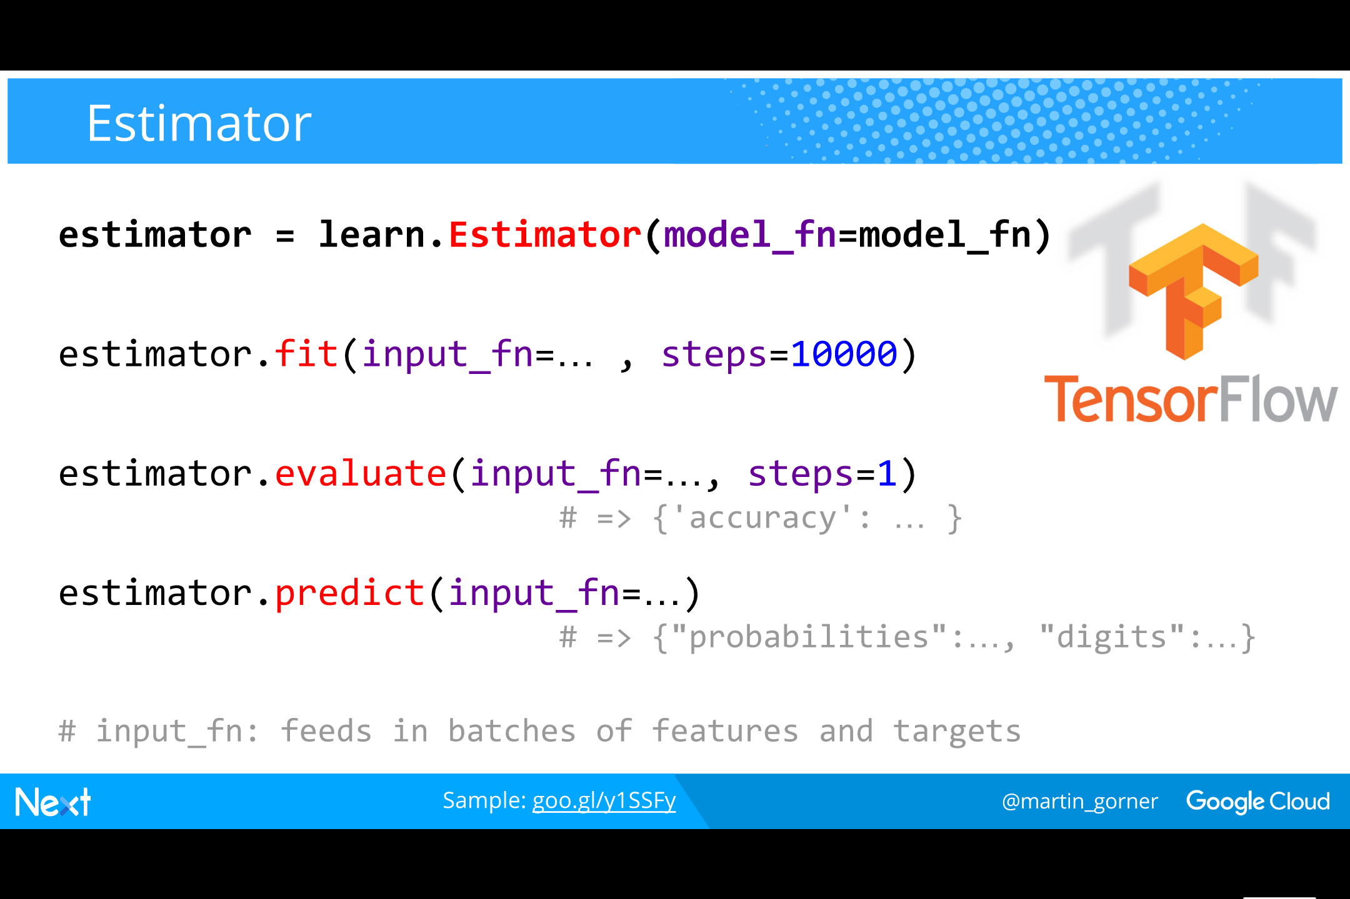
Notes:
The Estimator has three operation modes:
fit(training data and labels): does training for the specified number of iterations
predict(image): runs one prediction with the current set of weights and biases
evaluate(test images and labels, soem metric): evaluates the metric against the images and labels
​
The metric is defined from the MetricSpec base class as one of the standard available metrics, applied to one of the outputs of your model.
​
This is very flexible because the model function can return anything you want in a dictionary and similarly you can specify that metric consumes any of the values from that dictionary. You hve full freedom when designing models and metrics.

Slide 23
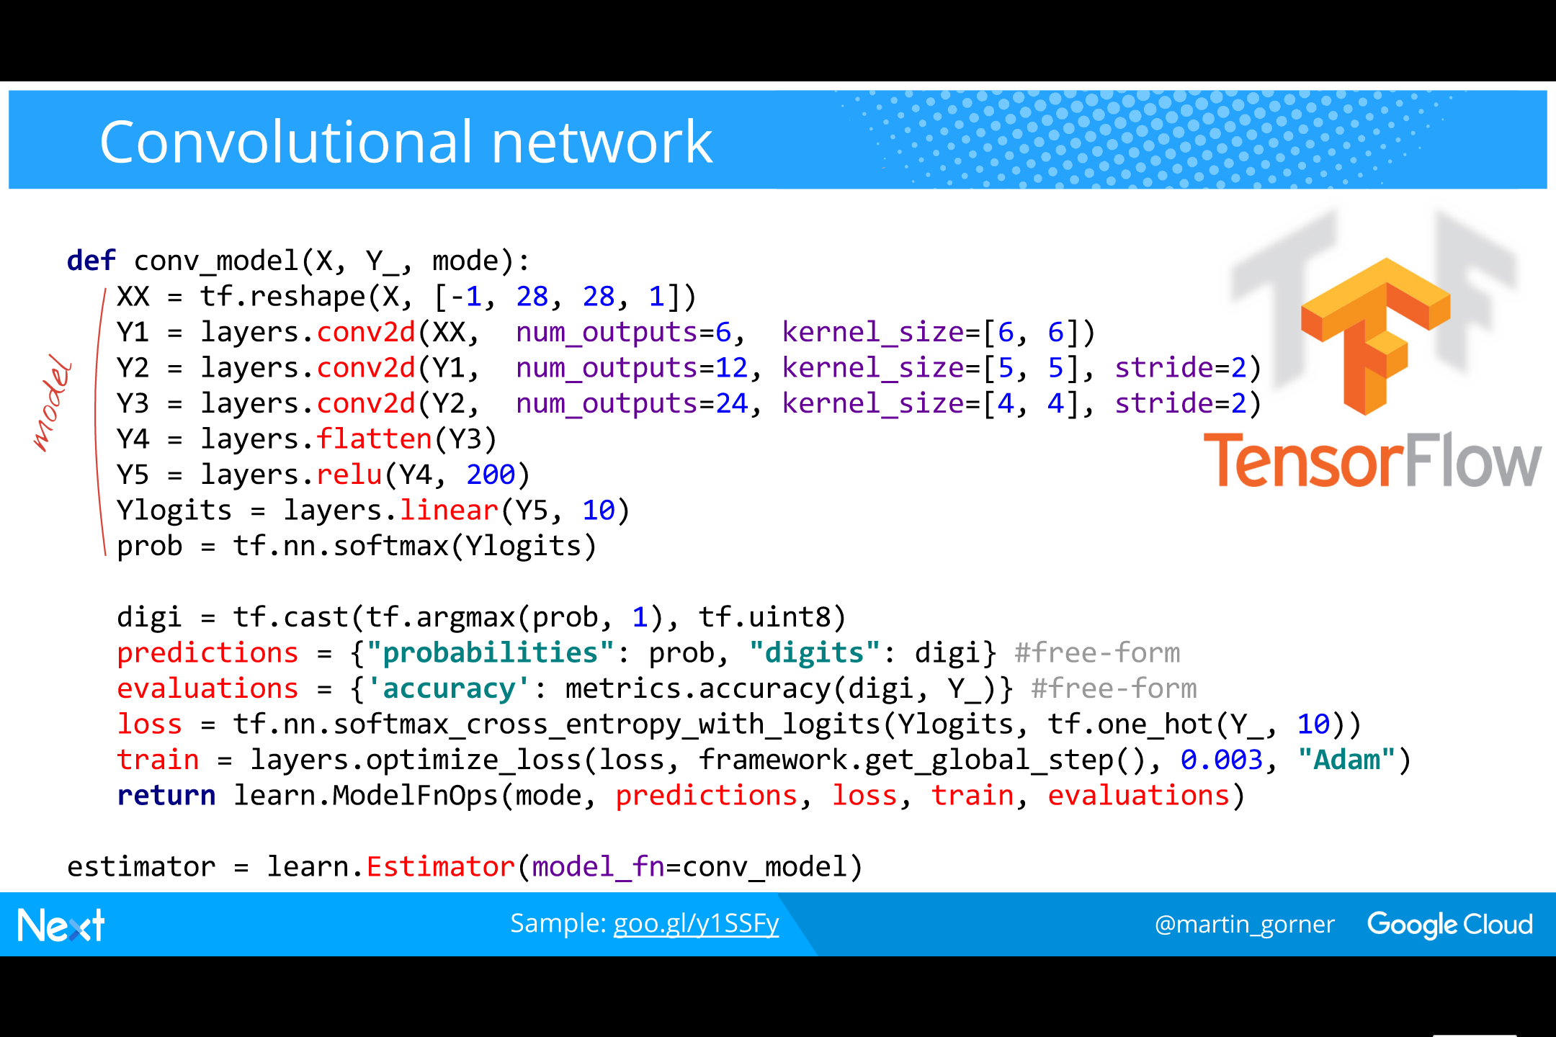
Notes:
Here is the convolutional network we built for the MNIST dataset (handwritten digit recognition), this time using tf.learn
Much more compact and if you already know what you are doing, you will miss neither the weights and biases definitions nor the hand-written training loop.

Slide 24
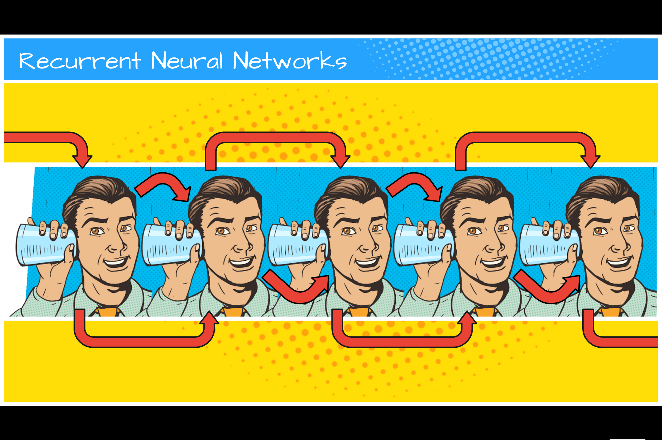
Notes:
Dense networks.
Convolutional networks.
One more and we are done with the basics: recurrent networks

Slide 25
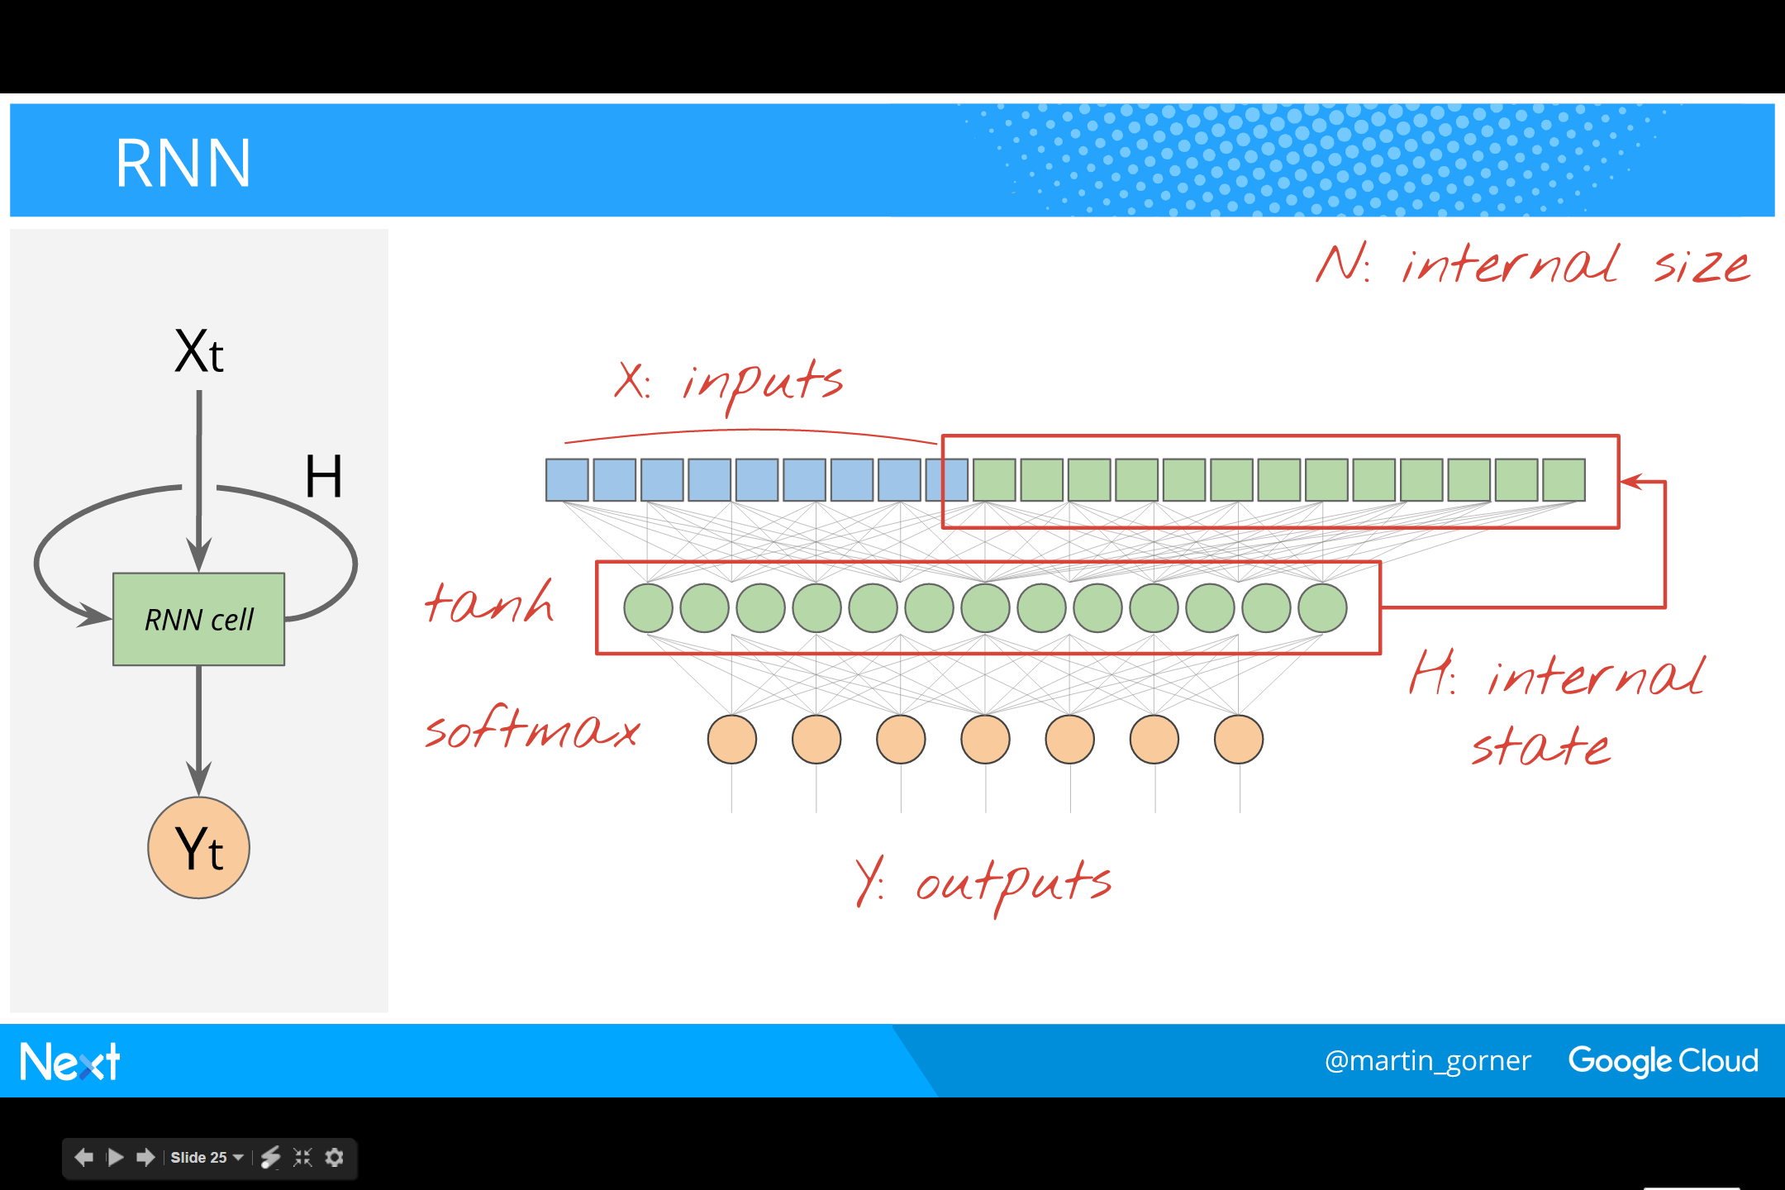
Notes:
RNN 的结构与训练
首先，RNN 的结构如下，其中第二层为 softmax 层（读取出东西）。但特殊的是，中间绿色层的输出在下一步骤中会返回到输入中。
Let us take a regular dense neural network with a single hidden layer.
We make it recurrent by feeding the outputs of the hidden layer back as a portion of its inputs, in addition to its normal inputs X.
​
These types of networks are applied to sequential data. At each step of the sequence, their inputs are the concatenation of the actual data at that step in the sequence and the outputs of the hidden layer from the previous step.
​
Hyperparameter: internal size (width) of the cell: number of neurons of internal state
​
A softmax layer is used to compute outputs.

Slide 26
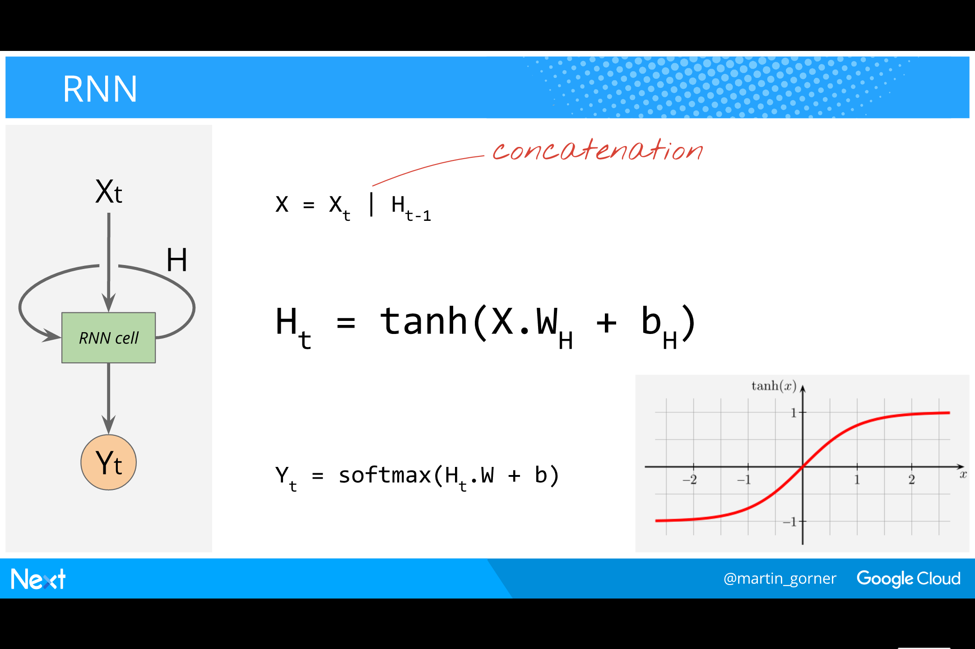
Notes:
下面是循环神经网络里面的等式。
Here are the formulas to compute the state and the output of the RNN cell at time t.
We are using the “activation(X.W+B)” formula for a one-layer neural network explained in part I (https://goo.gl/pHeXe7)
​
The hyperbolic tangent is commonly used as the activation function. Tanh is just a shifted and scaled sigmoid, rising gradually from -1 to 1 (instead of 0 to 1 for the sigmoid).
​

Slide 27
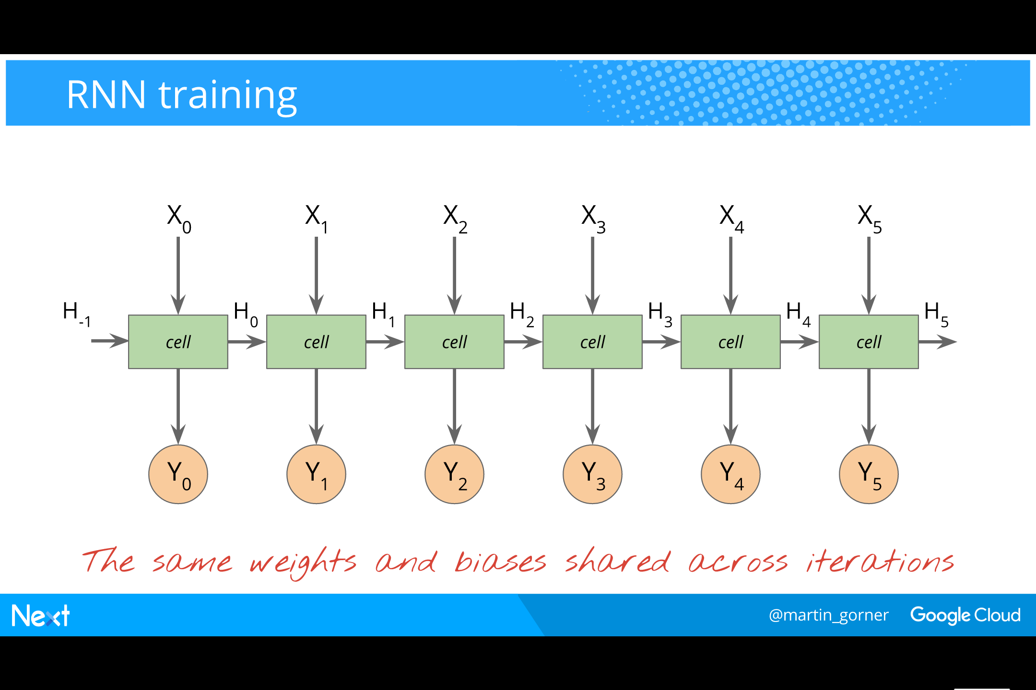
Notes:
那么接下来如何训练 RNN？以自然语言处理为例：输入通常为字符（character）。如下图中所示，我们输入字符，反向传播通过该神经网络、反向传播通过 softmax 层，我们会得到字符的输出。如果得到的字符不是我们想要的，对比一下得到的与我们想要的，我们就对网络中的权重进行调整，从而得到更好的结果。
但如果结果是错的怎么办？而且不是因为网络中的权重偏见，而是因为状态输入 H-1 是错的。在此问题中，输入是连续的，有些无能为力的感觉。在这个问题上卡住了，那么解决方案是什么？
解决方案就是复制该 cell，再次使用同样的权重。下图演示了你该如何训练循环神经网络，在多次迭代中共享同样的权重和偏差。
To train an RNN cell, you must unroll it across time. Why ?
​
Consider a single cell. Put something on its inputs. It’s input state is the state received from the previous iteration.
This gives you some outputs. Not happy with what you got ?
Fine, compute the difference between what you got and your desired outputs, from that a gradient, and retropropagate.
This will adjust weights and biases so as to make the difference smaller ?
But wait, what if the problem was not in the weights and biases at all ? What if the problem was the input state you received from the previous iteration ?
No luck in that case. That state has already been computed, you cannot go back in time to try and recompute it using better weights and biases, or can you ?
​
Actually, you can, up to a certain point. The trick to training RNNs is to unroll a the network across n iterations. The first input state is still a constant as far as this training step is concerned. However, all of the following states are now combinations of weights, biases and inputs, amenable to backpropagation.
​
2 takeaways:
An RNN cell is a state machine and can therefore represent state changes across many many steps (for example close a parenthesis that was opened time 5000 step ago)
However, to train an RNN, it has to be unrolled across a finite number of steps (usually less than 100). If there are state changes you want to teach it (like opening and closing parentheses) they must appear in the training dataset across spans of no more than N time steps, N being the number of unrolled steps.

Slide 28
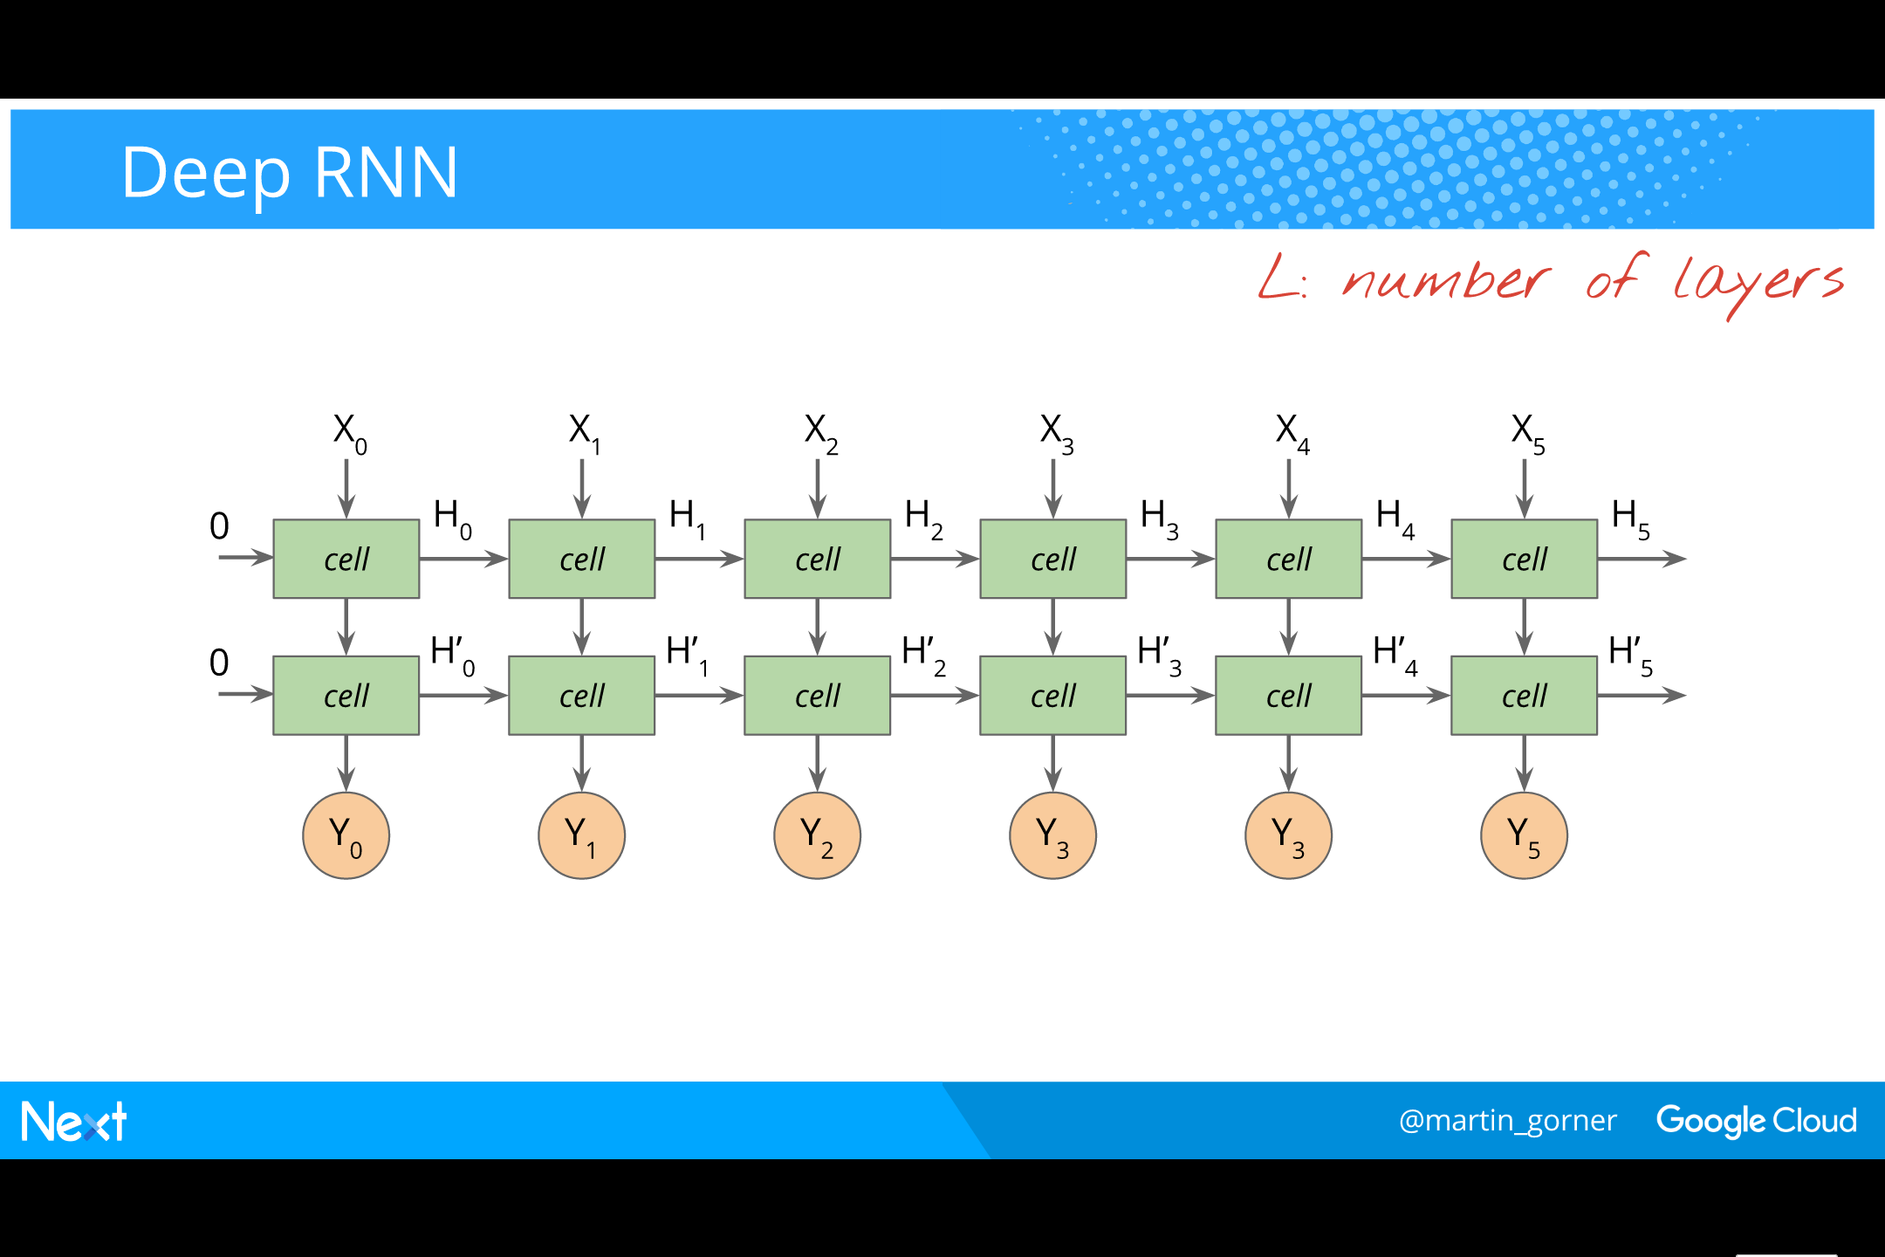
Notes:
另外，值得一提的是如果你想往深处做，可以堆叠 cells(如下图）。
It is straightforward to stack RNNs deep (see illustration).
​
Hyperparameter: L, the number of neuron layers in the cell

Slide 29
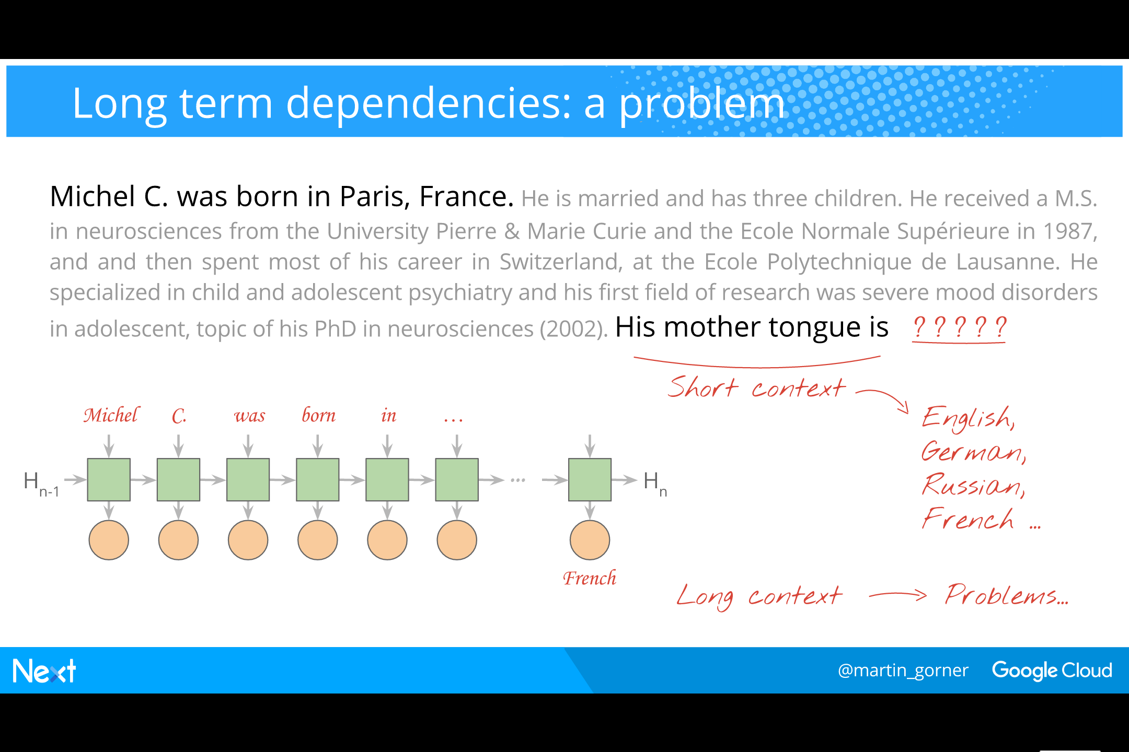
Notes:
而后，Gorner 以句子为例讲解了如何使用 TensorFlow 建立循环神经网络。在以下示例中，我们是用单词而非字符作为输入，建立这样的模型中就有一个典型的问题：长期依存关系。而要把下面的长句输入，需要非常深的循环神经网络，而如果网络太深，训练时候又不太好收敛。在数学细节上要提到的就是梯度消失的问题，梯度成 0 了。
We have already seen that an RNN can learn a time dependency only if it is shorter than the unroll factor N.
So you need to unroll a lot if you want to teach long-term dependencies to your network.
An RNN that you unrolled 100 times is actually very similar to a 100-layer deep neural network.
And it comes with all of the problems common in deep neural networks: vanishing gradients, and big issues when training them. They simply refuse to converge.
​
The solution researchers found was to make the RNN cell a bit more complex on the inside, while keeping the same inputs and outputs. The key ideas was to add an internal “memory”. This new kind of cell is called the LSTM: Long Short Term Memory cell
​
I will not explain here why the LSTM solves the convergence problem. That explanation involves a good dose of mathematics. However, let’s look at an LSTM cell in detail:

Slide 30
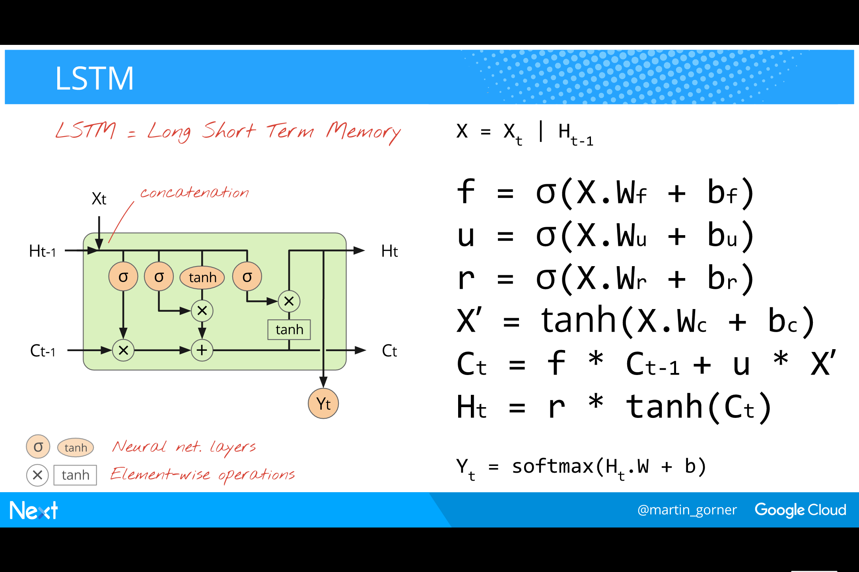
Notes:
对此问题的一种解决方案是 LSTM。下图从数学角度解释了该解决方案为何有效。
An LSTM explained as a schematic or as a set of formulas.
Let us look at the formulas. They look like code and we can read code can’t we ?

Slide 31
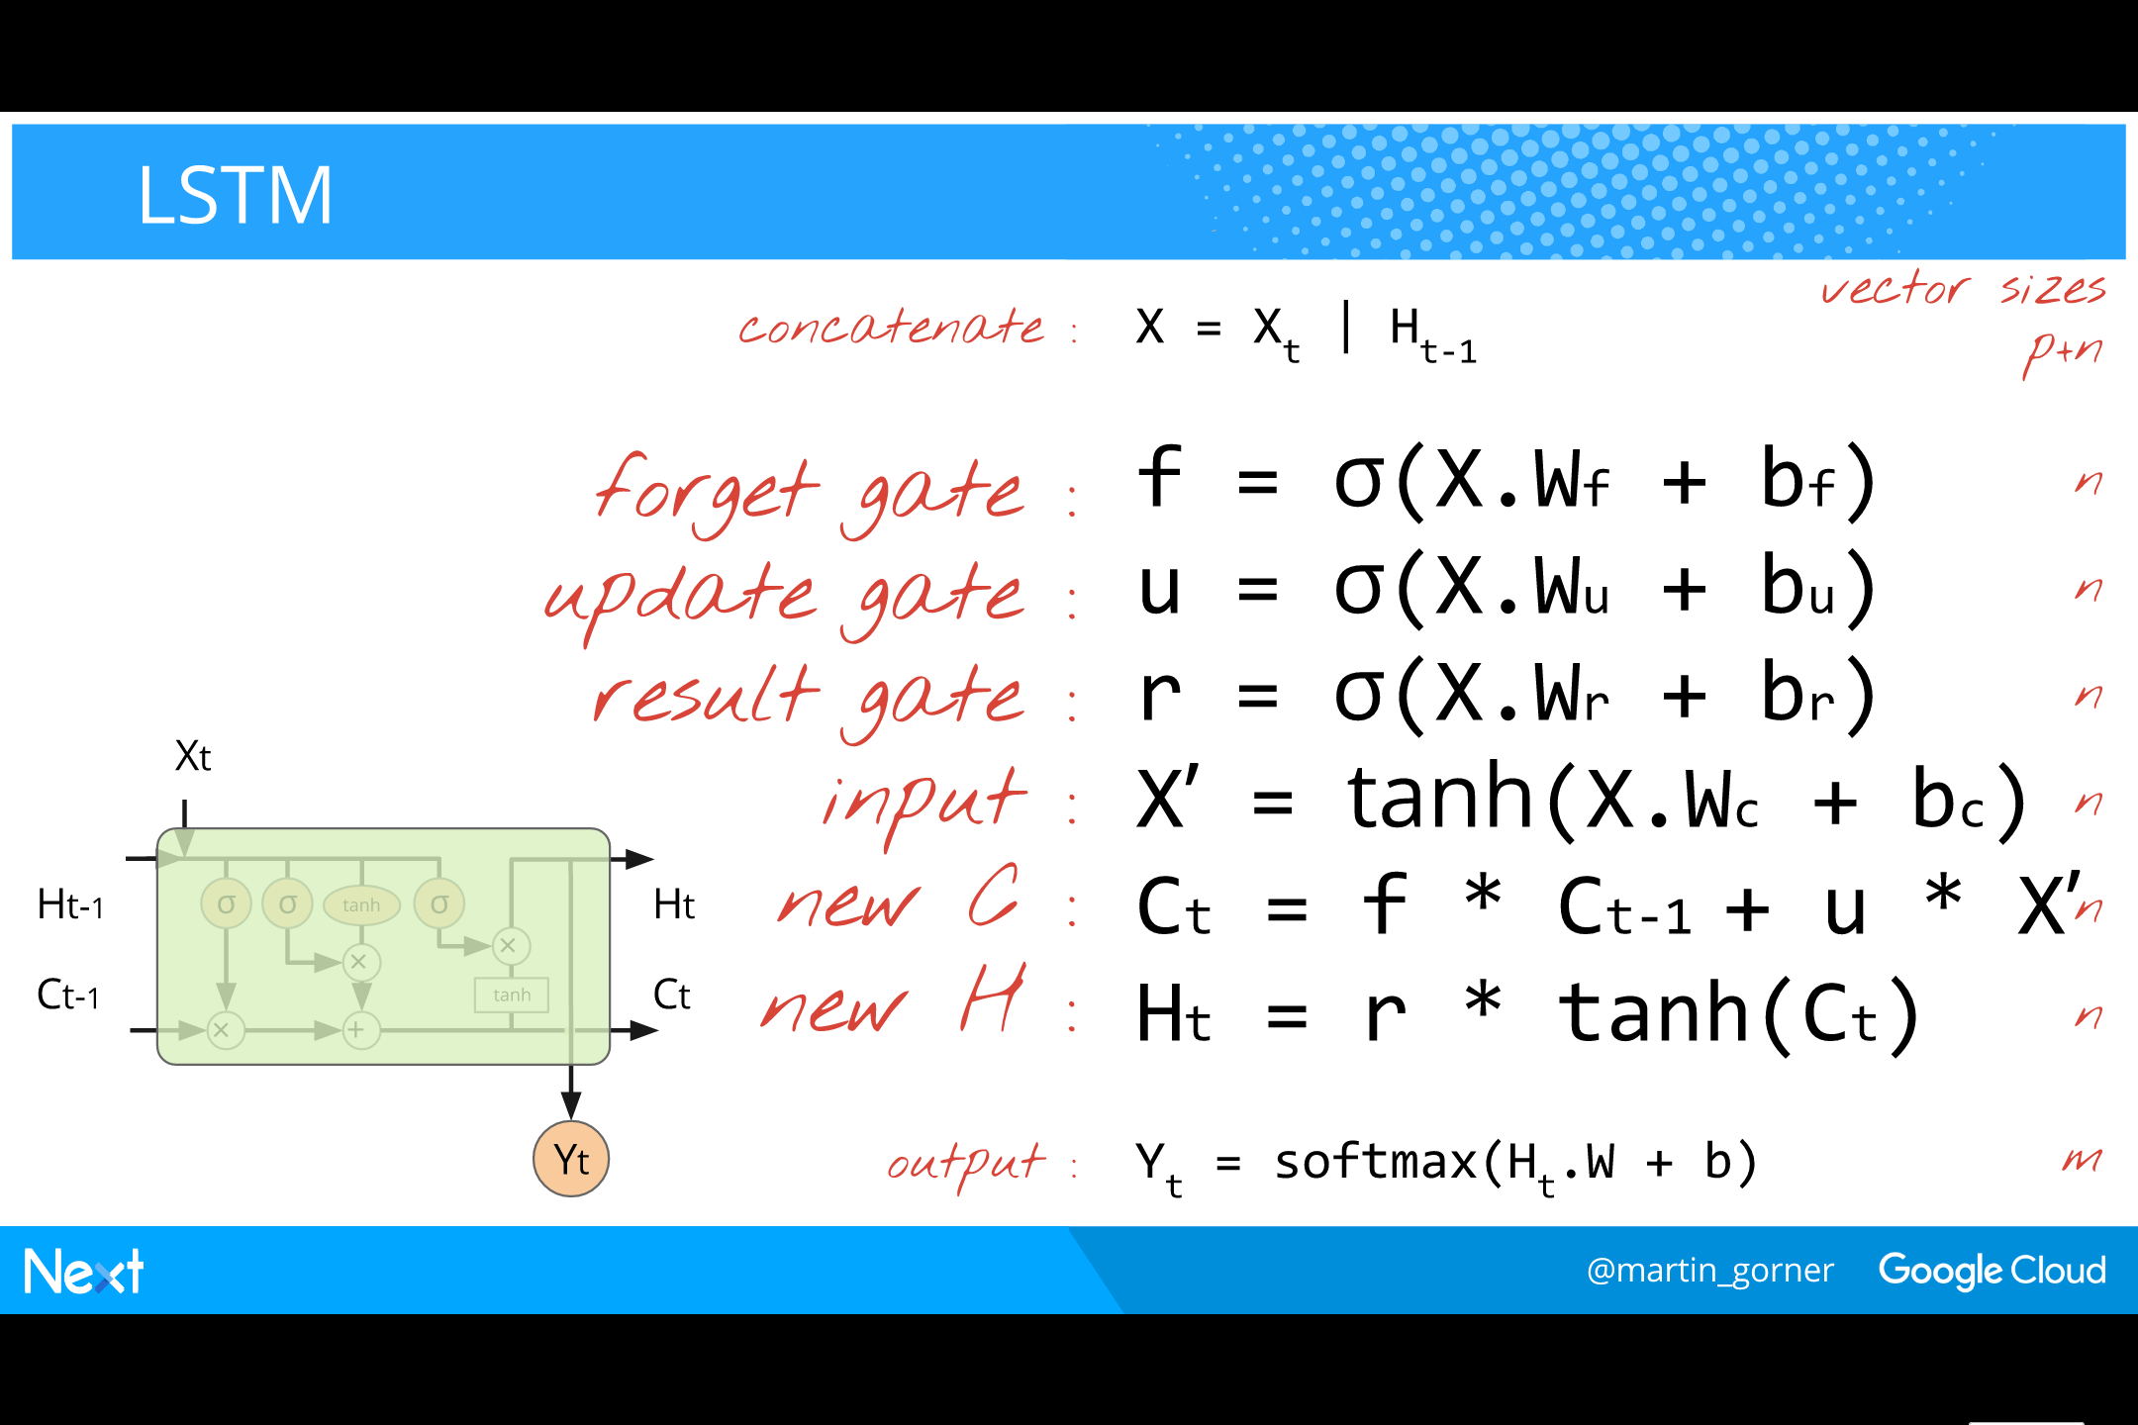
Notes:
在实践中，LSTM 有效是因为它基于了门（gates) 的概念:
The idea is that the cell has an internal memory and at each step, based on the inputs, itl will select:
What to forget from the memory
What new data to store into the memory
What data from the memory to send to the output
​
The memory is vector of n values (n = the internal cell size. Actually, all vectors in the cell are of size n)
The “selection” is performed by computing another vector of size n where all elements have values between 0 and 1 and multiplying it by the memory vector.
These selection vectors will be called “gates” and they are computed as the outputs of a sigmoid-activated neural network layer.
​
Here is the algorithmic explanation of an LSTM:
We construct the inputs as real inputs concatenated to the state from the previous step
Based on these inputs, we use single-layer neural networks to compute three vectors of size n - a forget gate - an update gate - a result gate These three neural net layers use the sigmoid activation to produce values between 0 and 1 (good for “gating” by multiplication)
We adapt the size of the real input vector X to make it compatible with the internal size n again using a single-layer neural network (necessary for next step). This step does not need to output a value between 0 and 1. It is not a gate. Any activation function is OK here. Tanh is usual. This step corresponds to the single tanh step of the basic RNN cell.
The new memory vector Ct is is a combination of the old memory vector and of the real inputs. The amount of previous memory is gated by the forget gate. The amount of new data to memorise is gated by the update gate.
In addition to the memory C, an LSTM still has a state vector H, which is what will drive the softmax layer. It is computed by gating the new memory vector by the result gate. A tanh is used to force the scale of the C values between -1 and 1. Notice that Ct is the sum of two terms and could therefore grow above 1.
This is the end of the LSTM cell. If outputs are needed, they are computed with an additional softmax layer.

Slide 32

Notes:
Many variations of the LSTM cell concept have been designed.
A recent paper found them all roughly equivalent in performance.
​
The one getting a lot of use recently is the cheapest one: the GRU

Slide 33
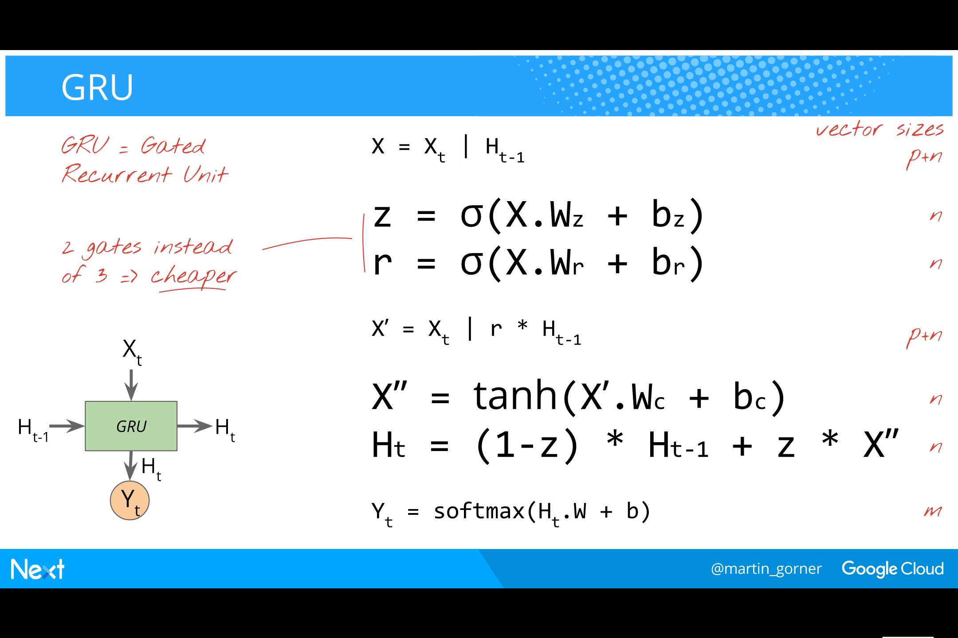
Notes:
GRU 的等式：
The GRU (Gated Recurrent Unit) achieves roughly the same thing as the LSTM, but using 3 neural network layers instead of 4. It is therefore cheaper (the layers are all of size n. Remember, everything is of size n inside an RNN cell)
​
A GRU has a combined forget/update gate z, and a retain gate r.
​
The algorithmic explanation is:
We construct the inputs as real inputs concatenated to the state from the previous step
Based on these inputs, we use single-layer neural networks to compute two vectors of size n - a z gate - an r gate
We compute a second type of inputs X’ by concatenating real inputs X with, this time, a gated version of the input state. The r gate is used here to gate how much of the previous state is retained for the rest of the computation.
A neural net layer is used to compute a candidate output X”. This step does not need to output a value between 0 and 1. It is not a gate. Any activation function is OK here. Tanh is usual. This step corresponds to the single tanh step of the basic RNN cell.
The new output state is computed as a combination of the previous state and the candidate output X”. The combination is gates by (1-z) and z. That is why z is a combines forget/update gate.
This is the end of the LSTM cell. If outputs are needed, they are computed with an additional softmax layer.

Slide 34
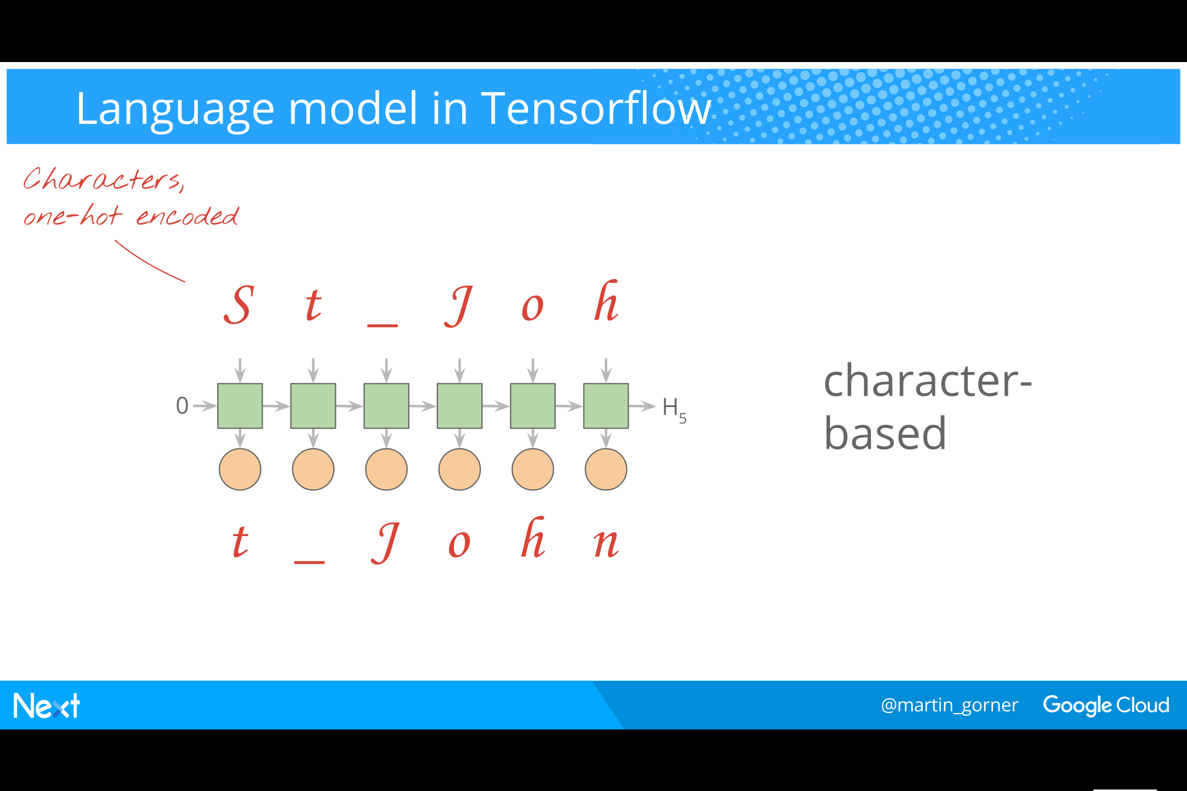
Notes:
We will use an RNN to build a character-based language model.
The RNN model is unrolled.
A sequence of characters is applied on its inputs (one-hot encoded)
The same sequence shifted by 1 is used as “expected outputs”.
​
This trains the RNN to predict the next character.

Slide 35
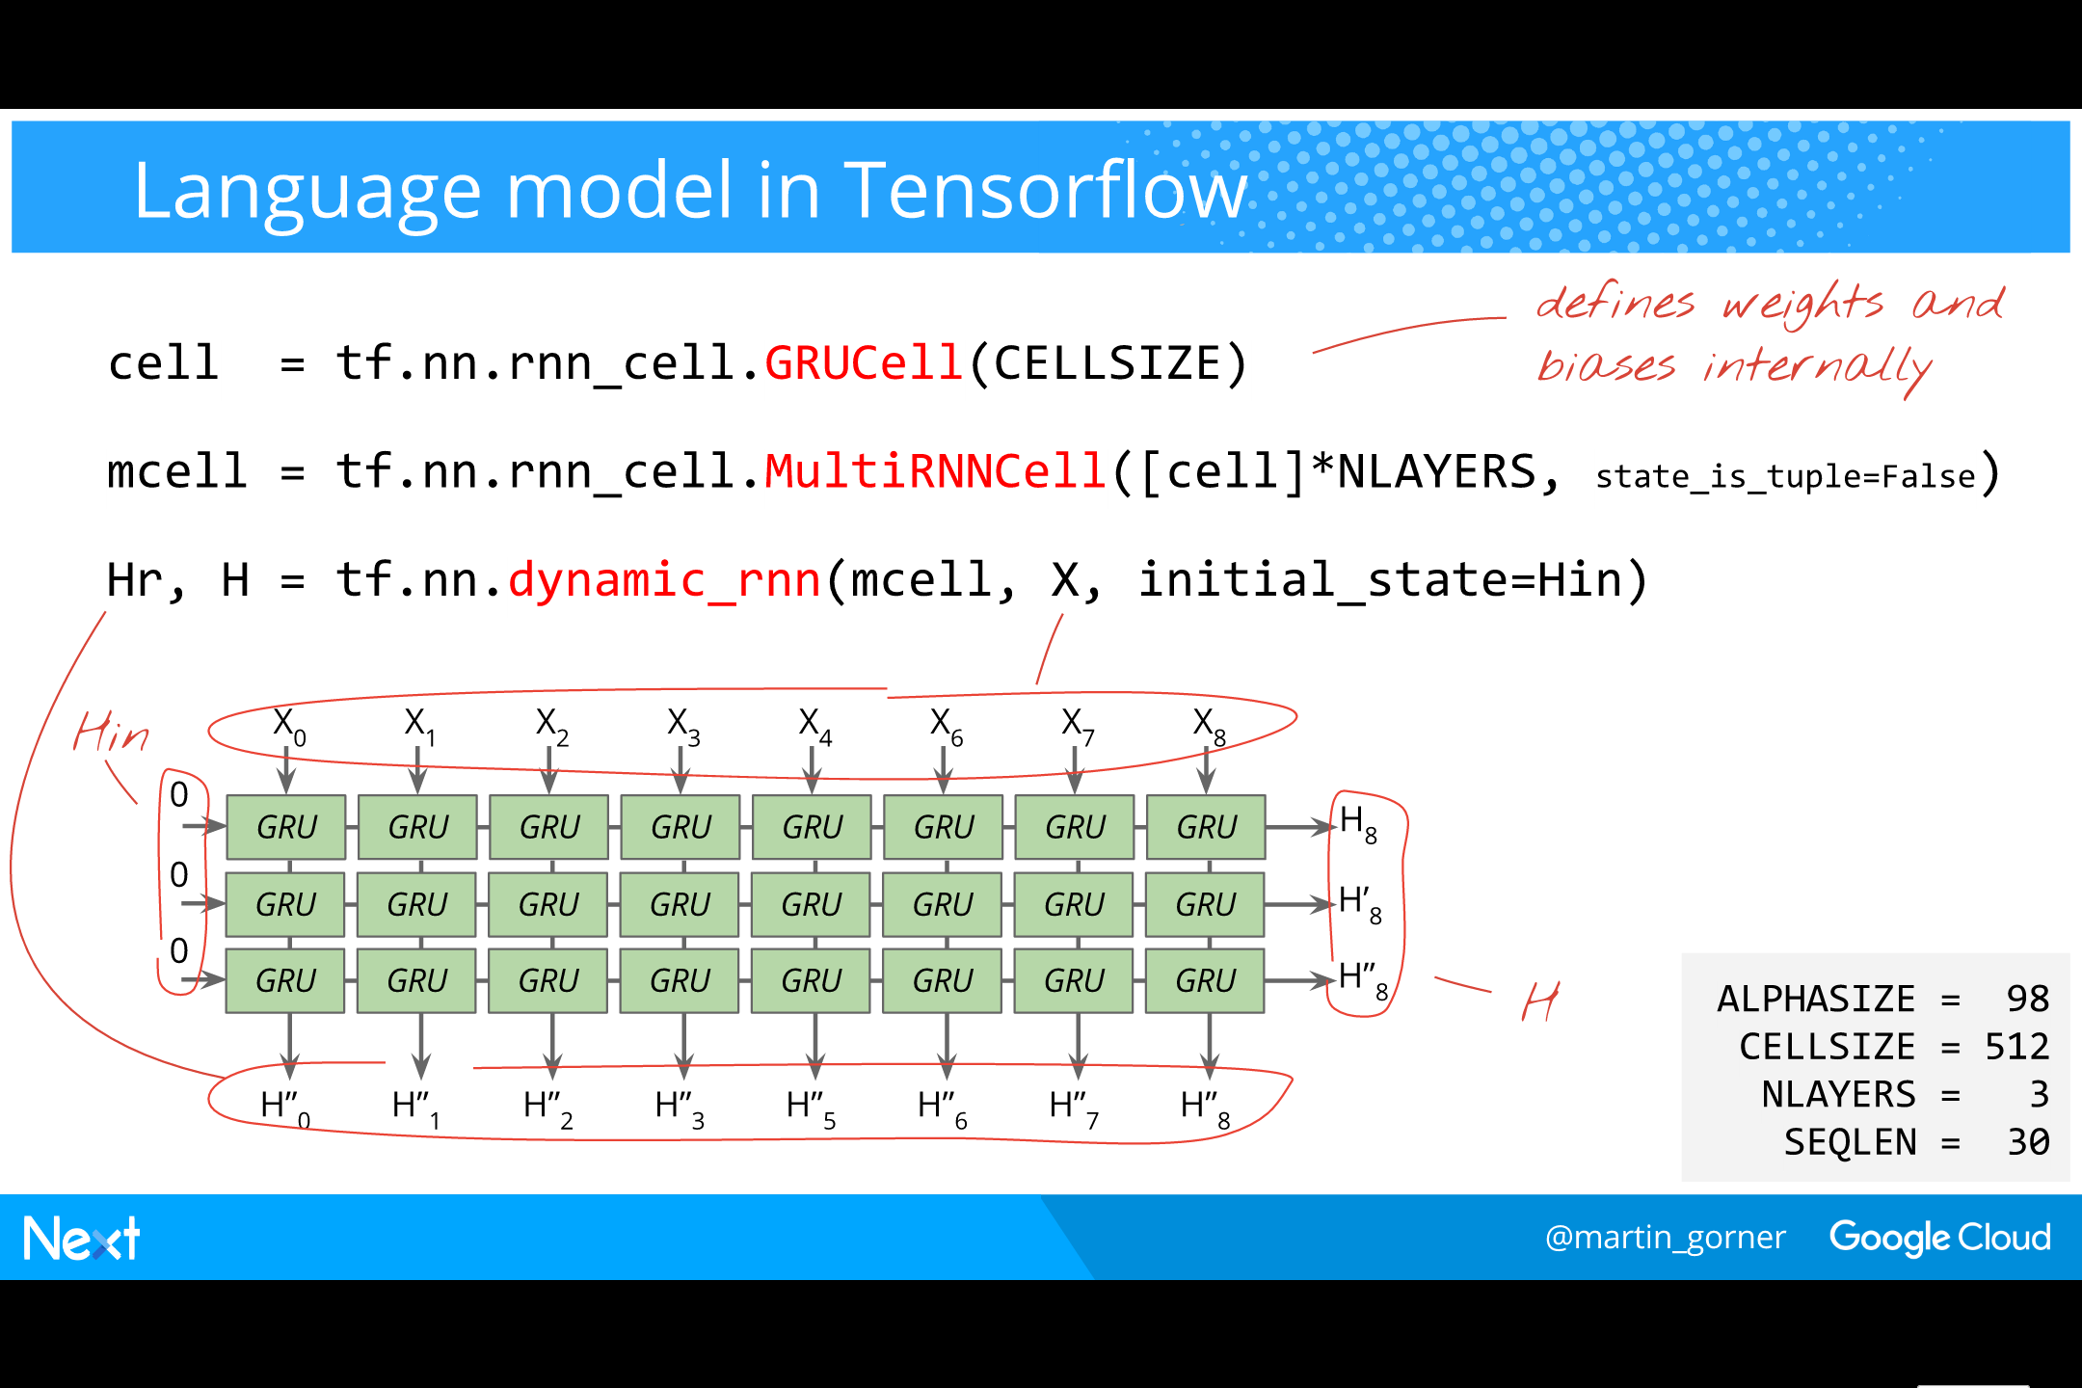
Notes:
在 TensorFlow 中实现 RNN 语言模型
接下来就是如何用 TensorFlow 实现语言模型的循环神经网络了。在教授语言模型预测单词的下一个字符是什么的例子中，Gorner 使用了 TensorFlow 中更高等级的 API。图中的 GRUCell 有着多层的循环神经网络层、两个门。然后把网络做的更深，3 个 GRU 堆叠在一起。接下来，展开整个网络，在 TensorFlow 中，这被称为动态 RNN 功能。最终得到如下结果。
Tensorflow has a really neat RNN API.
​
Pick a cell, here a GRUCell. Calling this also creates all the necessary weights and biases in the background. Remember that a cell size defines the size of all of its internal vectors. Here we choose CELLSIZE=512
Stack this cell 3-high to build a multi-layer RNN. Tensorflow has the MultiRNNCell function for that. It outputs a stacked cell but fortunately, stacked and simple RNN cells have the same API: input, outputs and a state. The state vector is simply bigger for stacked cells. The can be used in the same way.
Unroll this cell to allow training. dynamic_rnn unrolls the cell as specified by the shape of the input tensor X. It does so “dynamically” by inserting a “while loop” node into the computation graph, rather than replicating the cell a fixed number of times in the graph. This can be very useful because to process sequences of various lengths (we will not use this capability here though). We unroll the cell 30 times.
​
The complete RNN takes a 30-character sequence as input (characters one-hot encoded as vectors of ALPHASIZE=98 elements, i.e. a-z, A-Z, 0-9 and a handful of punctuation characters)
​
The RNN is 3 layers deep: NLAYERS=3
​
Its output state H is the output state of the last cell in the unrolled sequence. We have 3 layers so the output state is made of NLAYERS=3 vectors of CELLSIZE=512 elements. This is the state that needs to be passed in for the next sequence.
​
The output Hr to be used in a subsequent softmax layer to produce predicted characters is the output of the last layer. In a GRU cell, the output state and the “output for softmax” are the same thing. The RNN is unrolled SEQLEN=30 times so there are 30 output vectors of size CELLSIZE=512

Slide 36
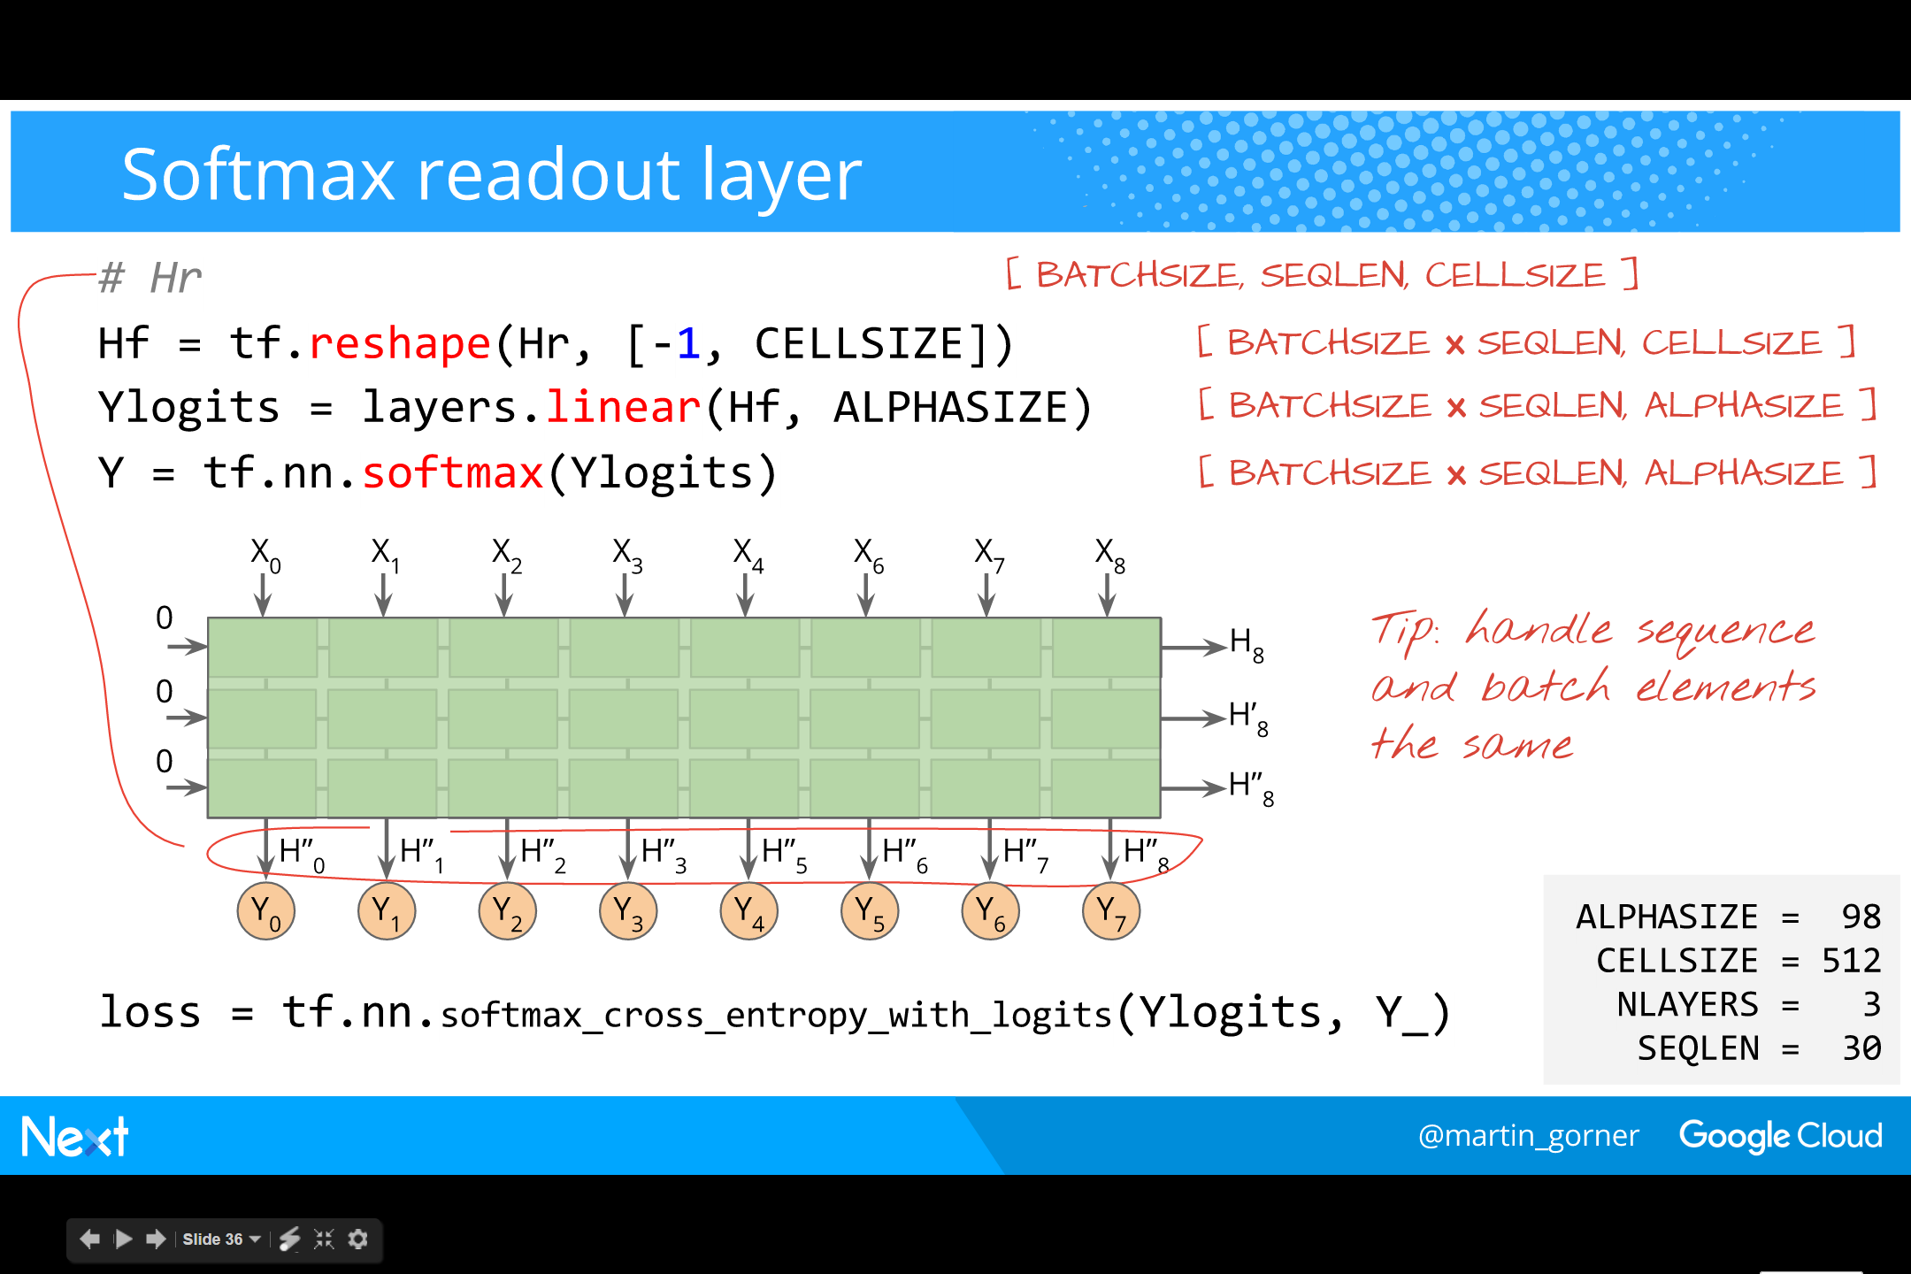
Notes:
图演示了如何在 TensorFlow 中实现 Softmax 层。
Problem: when unrolling the RNN, replicated cells share the same weights and biases
If we add a softmax layer, the SEQLEN=30 sets of weights and biases in this layer must be shared as well.
​
How do we solve that ?
Hint: as always, we will be processing sequences in batches. The first dimension of all of our tensors is the batch size. Each sequence in the batch is processed using the same weights and biases as the next sequence.
​
Trick: reshape the results and treat results from different unroll steps and results from different mini-batch elements in the same way. This trick will let us define a single softmax layer of input size CELLSIZE=512 and process the SEQLEN=30 outputs from our unrolled RNN through it. That’s the same as sharing the weights.

Slide 37
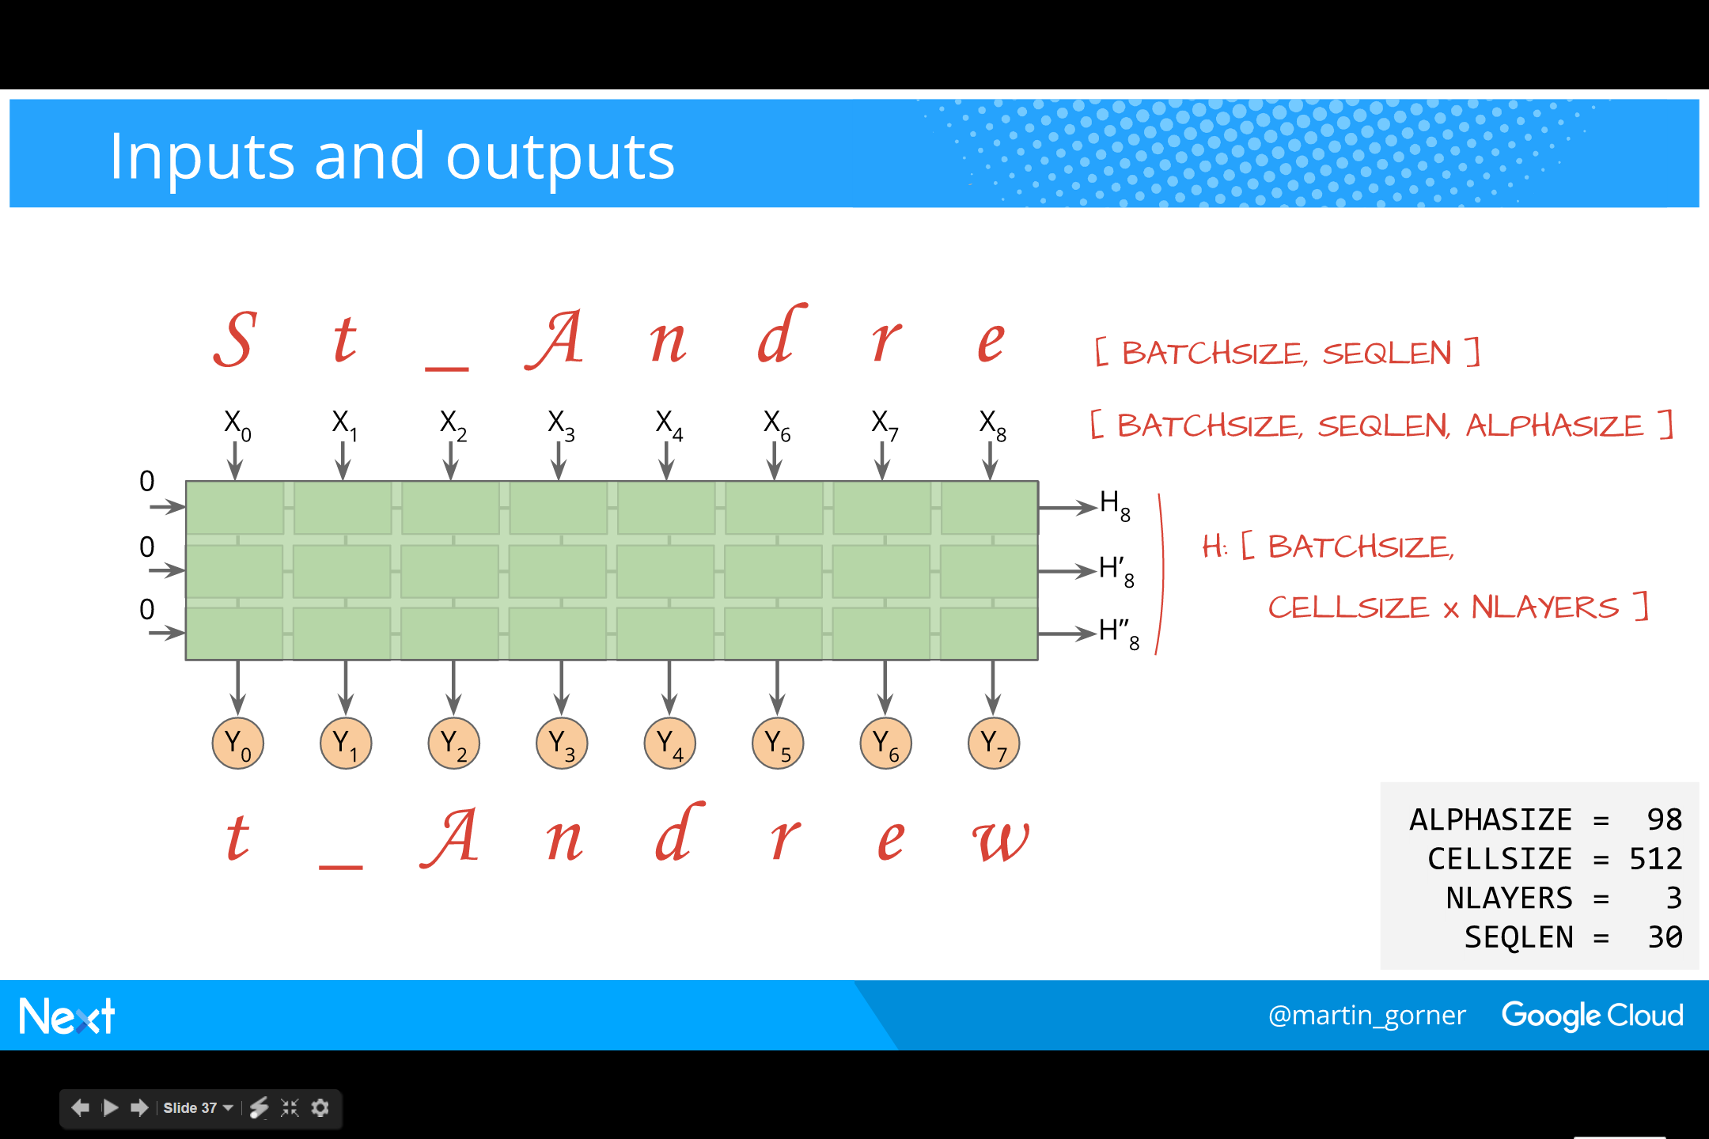
Notes:
就行正确理解 RNN 的工作原理很难一样，向它们正确的输入数据也很难，你会发现里面里面有很多误差。接下来 Gorner 尝试了如何做出正确的输入、得到正确的输出。依此为例，他讲解了所选择的 batchsize、cellsize 和层（如下）。
Wow, lots of vectors and lost of vector sizes flying around…
When constructing an RNN, the hardest part is to get all of the tensor sizes right.
Let us recap.
​
One input character is a one-hot encoded vector of size ALPHASIZE=96
When we unroll the RNN SEQLEN=30 times, its input becomes 30 vectors of size ALPHASIZE
With mini-batching, the first dimension of the input tensor is the size of the batch.
Therefore, the input tensor shape is [BATCHSIZE, SEQLEN, ALPHASIZE]
​
One input or output state vector is, as any vector in an RNN cell, of size CELLSIZE=512
When we stack our cells NLAYERS=3 high, the state vectors get concatenated into a vector of size CELLSIZE * NLAYERS = 512*3
With mini-batching, the first dimension of the state vector is the size of the batch.
Therefore, the state tensor shape is [BATCHSIZE, CELLSIZE * NLAYERS]

Slide 38
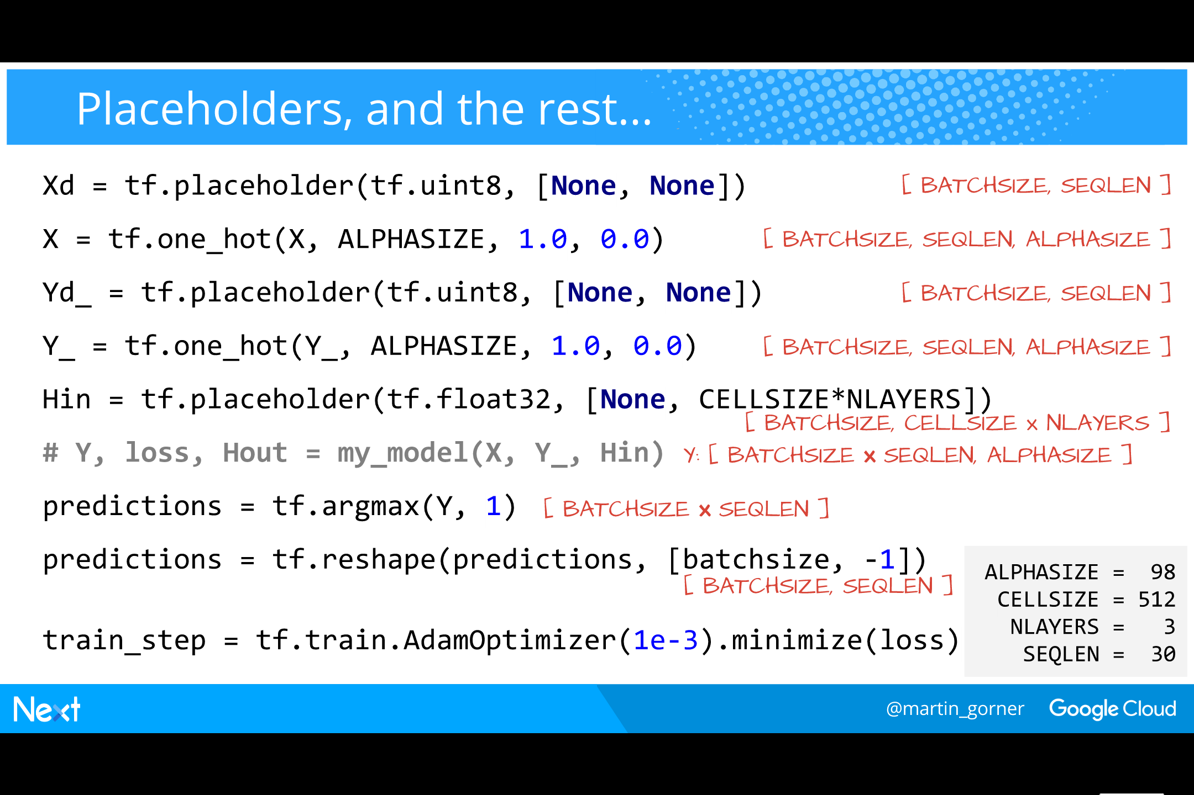
Notes:
各个步骤实现的代码如下：
Input and expected output character sequences are of shape [BATCHSIZE, SEQLEN] i.e. a mini-batch of character sequences as long as the unroll size of the RNN.
We define placeholders of the correct shape for the input and expected output sequences.
We use a Tensorflow helper function to one-hot encode them.
​
We also need a placeholder for the input state of the RNN, of the correct shape, determined on the previous slide.
​
We apply our RNN model, including the softmax layer.
​
With the trick explained previously, a prediction vector (i.e. a one-hot encoded character) comes out for every unroll step of the RNN and for every item in the mini-batch.
That is why the shape of the predictions tensor Y is [BATCHSIZE * SEQLEN, ALPHASIZE]
After reshaping and one-hot decoding, the predictions become, as expected, a batch of predicted character sequences of shape [BATCHSIZE, SEQLEN]
​
Unrolled RNNs can be trained using any of the usual optimisers, for example AdamOptimizer

Slide 39
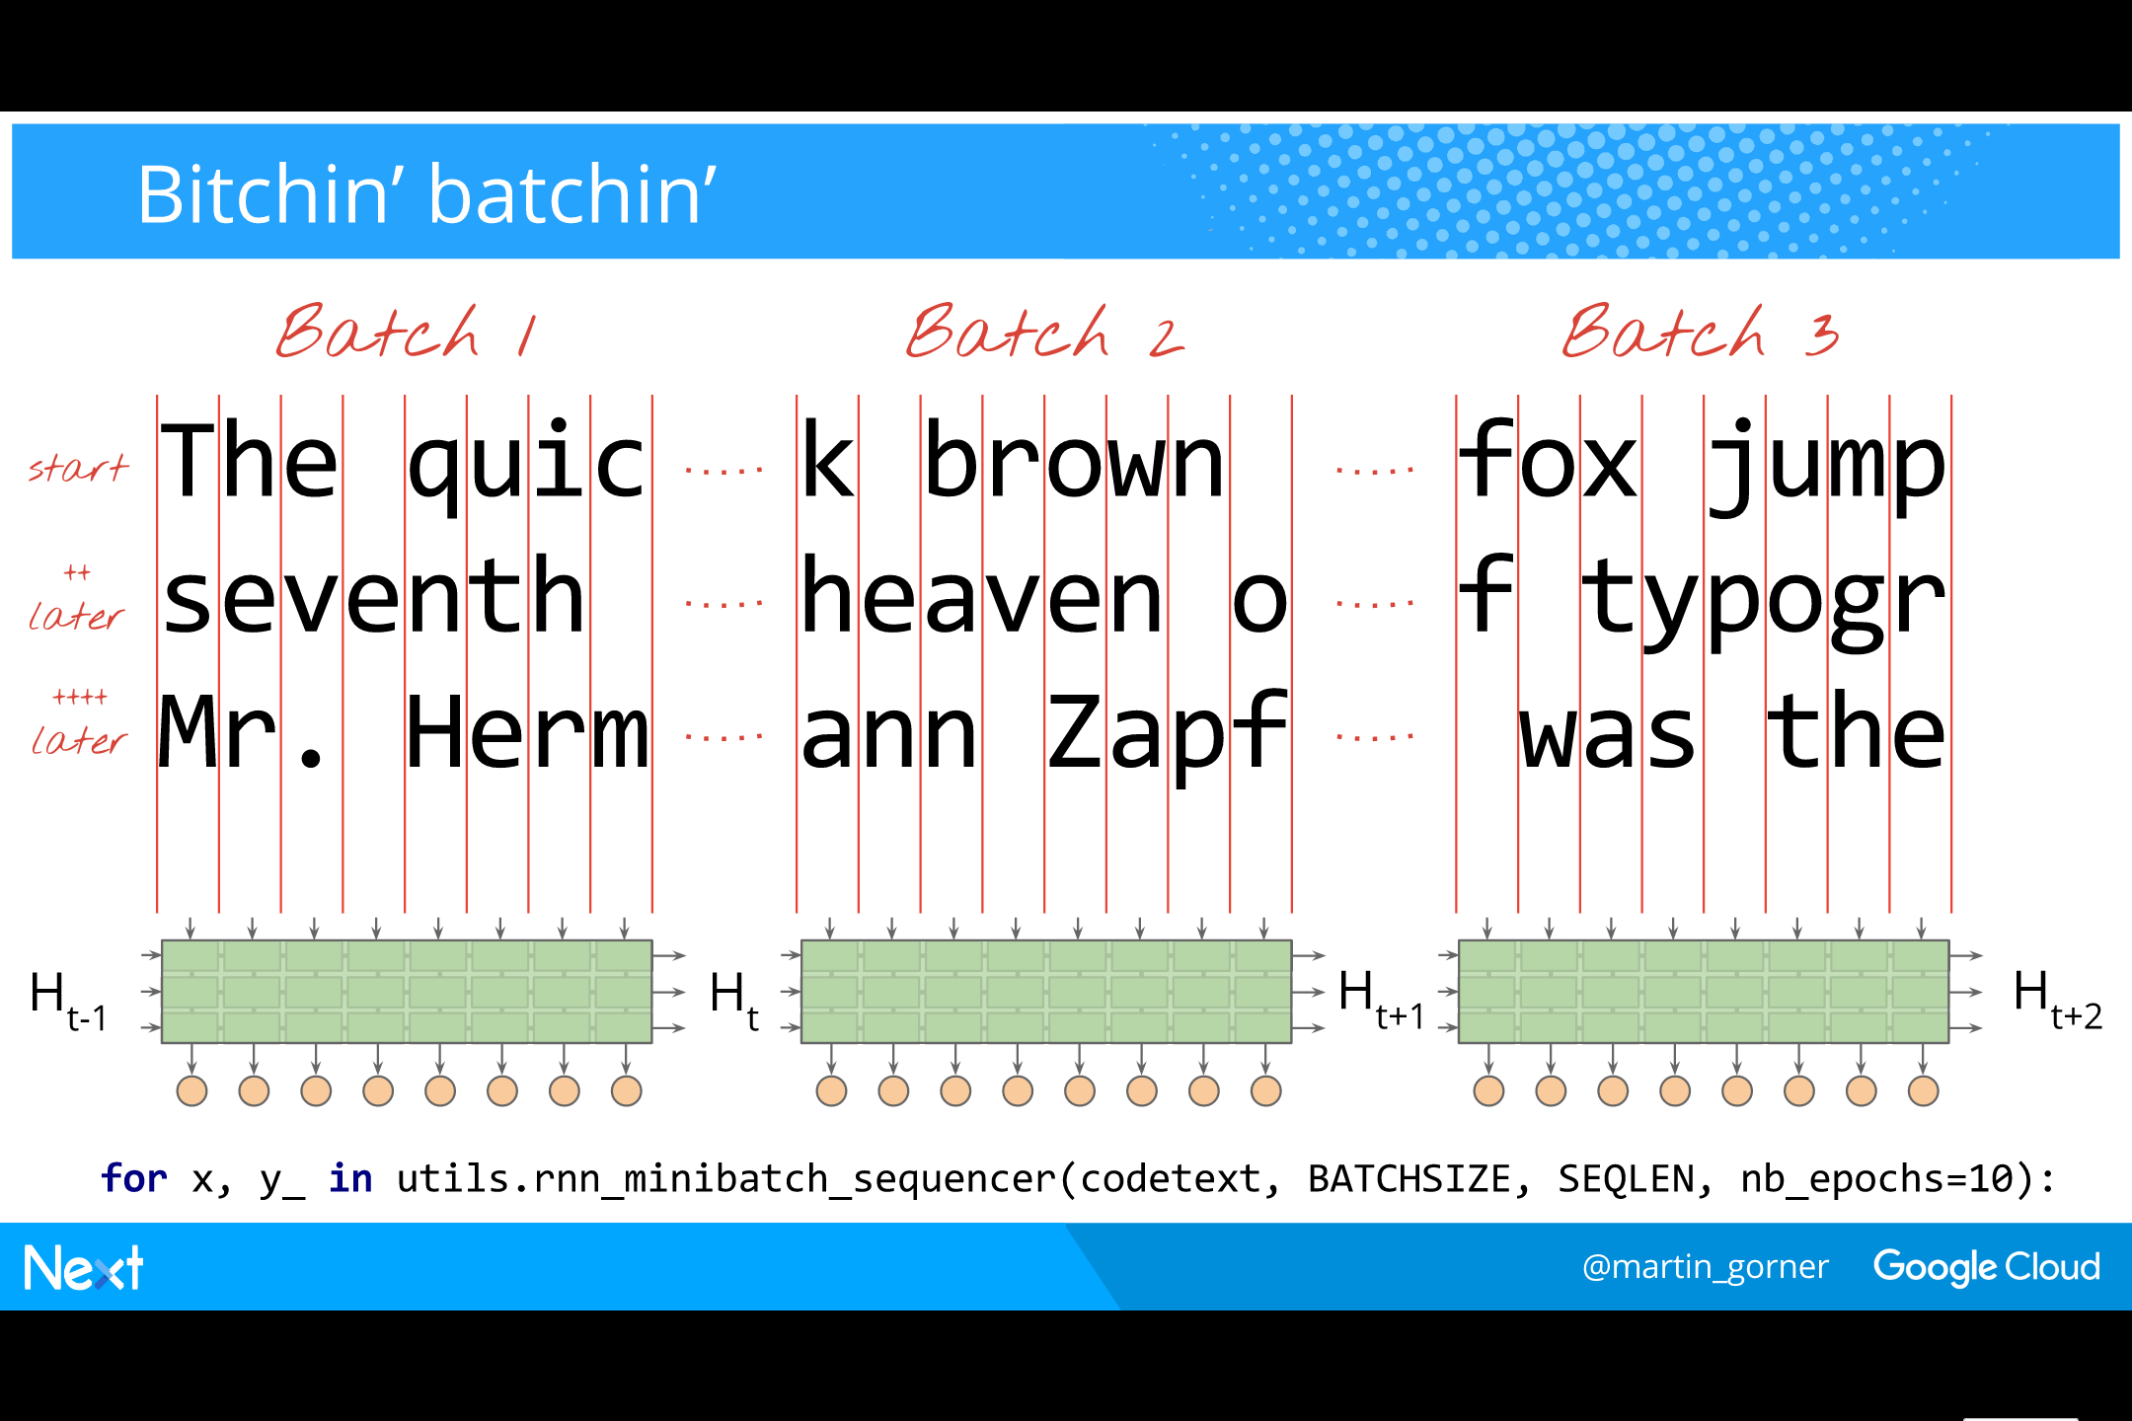
Notes:
What is the correct way of batching sequences of characters ?
​
The first sequence of the first mini-batch will produce an output state that will become the input state in the next run of the RNN.
This means that in the second mini-batch, the first sequence must be the continuation of the previous one, otherwise
We would be processing a sequence using an unrelated input state.
​
So the correct way of batching sequences for this language model is to split the text across the first line of the batches, until the desired number of batches NB is obtained.
From that point, the text is split across the second line of the mini-batches, then across the third lines of batches, and so on.
​
What is desired number of batches NB? It will depend on the number of sequences in a batch (BATCHSIZE) and on the total size of the training text Z.
The dependency is easily determined by stating that you need to fit the entire text exactly once into one epoch of NB batches.
SEQLEN * BATCHSIZE * NB = Z
=> NB = Z / ( SEQLEN * BATCHSIZE )
​
Fortunately a utility function that batches sequences in this way is provided in one of the Tensorflow examples: tf.models.rnn.ptb.reader.ptb_iterator

Slide 40
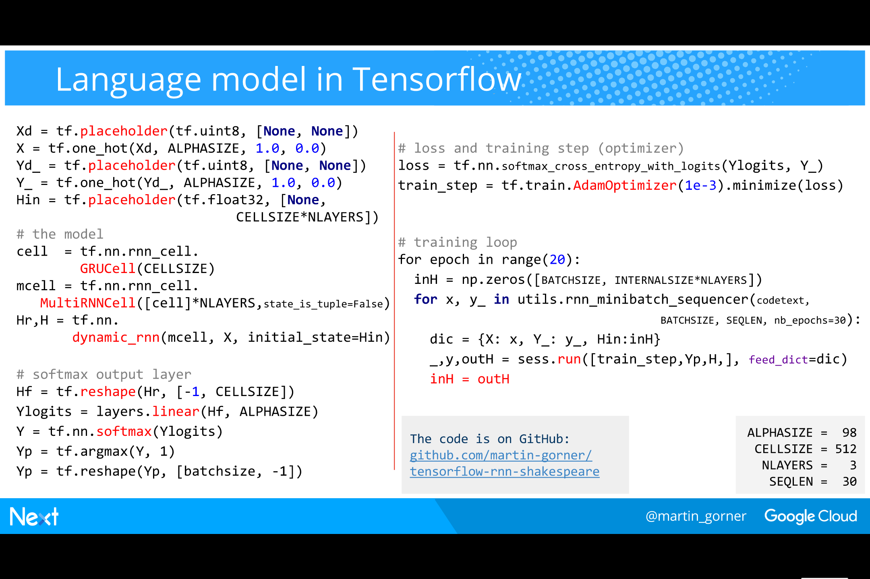
Notes:
在 TensorFlow 中实现语言模型的完整代码如下：
Here is the full code for our language model.
​
In the training loop, we start with a zero input state and then pass the output state from one iteration of the RNN into the input state of the next iteration.
We run the training step (train_step) in each iteration to train the model.

Slide 41
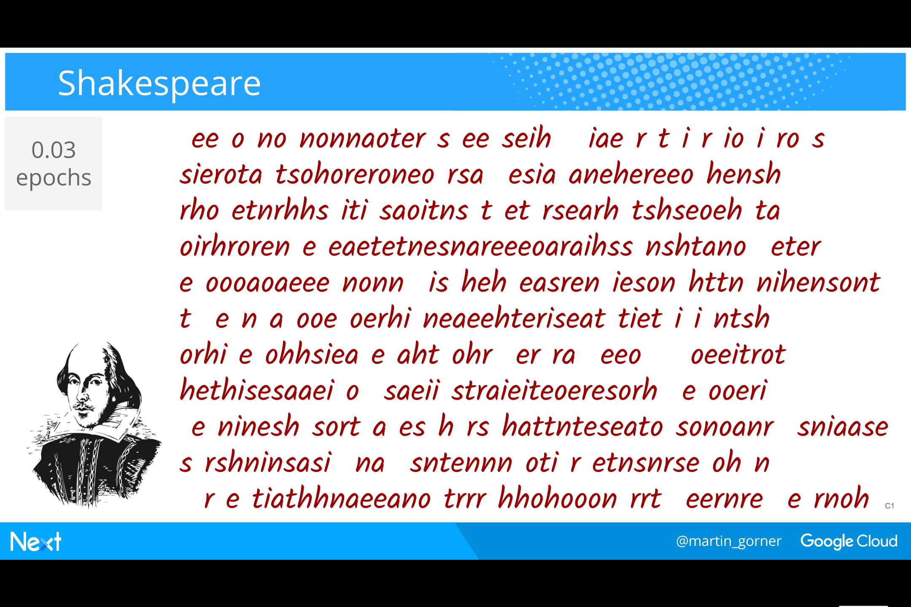
Notes:
With a trained model, we can now generate text, character by character.
​
No need to unroll the RNN for that, a single trained cell will do.
We start from a randomly selected character and a zero input state.
Then we sample from the output probabilities to obtain a character.
​
In the next iteration, we use the state and also the character from the previous iteration as respectively input state and input
​
We can now generate as much text as we want character by character.
​
Let us train our model on the complete works of William Shakespaeare (about 5M characters).
​
Tensorflow has a handy snapshot feature (tf.train.Saver) that we can use to same the state of our model (weights and biases) to disk and reload them later.
​
Initially, after training on only 200K characters (0.03 epochs) the output is gibberish.

Slide 42

Notes:
After just 0.1 epochs of training, we start seeing words and paragraphs.
Capitalised words at the beginning of certain paragraphs prefigure character names.

Slide 43
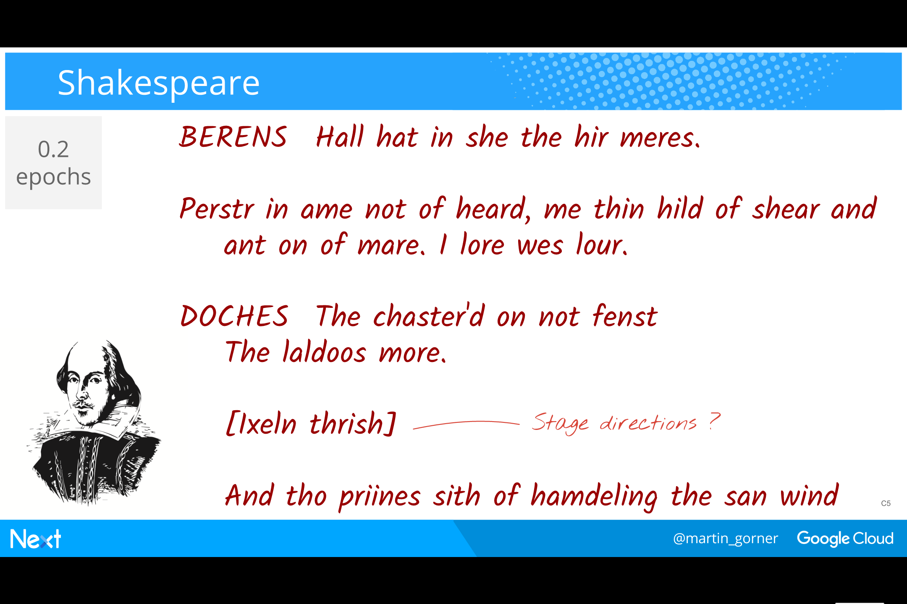
Notes:
After 0.2 epochs, character names are clearly visible and most words are actually english.
An indication in square brackets appears. Could these be stage directions ?

Slide 44

Notes:
After training on the entire Shakespeare corpus once (1 epoch),
We see real character names as well as credible inventions like PORDIA or HENRY BLUTIUS
Almost all the words are now recognisably English. The network has learned how to spell English!

Slide 45

Notes:
Finally, after 30 epochs,
The network can correctly line up a title/act/scene indication.
It invents a location for the scene
It also capitalises words correctly: characters are all caps when they are called by their name but only the first letter is capitalised when they are called by their function (“Chamberlain”, “Lord”)

Slide 46

Notes:
Stage direction are now totally credible and the RNN has even been able to split a verse in the middle across two characters!

Slide 47
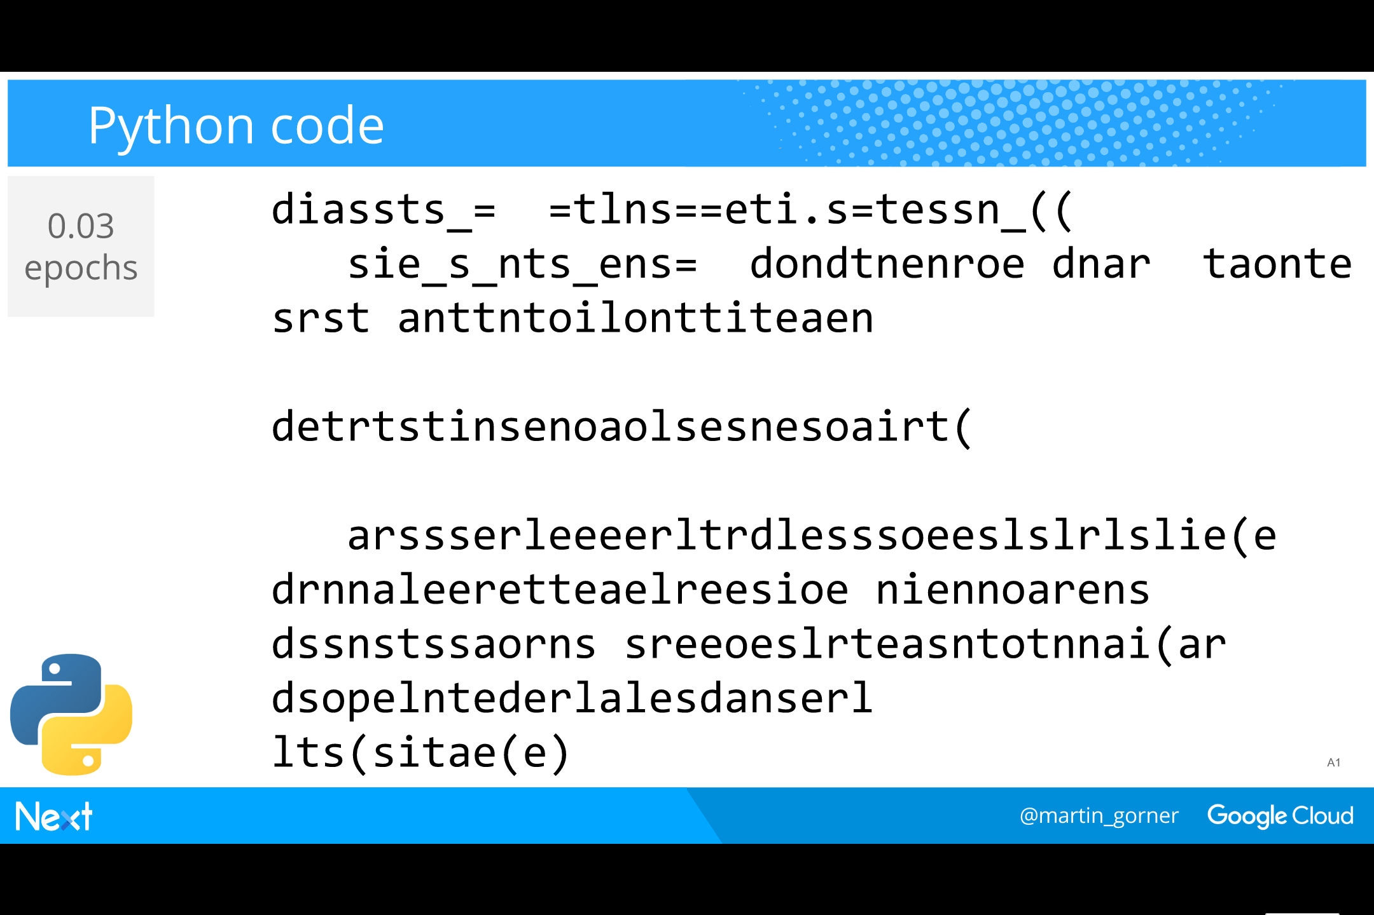
Notes:
We can try to train our language model on the Tensorflow source code (Python files).
​
At the beginning, mostly noise, some structures appear that could make us think about code

Slide 48
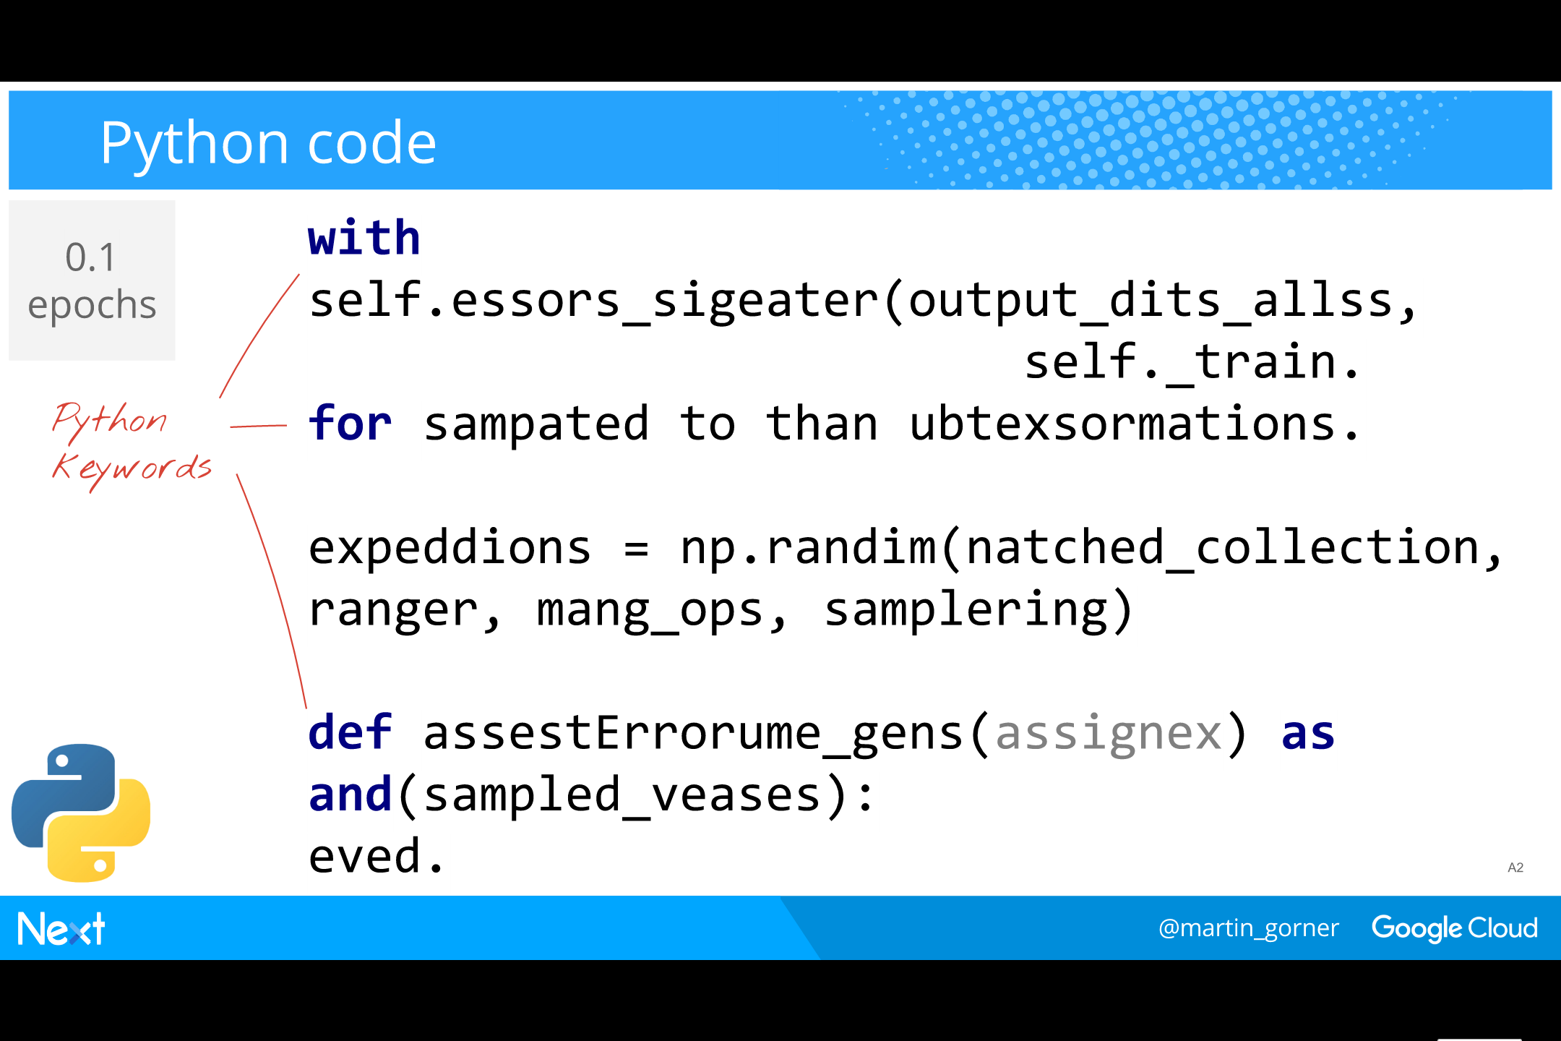
Notes:
At only 0.1 epochs into the training, the generated text looks unmistakably like Python code.
Python keywords are used and some parentheses are opened and closed correctly.

Slide 49
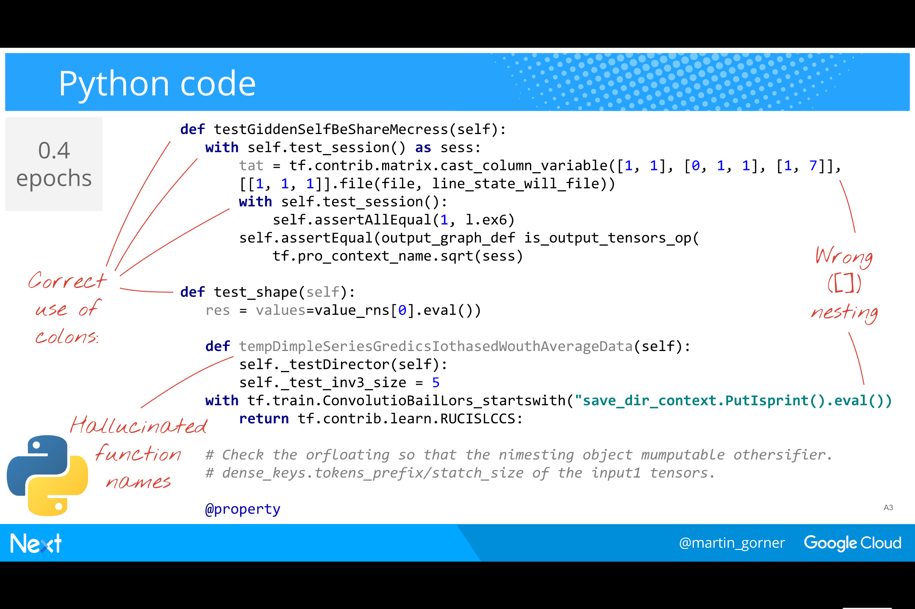
Notes:
At 0.4 epochs the RNN has figured out how to use keywords with colons “:” correctly.
It is also hallucinating credible function names and comments.
You have to look at multiply nested parentheses to find errors.

Slide 50
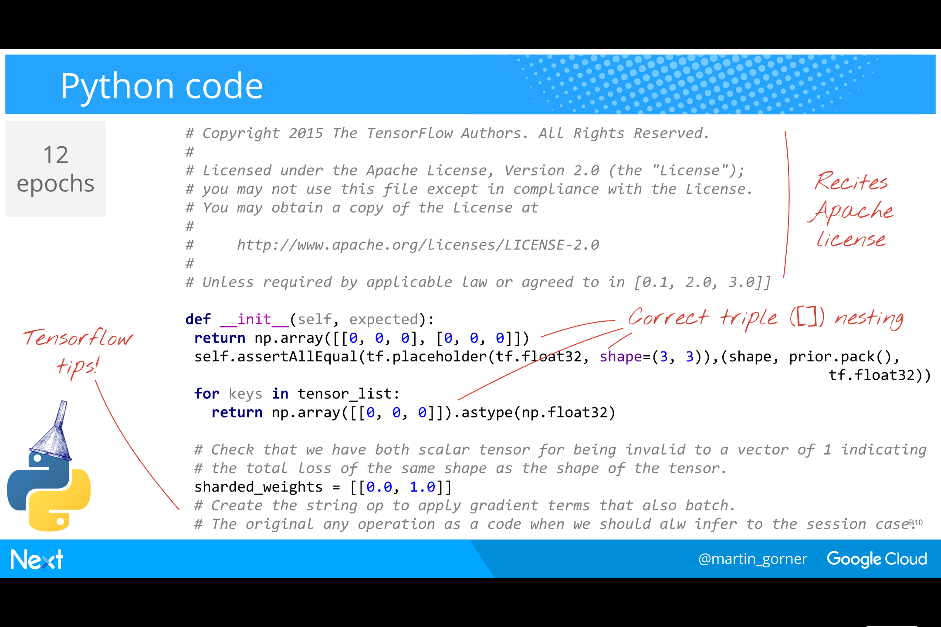
Notes:
Finally, after 12 epochs of training, the RNN is capable of reciting the Apache license and to open and close triple-nested parentheses and brackets.
​
It has also figured out how to write Python comments in proper english and look, it is giving us Tensorflow advice !
​
Please never forget to “apply gradient terms that also batch” and to “always infer to the session case” !!!

Slide 51
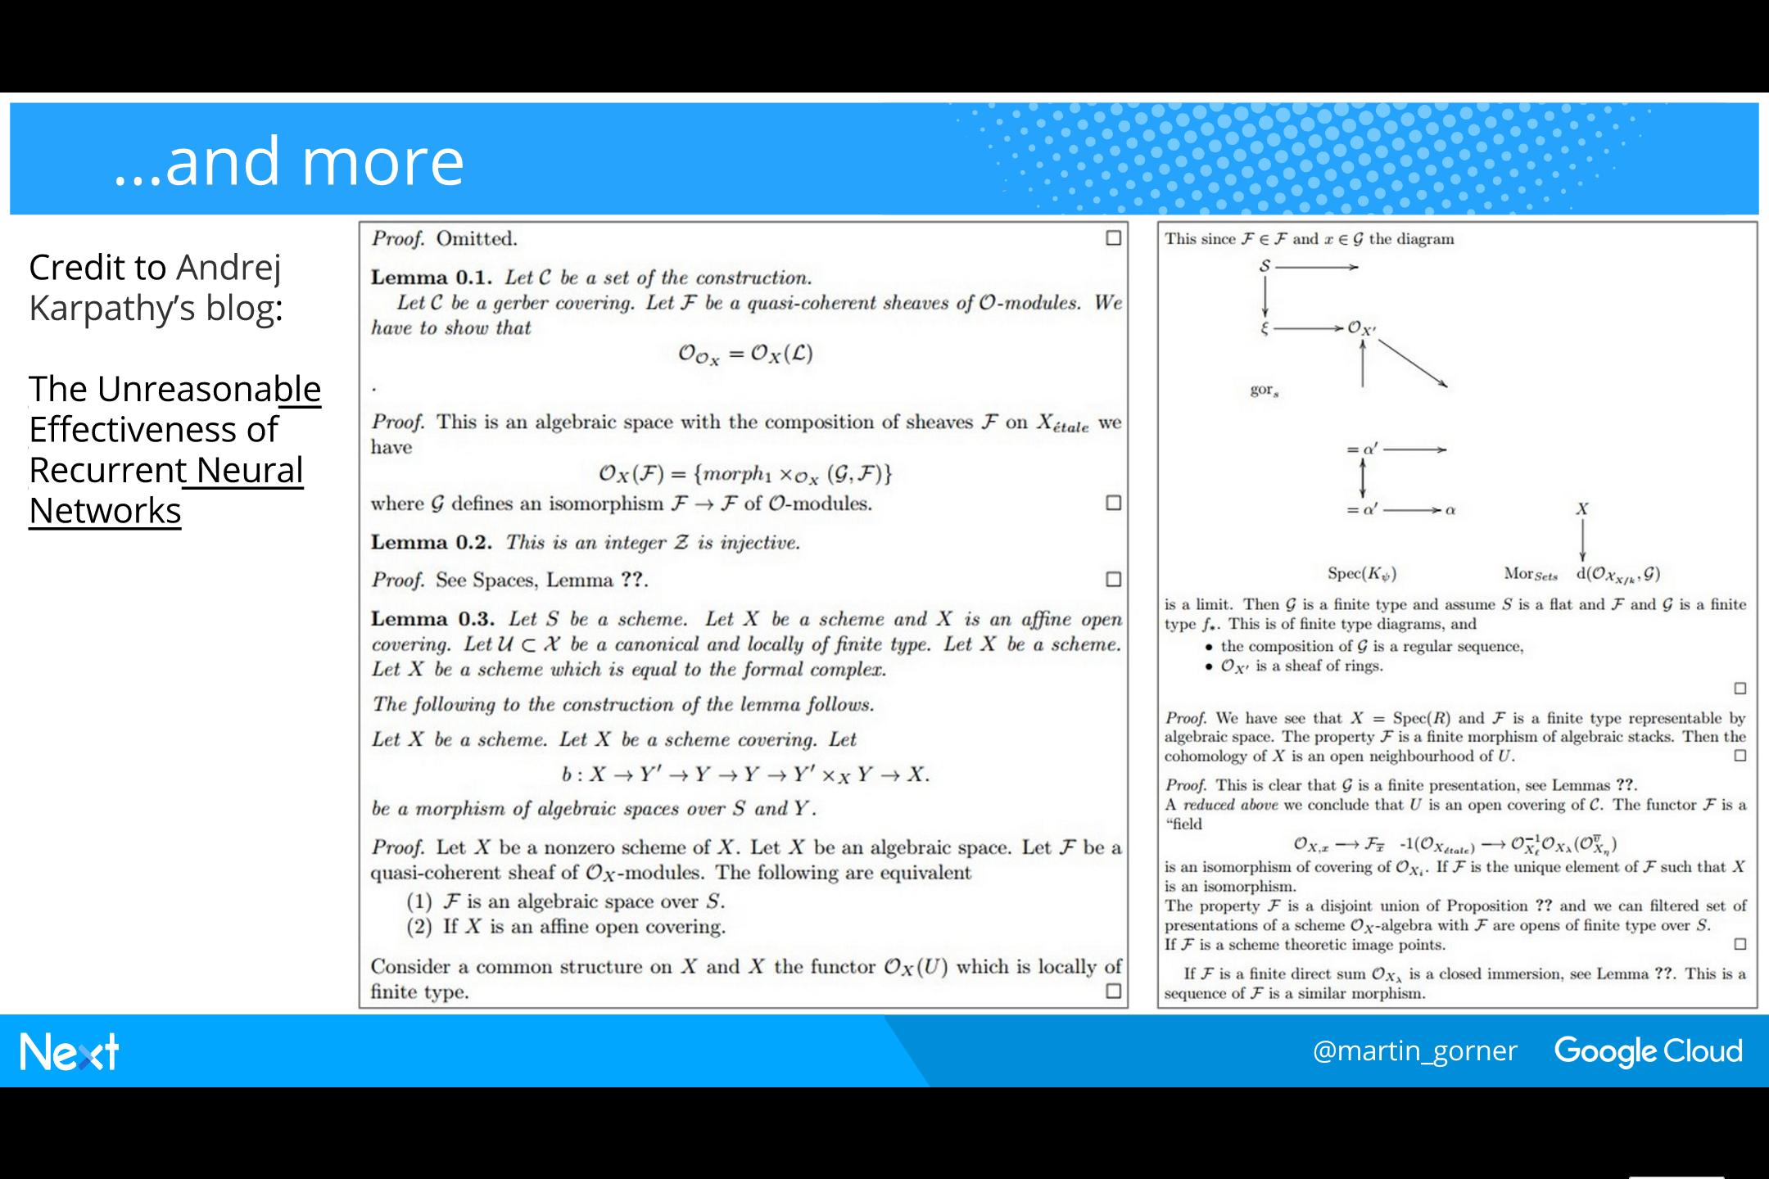
Notes:
This RNN is based on an original idea and blog form Andrej Karpathy: The unreasonable effectiveness of Recurrent Neural Networks.
He also tried to train the network on the Latex source of a geometry book. His RNN was then capable of producing almost-syntactically valid Latex.
With a few manual fixes to make it compile, look, a hallucinated geometry book! On the top of the second page, the RNN even attempted to display a drawing.
​
And it can generate proofs for its hallucinated theorems too. Look at the first line: “Proof. Omitted”
Hmm, that was clever...

Slide 52
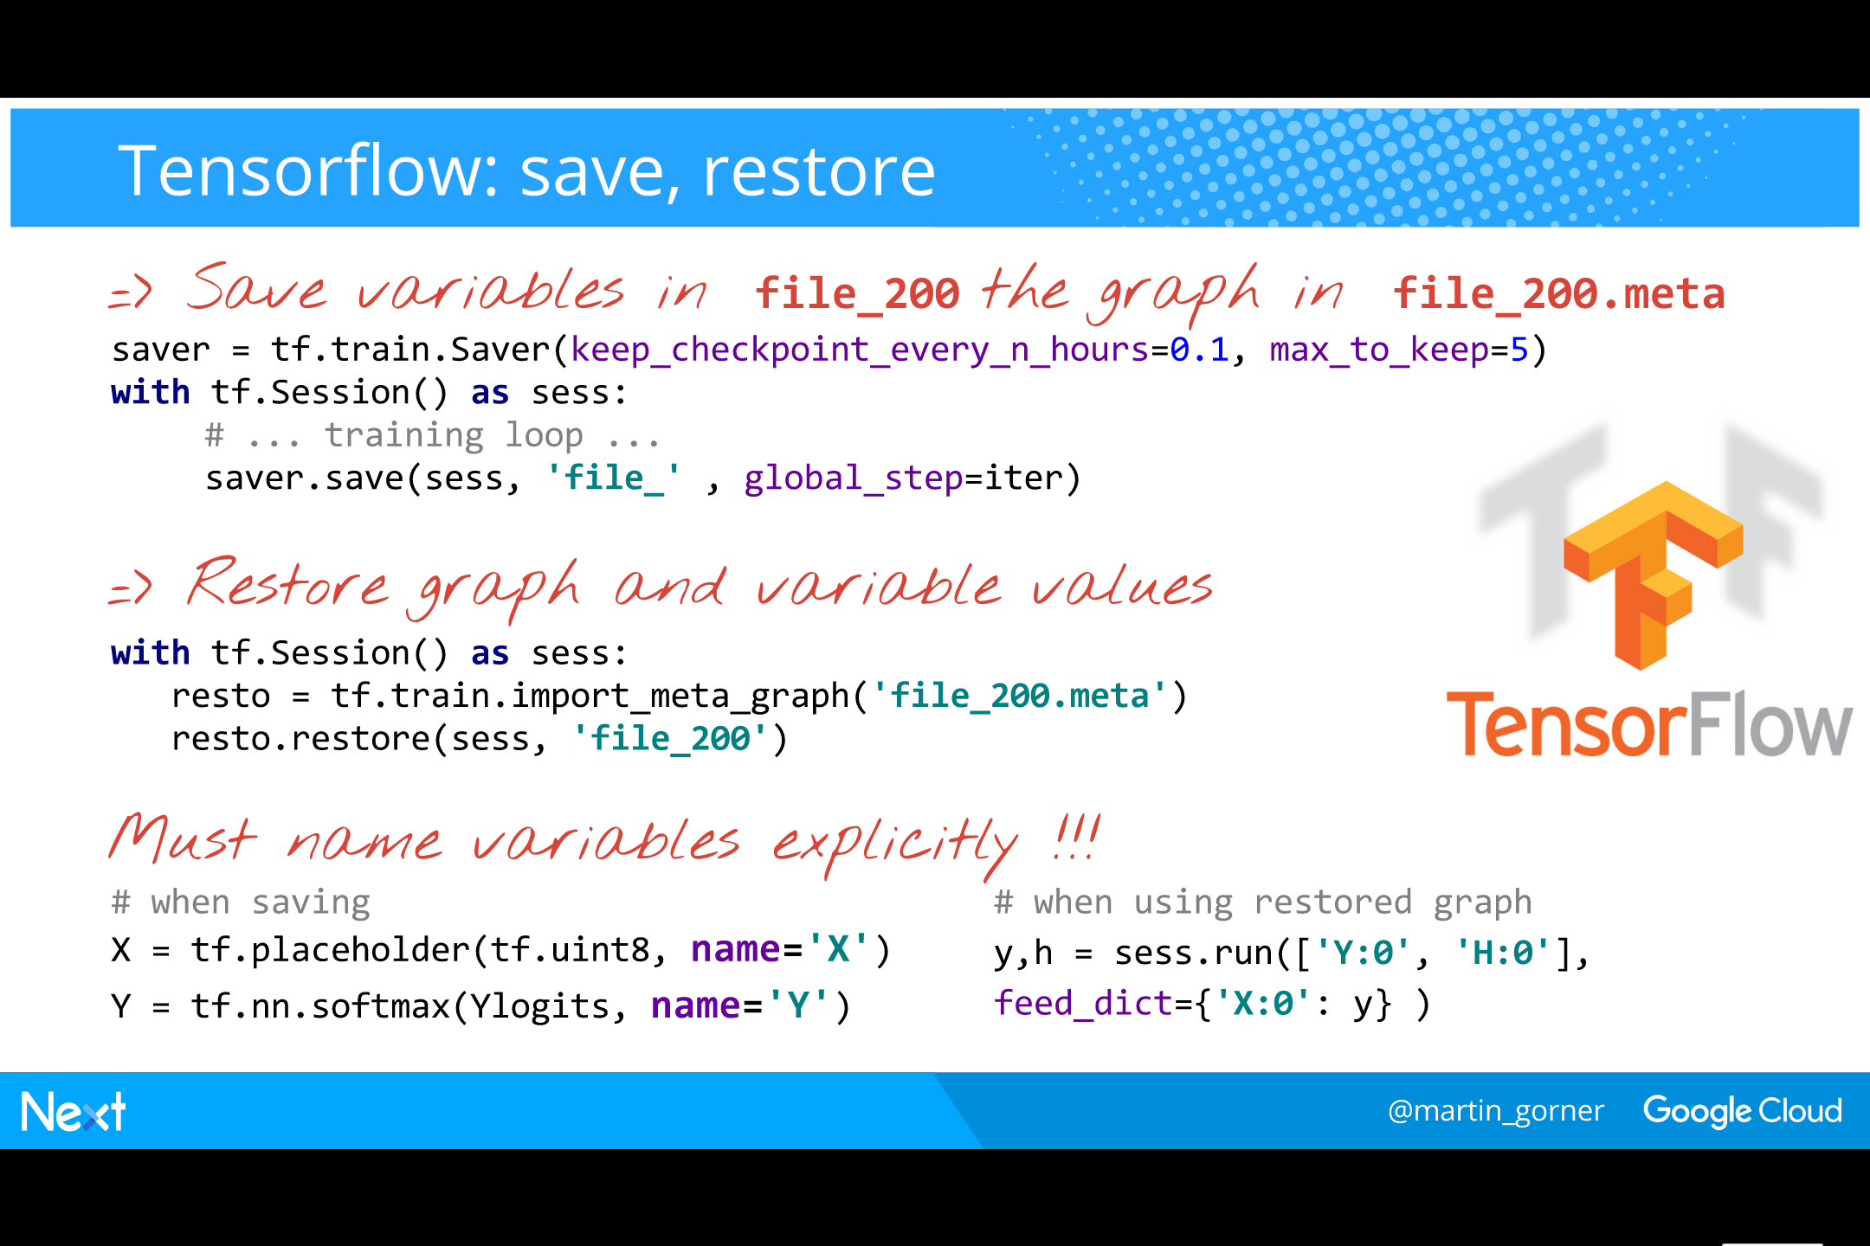
Notes:
Here is the code for saving and restoring a neural network state in Tensorflow.

Slide 53
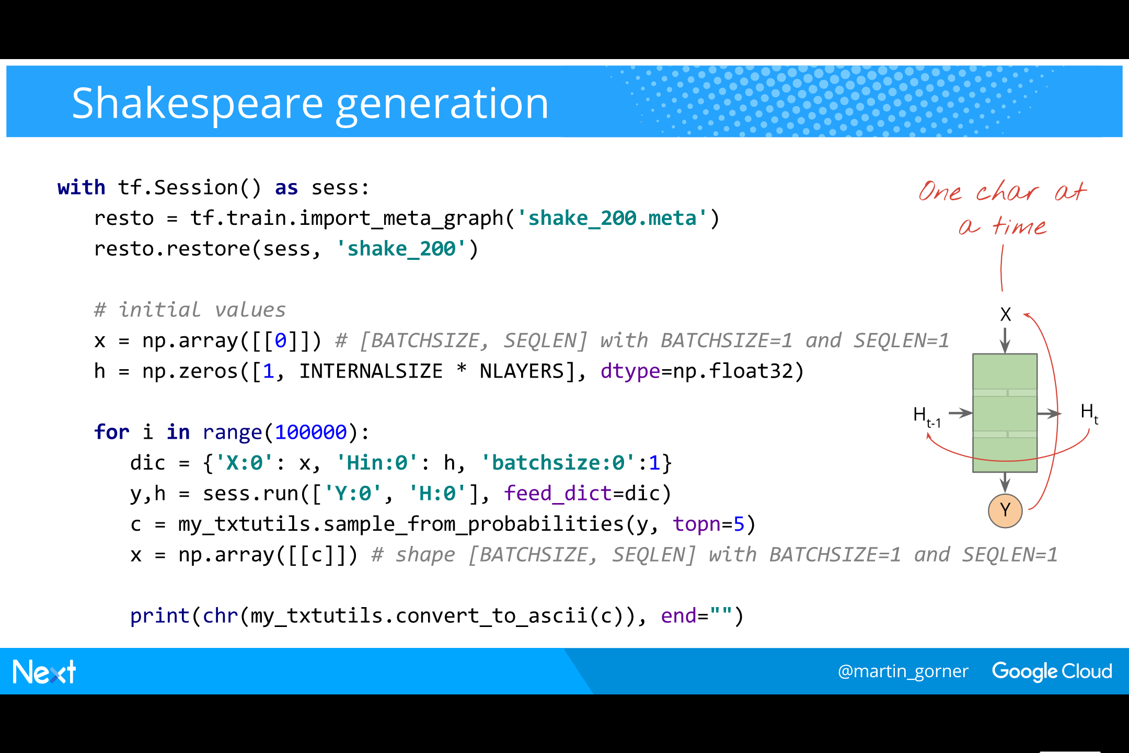
Notes:
Here is the code that uses a trained RNN cell to generate text.
​
We use a single trained RNN cell, restored from a saved state.
​
We start from any character (here 0) and a zero input state.
​
One run through our RNN cell produces a ALPHASIZE=98 long vector of probabilities. These are the probabilities for the next character.
​
We “sample” the next character from those probabilities: we select the next character at random but respecting the probabilities we computed.
There is an option in the code for sampling from the top-n most probable characters only. This gives more English-looking text at the expense of variety.
With topn=1 (always selecting the most probable next character) the generated text is a collation of the most frequent English words: “the of me the for of a …”. Not great.
But topn=2 or 3 are actually good values.
​
In the next iteration, we use the state and also the character from the previous iteration as respectively input state and input

Slide 54
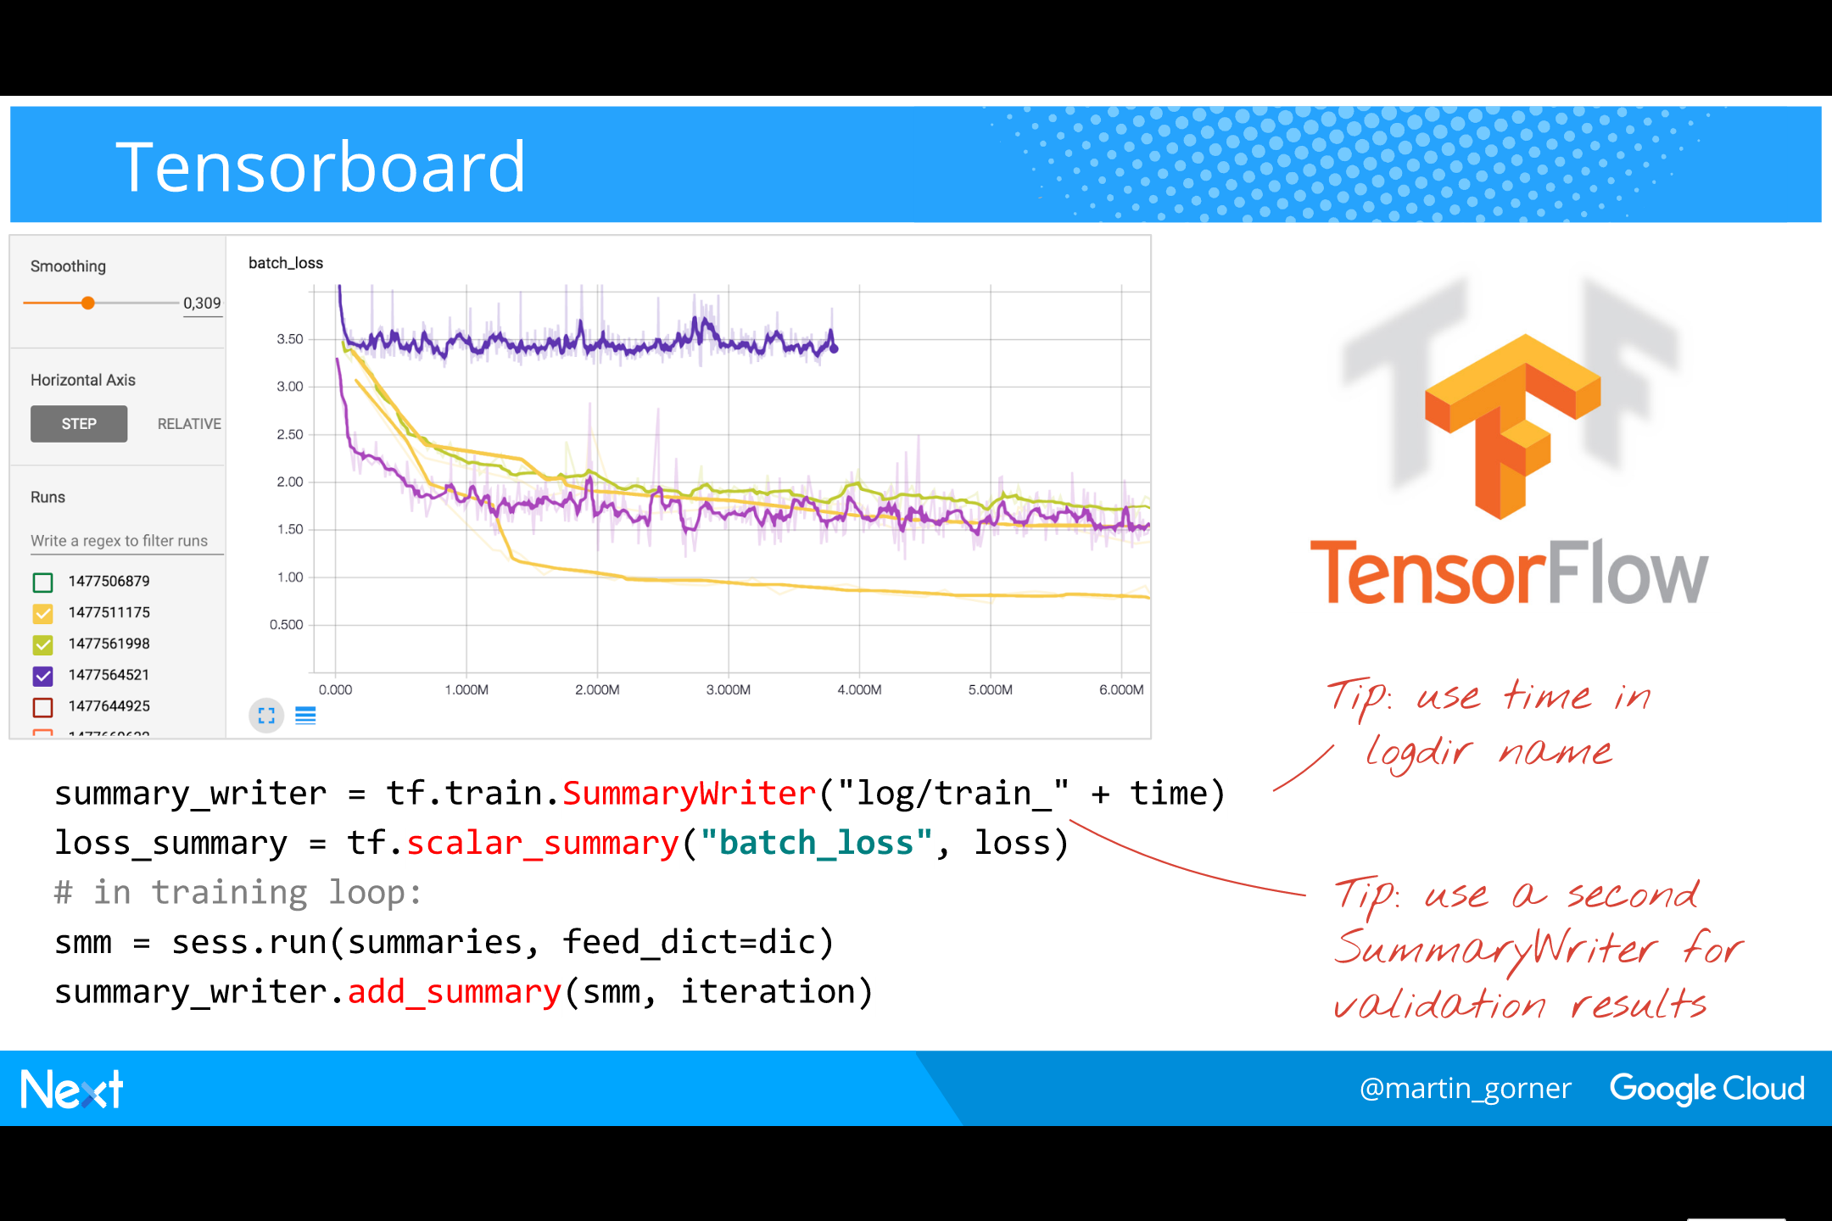
Notes:
A great tool for following your training curves in Tensorboard.
It has been designed to work well in typical distributed settings (such as Google Cloud ML) where training is performed on a cluster of remote servers.

Slide 55
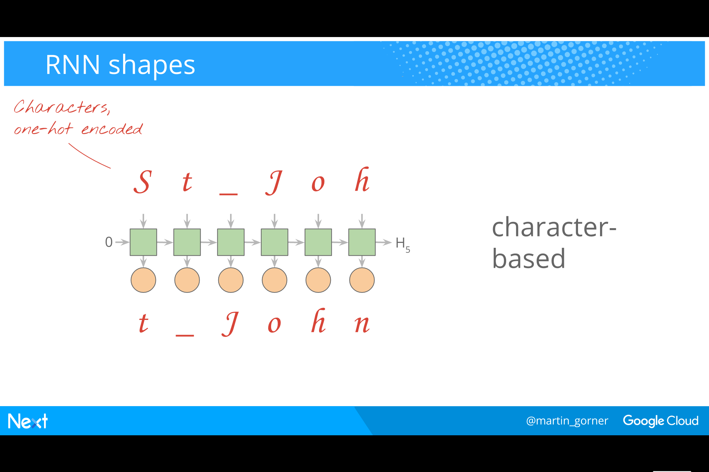
Notes:
There are several typical RNNs
​
Here we have seen a character based language model where the input is a sequence of characters. It is trained to predict the next character in the sequence.

Slide 56
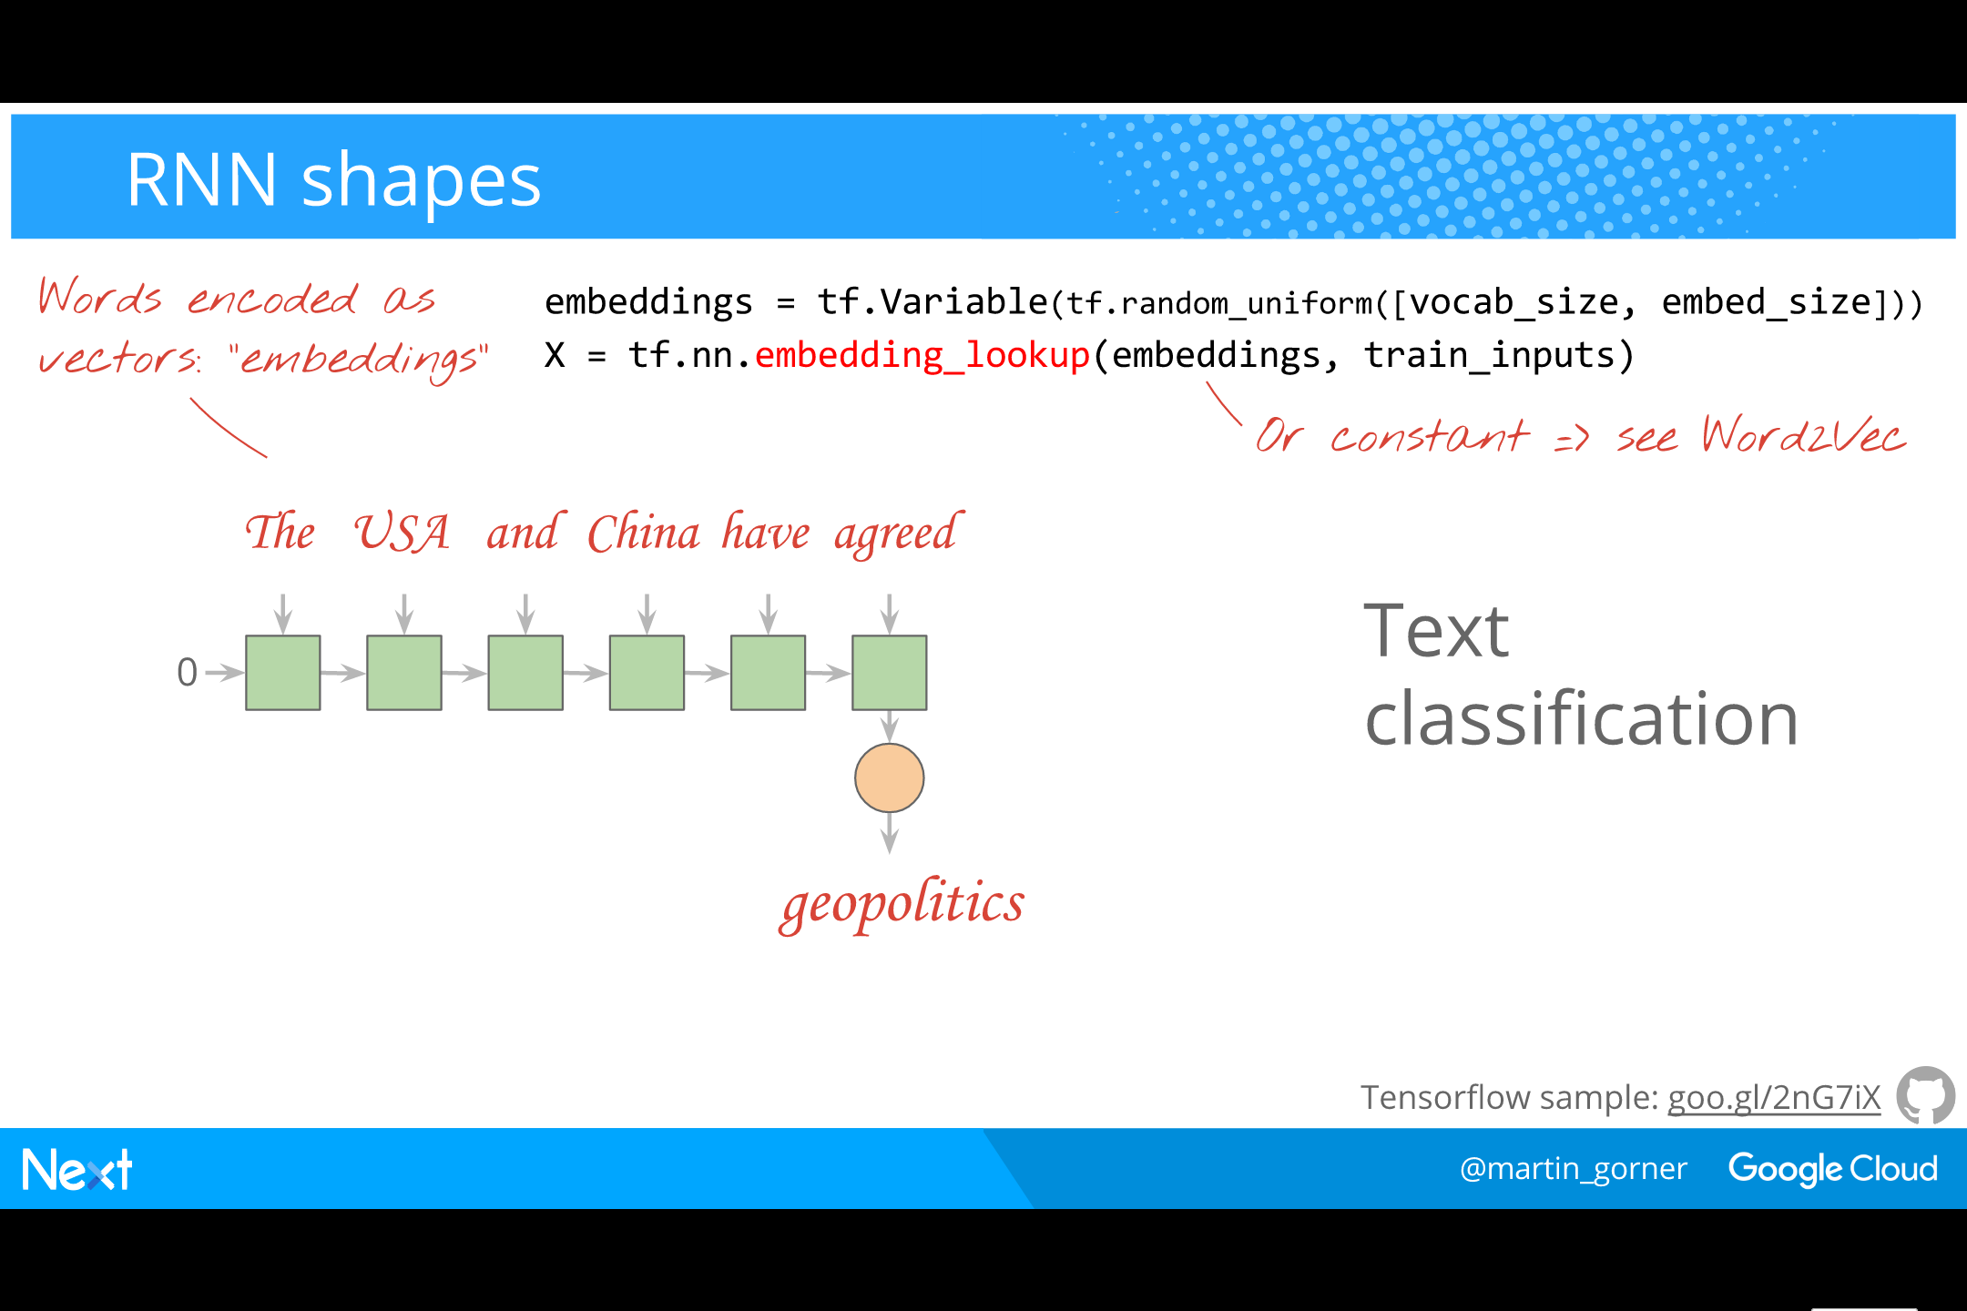
Notes:
RNNs can also be used at the word level for example for classifying articles into newspaper categories such as “sports”, “business”, “technology,” …
​
One-hot encoding words is very expensive though. With a vocabulary of 30,000 words (typical English) you need a 30,000 component vector to represent each word!
Therefore, the first step in a word-based RNN is always a dimension reduction called an “embedding”. A neural network layer is used to produce a smaller vector representation of words.
​
Tensorflow has a helper function for retrieving the short representation based on the index of the word in the vocabulary: tf.nn.embedding_lookup
​
The weights and biases of the embedding layer can either be trained alongside the rest of the neural network or you can use a pretrained embedding.
For example, for any problem with English text, it is very common to use pre-trained embeddings that have been trained on the English language, independently of the problem at hand.
Word2Vec is the most popular algorithm for pre-computing word embeddings.
​
Embeddings aside, a word-based text classifier is a normal RNN that takes a sequence of words as its input and produces a category as an output.

Slide 57
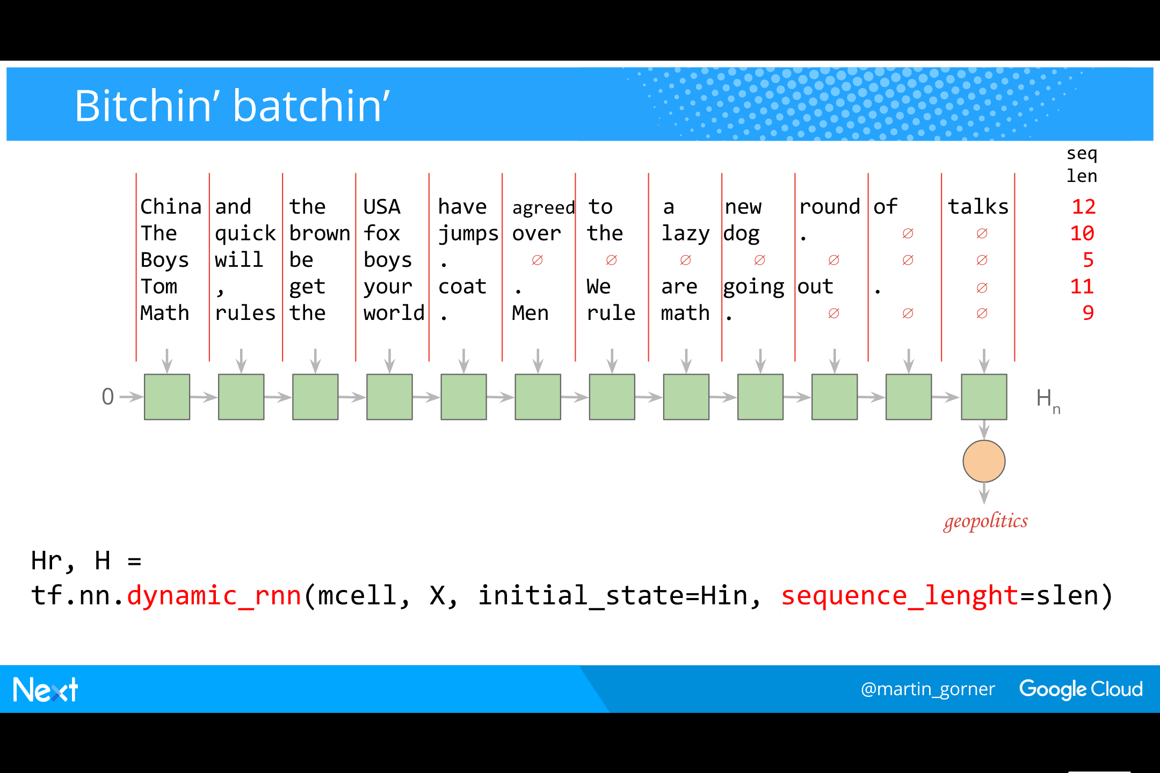
Notes:
With a text classifier, the dynamic_rnn feature of Tensorflow is really handy.
​
The sequences you want to classify do not have the same size but you still want to process them in batches.
Normally, you would have to pad shorter sequences with a zero characters to be able to process them in a batch.
With dynamic_rnn, no padding is not necessary. Simply pass along a vector containing the lengths of the sequences in the mini-batch.
Tensorflow will unroll the RNN as needed for each sequence.
It will also produce the correct output state for each sequence in the batch.

Slide 58

Notes:
RNNs are also used for text translation.
​
We use 2 unrolled RNN sequences back to back for translation.
For English to French translation for example:
The first sequence receives the the English sentence as a sequence of vectors representing words (again, using fixed or trained embeddings).
It is terminated with a special ∅ character.
​
The second sequence stars with the output state computed by the first one.
Its expected output is the translated sequence of words in French.
It would be logical to use the the translated words, as they are being produced, as inputs for the cells of the second sequence.
It is a common trick however to force the expected translation on the inputs instead.
​
A problem that does not have an easy standard solution is the softmax layer. Here, we have to compute word probabilities over the entire 30,000 word French vocabulary.
So we need a softmax layer that outputs vectors of 30,000 elements. From vectors typically in the 500-element range. That’s 15M weights to predict one word. Ouch!
Many techniques have been devised to do this in the least expensive way possible. They all compute an approximation of the output probabilities, with a trade-off between computation time and precision.
A great recap of all these techniques can be found in this blog post: http://sebastianruder.com/word-embeddings-softmax/index.html
​
Tensorflow implements a couple of these techniques, for example tf.nn.sampled_softmax_loss
​
For math geeks only:
We will not dive here into the technical explanation of the sampled softmax loss. If you want to look into this yourself, start by writing the loss as the distance (cross-entropy) between the expected one-hot encoded outputs words and the word probabilities predicted by the softmax layer. Then derive this formula and try to see how to compute an approximate gradient that would be “good enough” but faster to compute.

Slide 59

Notes:
We can also use an RNN vector to caption images!
The goal is to compute a sequence of words that describe what is in an image for example “A young girl holding a teddy bear”. Just from the pixels of the image.
RNNs a great for generating sequences.
​
This time, a vector representation of the image is used as an additional input to the RNN cells. It’s simply concatenated to the normal input vector that represents a word.
The expected output used for training is a sentence describing the image written by a human.
​
As in the translation case, a common trick is to use, during training, the correct caption as inputs instead of using the previously predicted word as would be “normal” in an RNN.
​
As for words, there are many ways of representing an image as a vector. You can use a dense or a convolutional network. This network can be part of the training or pre-trained and used as a fixed encoding function.
​
A neat way to pre-train a network to encode images is to use an auto-encoder (Google it!).

Slide 60

Notes:
Surprisingly good results from Google’s image captioning model. Check it out, it’s open source.

Slide 61

Notes:
And a couple of total FAILs

Slide 62

Notes:
Cloud Machine Learning allows you to run your Tensorflow code on Google’s infrastructure and do both distributing training and serving predictions from your trained model.

Slide 63

Notes:
The simplest way of training a neural network on multiple machines is called “asynchronous” training. The model is replicated on many workers while the variables (weights and biases) are centralised on one (or a few) parameter servers. Then training proceeds on the workers. As soon as a worker has computed a gradient, it is sent to the parameter server(s) and used to update the weights and biases. How can it be right to apply deltas to weights and biases that might already have been modified by another gradient computed by a faster worker ? Actually, it’s not right. Its wrong. But as long as the workers are not desynchronised too much, it simply adds some noise to the training and noise usually does not negatively impact neural network training. It can even help.
​
Synchronous training is also possible.
​
The nice thing about the implementation of CloudML is that it was done entirely in Tensorflow, which means that you can also use your own distribution strategies. Tensorflow has a mechanism for pinning operations and variables to specific machines and the “asynchronous training” implementation in CloudML simply uses that to replicate the computation graph and assign each copy to a worker, and to pin all variables to the parameter server.

Slide 64

Notes:
To use cloudML, first build a model using the Estimator class from tf.learn

Slide 65

Notes:
Then create and Experiment class that bundles the Estimator with data loading functions.
When training large models, keeping the workers fed with well shuffled training examples can be a challenge but Tensorflow has a collection of queueing functions designed specifically for this task. They insert data queue nodes directly into the computations graph which, when executed, pull in data. That is what you use to implement the input_fn functions.
​
Finally, use the learn_runner.run() function to start the training and make that the entry point of this Python module.

Slide 66

Notes:
Here is a dummy train_data_input_fn function that simply shuffles data from a constant dataset entirely loaded in memory. This works when the dataset is small.
For evaluation, is it more common to have evaluation data that fit in memory and no batch shuffling is necessary so you can simply return a tf.constant.

Slide 67

Notes:
Here is a dummy train_data_input_fn function that simply shuffles data from a constant dataset entirely loaded in memory. This works when the dataset is small.
For evaluation, is it more common to have evaluation data that fit in memory and no batch shuffling is necessary so you can simply return a tf.constant.

Slide 68

Notes:
Finally, you package your training code in a directory and add a config.yaml file alongside this directory. The config file allows you to specify the number of workers. STANDARD_1 is a shortcut for one parameter server and a small number of workers. By the way, this directory structure is the standard way of packaging Python modules.
​
The training is started from the command line. It will output checkpoints (computation graph + all variables) at regular intervals into the specified storage bucket, as well as Tensorboard summaries that allow you to follow the training remotely. The checkpoint interval is 10 min by default but you can change that.
​
When the training is done, you can point CloudML to one of the checkpoints to create a prediction service.

Slide 69

Notes:
One of the easiest and fastest ways to train a neural network for a visual recognition task specific to your business is call transfer training.
You start with a large, very deep neural network trained by someone else, on millions of tagged images, for a generic visual recognition task. Google’s Inception network for example.
Then you chop off the last 2-3 layers from this network use the rest as a fixed encoding function for your images and train a couple of your own layers, using your own images.
Since you are training far fewer weights and biases than the entire network (often by an order of magnitude), you need significantly less training images and labels (also by an order of magnitude).
​
Japanese used cars dealer Aucnet did just that. When adding a car for sale in their database, dealerships can now simply take pictures of the car, upload them, and the neural network identifies the make and model of the car, and classifies the images in interior/exterior, front/rear shots and so on.

Slide 70

Notes:
Your turn to play. Nothing I have shown here exceeds 100 lines of Python/Tensorflow code.
To run faster, you can run it on Cloud ML,
or use any of our pre-trained APIs.

